Slide 1
Client-Centered Contraceptive Counseling
A presentation of the
Buffalo, NY
Wednesday, June 28, 2017
NYS Center of Excellence for Family Planning and Reproductive Health Services
A Project of Cicatelli Associates, Inc. (CAI)

Slide 2
Welcome & Introductions
Michelle Gerka
Senior Trainer/Vice President, CAI
Gricel Arredondo
Director, Center for Evidence Based Interventions, CAI

Slide 3
Welcome & Introductions
Name
Role
Practice Site
Expectation for the training today

Slide 4
Goal & Objectives
Goal: To enhance participants’ capacity to provide effective contraceptive counseling to clients
As a result of this training, participants will be able to:
Demonstrate how to use the 5-Step Contraceptive Counseling Model to conduct a contraceptive counseling session
Apply key communication skills to facilitate a client-centered contraceptive counseling session
Describe how to use the Birth Control Options Grid during contraceptive counseling sessions

Slide 5
Day at a Glance
Welcome
What Does Success Look Like?
Sexual and Reproductive Justice Framework
Core Communication Skills
Overview: Client-Centered Approach, Shared Decision-Making and the 5-Step Model
Step 1: Identify Pregnancy Intention
Step 2: Explore - Learn More
Step 3: Assist - Birth Control Options Grid
Step 4. Review & Step 5. Provide
Putting It All Together
Closing and Evaluations

Slide 6
Warm-Up
What makes contraceptive counseling rewarding?
What makes contraceptive counseling challenging?

Slide 7
What does success look like?

Slide 8
Defining Success
Success isn’t…
Success is…
Ensuring
knowledge,
opportunity,
and a positive experience
Number and type
of contraception

Slide 9
Defining Success
Clients are provided with accurate and unbiased counseling and information
People that choose to contracept, have the opportunity to receive their method of choice that same day by a trained healthcare provider

Slide 10
Sexual and Reproductive Justice Framework
10

Slide 11
Sexual and Reproductive Justice Framework
What does sexual and reproductive justice mean to you?

Slide 12
Sexual and Reproductive Justice Framework
Term “reproductive justice” defined in 1994 by African-American women who felt the experiences of women of color were not acknowledged within the women’s and reproductive rights movements
Rooted in human rights framework and honors reproductive autonomy
Informed by current and historical instances of reproductive injustices

Slide 13
Sexual and Reproductive Justice Framework
Examples of bias, reproductive coercion and injustice:
Eugenics laws and federally-funded sterilization programs in 32 states throughout 1900s that targeted low-income, disabled, and mentally ill populations and communities of color
Mexican-American women in Los Angeles unknowingly sterilized while giving birth in 1960s-1970s
Low-income women required to use Norplant to continue to receive government assistance or avoid jail time
Current research supporting that providers disproportionately counsel women of color on contraception generally and especially LARCs

Slide 14
Sexual and Reproductive Justice Framework
NYC Department of Health and Mental Hygiene has created a Sexual and Reproductive Justice initiative to guide its work
Video created by the NYC DOHMH’s Community Engagement Group:
https://www1.nyc.gov/site/doh/health/health-topics/sexual-reproductive-justice-nyc.page

Slide 15
Sexual and Reproductive Justice Framework
Framework urges us to think about how our identities impact our ability to make reproductive choices and our experiences accessing health care
Examples:
Discrimination by a medical provider based on race/ethnicity
Not having financial means to afford contraception
Reproductive choices being questioned based on age or other identities
Providers assuming heterosexuality
Not having medical staff or education materials that reflect your native language

Slide 16
Sexual and Reproductive Justice Framework
What would this mean for the communities you work in?

Slide 17
Core Communication Skills

Slide 18
Core Communication Skills

Slide 19
Open-Ended Questions
Cannot be answered by a yes or no response
“What are your thoughts about having a baby right now?”
“What are your thoughts about birth control?”
Tell me more…

Slide 20
Affirmation
Statement of appreciation and understanding to acknowledge and validate client’s strengths, efforts and experiences, not their specific decisions
“It’s very thoughtful of you to try to find what works for you.”
“It’s great that you are doing research about different methods.”

Slide 21
Reflection
Repeat back to the speaker the key message you received paying close attention to both verbal and non-verbal communication
“Sounds like your partner is concerned about how birth control might affect your health.”
“Sounds like you are not sure if now is the right time to have a baby.”

Slide 22
Summary
It sounds like you didn’t like the pill because it made you feel nauseous and you forgot sometimes, and you like the idea of a method like the IUD or Implant that you don’t have to think about taking everyday.
Repeating back to the client key pieces of the conversation
Be strategic:
Link material together
Summarize what you want the client to focus on and remember

Slide 23
Core Communication Skills
These skills foster a client-centered and shared decision making environment
Together these communication skills support the client in:
Clarifying their pregnancy goals
Exploring their past experiences with birth control
Identifying what’s important to them in a birth control method
Selecting a birth control method that is right for them, should they decide to contracept

Slide 24
Overview: client-centered approach, Shared Decision Making and the 5-step counseling Model

Slide 25
Client-Centered Counseling
A client-centered approach personalizes the discussion between counselor and client to meet their individual needs.
Approaching care in this way improves client outcomes.

Slide 26
Shared Decision Making
Brings together the expertise of the client regarding their own values and preferences and the expertise of the provider regarding medical information
Client and provider work together to come to a mutually acceptable decision guided by the client’s needs

Slide 27
Client Centered Care & Shared Decision Making
This approach improves health outcomes by increasing:
Knowledge about contraceptive options
Contraceptive use
Correct use of contraception
Use of more effective methods
Use of dual-method contraceptives to prevent STIs and pregnancy
Quality of and satisfaction with services

Slide 28
Structured Contraceptive Counseling

Slide 29
5-Step Contraceptive Counseling Model

Slide 30
Step 1. Identify Pregnancy intention

Slide 31
Step 1. Identify Pregnancy Intention
Do you want to be pregnant in the next 3 months or have a baby in the next year?

Slide 32
Step 1. Identify Pregnancy Intention
“Do you want to be pregnant in the next three months or have a baby in the next year?”
Yes
Not Sure
No

Slide 33
Step 1. Identify Pregnancy Intention
Yes
Not Sure
No
Yes. My boyfriend and I have been actively trying.
I’m not sure. I never really thought about it...I think a baby would make things hard, but I always wanted to be a mom.
No. I really don't want to get pregnant now. I have way too much going on in my life...

Slide 34
Step 1. Identify Pregnancy Intention
Yes
Not Sure
No
Preconception Care
Contraceptive Counseling
Notes:
If a client is clear about their desire to become pregnant in the next three months or have a baby in the next year, we will want to make sure that she has access to preconception services that will assist them in having a healthy pregnancy.
If the client is unsure or clear about their desire to prevent a pregnancy in the coming months, we will want to spend some time to explore their thoughts and feelings about pregnancy and contraception and provide then with the information she needs to decide whether or not to contracept.

Slide 35
Preconception Care
According to the CDC, ‘Preconception health refers to the health of women and men during their reproductive years, which are the years they can have a child.’
Regardless of pregnancy intention, it is important that clients are aware of how they can get healthy and stay healthy

Slide 36
Preconception Care
For women that are interested in becoming pregnant, it is essential that they are empowered to get healthy
Areas to address with clients, no matter their pregnancy intention are:
Referral Process
Healthy Birth Spacing
Physical Activity
Healthy Weight and Diet
Management of Chronic Diseases
Smoking, Alcohol and Drug Use
Notes:
https://www.cdc.gov/preconception/overview.html

Slide 37
Step 1. Identify Pregnancy Intention
Yes
Not Sure
No
Preconception Care
Contraceptive Counseling
Notes:
If a client is clear about their desire to become pregnant in the next three months or have a baby in the next year, we will want to make sure that she has access to preconception services that will assist them in having a healthy pregnancy.
If the client is unsure or clear about their desire to prevent a pregnancy in the coming months, we will want to spend some time to explore their thoughts and feelings about pregnancy and contraception and provide them with the information she needs to decide whether or not to contracept.

Slide 38
Step 2. Explore

Slide 39
Step 2. Explore
Deepens the patient’s understanding of how pregnancy and birth control does or does not fit into their life.
It’s the client’s own thoughts and feelings that will trigger them to action—not yours.

Slide 40
Step 2. Explore: Learn More
There are four key areas to explore:
Pregnancy intention – why they do or do not want to be pregnant
Past experiences with birth control
Feelings and beliefs of individuals that may influence contraceptive choice
Birth control preferences

Slide 41
Step 2. Explore: Learn More
Explore Questions
What would be hard about having a baby now?
What would be easy about having a baby now?
What makes now a good time for you to have a baby?
What experience have you had with birth control?
What is important to you in a birth control method?
What does your mom/boyfriend/partner/friend think about you using birth control?

Slide 42
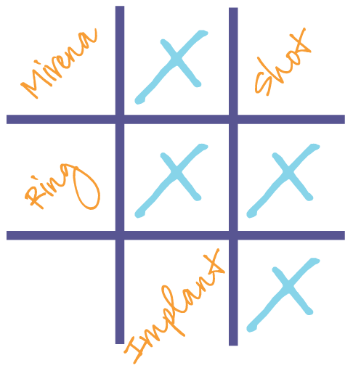
Step 3. Assist Birth control Options grid

Slide 43
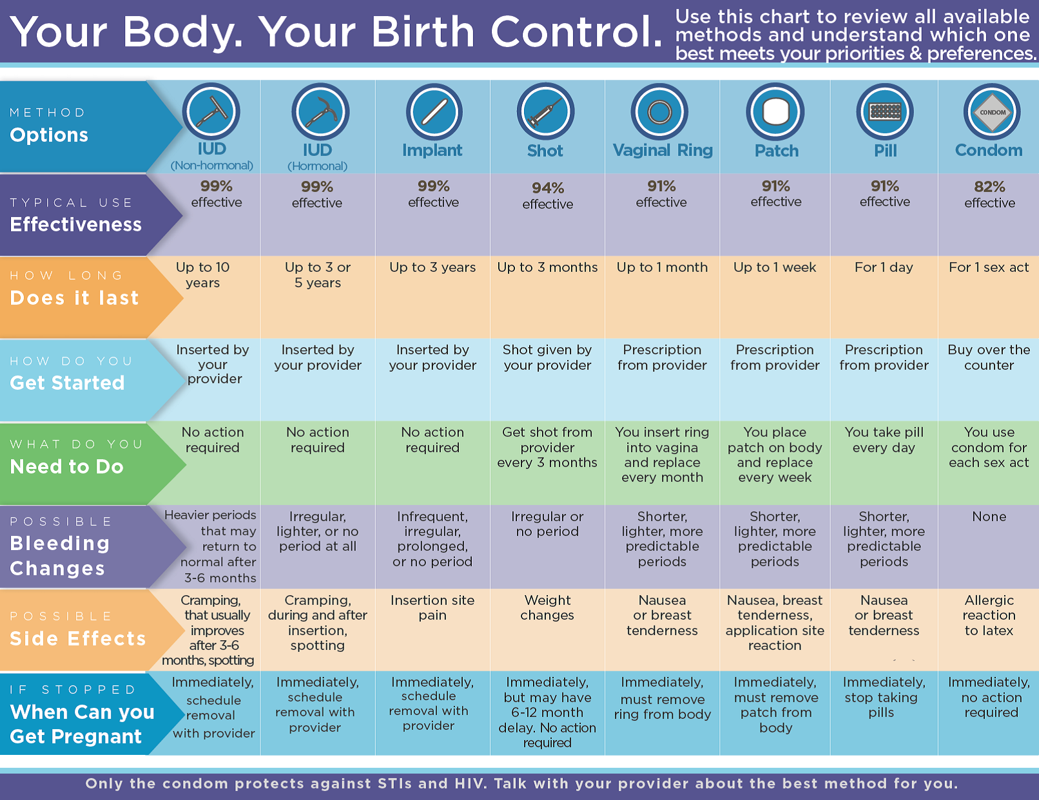

Slide 44
Step 3. Assist: Birth Control Options Grid
IUD ♦ Implant ♦ Shot ♦ Vaginal Ring ♦ Patch ♦ Pill ♦ Condom
Across the top of the grid is the range of effective contraceptive methods.

Slide 45
Step 3. Assist: Birth Control Options Grid
Down the side of the grid are key considerations that influence a person’s contraceptive choice.
Effectiveness
Does it Last
Get Started
Need to Do
Bleeding Changes
Side Effects
When can you get pregnant

Slide 47
Step 3. Assist: Birth Control Options Grid
Introduce the Birth Control Options Grid
Orient client to the Grid
Ask the client where they would like to start

Slide 48
Step 3. Assist: Birth Control Options Grid
Information gathered during Step 2: Explore guides how to introduce and use the Birth Control Options Grid in Step 3: Assist.
Example: Client shares that she is interested in a method that will lighten her period and reduce cramping.
How would you introduce the Birth Control Options Grid to this client?

Slide 49
Step 3. Assist: Birth Control Options Grid
Example: Introduction Statement
“Earlier you mentioned that you might prefer a method that lightens your periods and reduces cramping. One of the key preferences along the side of the grid is bleeding changes. Would you like to start there?”

Slide 50
Step 3. Assist
Offer accurate and unbiased information about all of the contraceptive options
Walk the client through the contraceptive methods, guided by their identified preferences, current needs and wants

Slide 51
Step 4 : review method and understanding Step 5: provide Method same day

Slide 52
Step 4. Review
Review and summarize the conversation
Pregnancy intentions and goals
Thoughts on using birth control
Chosen method
Use teach back to review side effects, instructions for use, and maintenance of the method
Develop a follow-up plan

Slide 53
Step 5. Provide
Provide method that same day
Remove requirements for unnecessary tests
Provide a bridge method if necessary
Review what will happen next
Provide contact information if any questions or concerns arise after leaving the health center
Offer and provide EC if requested
Offer condoms to promote protection from STIs and HIV

Slide 54
It’s Your Turn!
Putting It All Together

Slide 55
Questions?

Slide 56
Thank you!
Michelle Gerka, CAI:
Michelle@CAIGlobal.org
Gricel Arredondo, CAI:
GArredondo@CAIGlobal.org

