Slide 1
Impacting Policy at the Community Level
2019 Provider Meeting
May 23rd

Slide 2
WELCOME

Slide 3
Public Health: What have we learned?
Different types of public health interventions have different outcomes
Public health pyramid shows impact of different public health interventions

Slide 4
Framework to Improve Health:
5 Tier Model
At the base of this pyramid show interventions with the greatest impact are efforts to address socio-economic determinants of health

Slide 5
5 Tier Model
health education counseling
ongoing direct clinical care
clinical interventions that require limited contact but confer long-term protection,
interventions that change the context to make individuals’ default decisions healthy
Highest Impact
Lowest Impact

Slide 6
What works?
Interventions focusing on lower levels of the pyramid are more effective
Reach broader segments of society
Require less individual effort

Slide 7
The Health Impact Pyramid

Slide 8
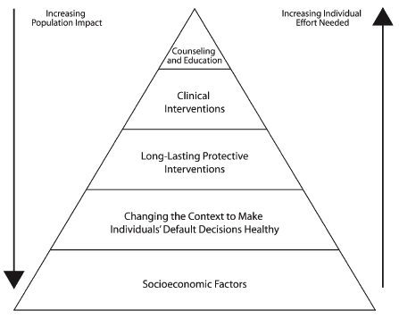

Slide 9
Socioeconomic Factors
Reduced poverty to improve immunity, decreased crowding and environmental exposure to communicable microbes, and improved nutrition, sanitation, and housing
Reduced poverty, increased education levels, and more nutritional options to reduce cardiovascular disease, some cancers, and diabetes
Reduced poverty levels to reduce drug use and violence, improved housing options, and lowered vulnerability to extreme weather conditions

Slide 10
Changing the Context
Fluoridation of water to prevent dental cavities
Increased unit price for tobacco, alcohol, and sugar-sweetened beverages
Smoke-free workplaces
Road and vehicle design requirements to reduce crashes and protect pedestrians and bicyclists
Laws prohibiting driving at even low blood alcohol levels
Effectively implementing laws to mandate helmet use by motorcyclists and motorcycle passengers

Slide 11
Long-Lasting Protective Environments
Immunizations
Male circumcision in countries with high HIV prevalence and significant female-to-male transmission
Mass antibiotics to prevent or treat tropical diseases
Treatment of tobacco addiction
Brief behavioral counseling to reduce alcohol consumption
Home modifications, such as installation of grab bars and handrails to prevent falls

Slide 12
Clinical Interventions
HIV treatment to decrease viral load
Treatment of hypertension and hyperlipidemia
Aspirin therapy for people with coronary heart disease
Methadone and buprenorphine treatment to decrease opiate overdose
Screening and treatment of women older than 65 years for osteoporosis to reduce fractures

Slide 13
Counseling and Education
Dietary counseling
Counseling to Increase level of physical activity
Counseling and public education to avoid drinking and driving and encourage compliance with traffic laws
School-based programs to prevent or reduce violent behavior

Slide 14
Education Alone Will Not Change Behavior

Slide 15
Why Policy?

Slide 16
Traditional Health Interventions
  Focus on individual behavior change
  Increases awareness via info & education
  Supports internal motivation
  With knowledge, person will change behavior
Notes:
16

Slide 17
Population-Based Interventions
  Focus on impacting whole populations
  In tobacco prevention, primary strategy is policy change
    Laws, ordinances, etc.
Notes:
17

Slide 18
Population-Based Interventions
Includes:
  Policy – i.e., Smoke-free workplaces
  Systems – i.e., integrate tobacco screening into every doctor visit
  Environmental Changes – i.e., Tobacco Free campus, bike paths

Slide 19
Population-Based Interventions
Lead to social norm change
  Social Norms: A set of beliefs, values, or behaviors generally held by people in a culture or sub-culture

Slide 20

Policy Change leads to…
Private Policy
Public Policy
Public Practice
Public Opinion
Social Norm Change

Slide 21
Examples of Policy Changes
Worksite policies that establish healthy food guidelines for meetings
School Policy around healthy snacks in vending machines
Traffic safety laws such as speed limits, limits on the use of cell phones while driving, and seat belt and helmet requirements
Local ordinances that restrict fast food outlets near schools

Slide 22
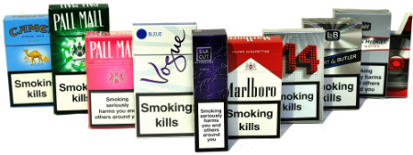
The cigarette companies said they would pay for any educational program as long as we stopped our policy work… That’s when I realized we were taking the right approach.
-Larry Cohen, Prevention Institute

Slide 23
Environmental Change
Making changes in the environment where we live, work, and play is another population-based strategy that affects an individual’s tendency to engage in healthy behaviors.
  Environmental changes effect the “built environment,” i.e., the physical structures, resources, transportation systems, and infrastructure in our community.
The focus in on changing the economic, social, and physical environment that will foster healthy lifestyles

Slide 24
Examples of environmental change
Incorporating walking paths, green space and recreation areas into a new housing development
Establishing partnerships to allow and promote the use of recreational facilities in schools by community members during non-school hours

Slide 25
Mobilizing area growers for a community farmers’ market, increasing access to fresh fruits and vegetables
Developing, improving and promoting the use of parks and recreation areas.

Slide 26

Individual Change
Notes:
26

Slide 27
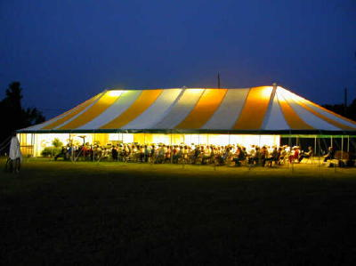
Policy Change = Population Change
Notes:
27

Slide 28

What Does This Look Like on an Organizational Level?

Slide 29
Sample Tobacco Policy
Healthcare Setting
All patients screened for tobacco use
Referral policy for patients to tobacco cessation programs
Offering general support/resources for nicotine addiction
No smoking on building property

Slide 30
Sample Wellness Policy
School District
Physical education requirements for schools
Providing healthy snacks at all school related events
Students and staff receive nutrition programming

Slide 31
POPULATION
BASED
POKER

Slide 32
You run the school cafeteria. You are concerned about the rate of childhood obesity in your school and want to do something to make an impact. Which of these things would have the biggest impact?

Slide 33
Talk to the students as they come into the cafeteria about food choices
Put up a sign about five fruits and vegetables a day
Have the student government vote on a rule to remove all snack machines from the school property
Write a letter to McDonald’s requesting that they make healthier food choices available.

Slide 34
You are a parent in your community who works part-time as an emergency medical technician (EMT). You see too many head injuries from bike falls and want to get everyone to wear bike helmets. What actions will have the most impact?

Slide 35
Send a brochure to all residents of the community encouraging helmet use.
Organize to pass a mandatory helmet law for cyclists in your community
Teach bike and helmet safety in school health classes
Give away free helmets as part of a bicycle clinic

Slide 36
You are a doctor at the local health center. You are concerned about the number of children with asthma that you see each week. Most of the children with asthma live in homes where adults smoke. What strategy is the most effective?

Slide 37
Put posters and brochures in the waiting area about second hand smoke
Do educational presentations at day care center for parents.
Create a local website about tobacco and second hand smoke
Work with your local government to pass ordinances regarding smoke free apartments and cars.

Slide 38
You own a local insurance company. You are worried about the number of car accidents involving teenagers. The number of serious accidents and deaths in your community increased by 20% in the last year. What strategy would be most effective?

Slide 39
Pass a local ordinance that limits the number of passengers with a 16-19 year old driver.
Provide more opportunities for driver’s education in the high school.
Do an “ad” campaign about safe driving
Develop a brochure that could be sent to each of your customers who have teen drivers on their policy.

Slide 40
You are a high school gym teacher who is concerned about the number of overweight young people in your classes. It seems to be getting worse every year and you are worried about their health and well being. What strategy might be most effective?

Slide 41
Provide training for the faculty on good nutrition and obesity
Develop a strategy with the local school board to increase the number of hours of mandatory physical education
Have each student weigh in weekly
Ask the cafeteria to post information about calories for each lunch item served

Slide 42
You are a nurse in your community. There has been increasing numbers of the flu among pre-school age children. This is a life threatening disease. There is an effective vaccine but many families do not access this. What is the most effective strategy?

Slide 43
Make flu shots mandatory for any child attending day care, pre-school or any other group early childhood program.
Do a story on the local news about the increased incidents of influenza.
Send a brochure about the dangers of the flu to each family registered with your office.
Provide additional trainings for early childhood staff on hand washing.

Slide 44
You are the head of customer service for a large grocery store chain. You are astounded by the number of plastic bags used each month by customers. You want to “propose” green solutions to your Board of Directors. What strategy might be most effective?

Slide 45
Ask customers to bring in their own bags.
Sell reusable bags at an inexpensive cost to customers.
Charge 15 cents for each plastic bag used for groceries
Develop a creative public education campaign

Slide 46
You are the principal of an elementary school and you are concerned about the amount of cookies, candies and other sweets that are a part of the regular day to day school environment. You think it sends an unhealthy message to everyone. What strategy might you use?

Slide 47
Ask the PTA to adopt a policy to not sell sweets as part of any fund raiser.
Develop a written policy that food is not to be utilized for rewards with students.
Develop written guidelines for food choices for holidays and celebrations.
Provide faculty with enhanced training on childhood obesity.

Slide 48
You are the HR Director of a large non-profit organization. You are concerned about the health and well being of your employees and the rising health insurance costs. You need healthy employees. What strategy might be most effective?

Slide 49
Work with your insurance company to include a gym membership as part of your routine coverage.
Promote a walking club for staff during lunch time
Develop guidelines for healthy meeting food options that the organization will use
Pay for an worksite Weight Watchers group

Slide 50
You are the Director of Physical Education for a local school district. It seems your students are more and more sedentary each year. You’re not sure what to do. What strategy might be the most effective?

Slide 51
Work with your local community to create bike paths for the two miles surrounding the school
Develop a “ride your bike to school” campaign in your community
Work with local merchants to donate bicycles to your school.
Develop a policy that provides incentives (i.e. prizes, extra credits, movie tickets) for students who ride their bike to school at least ten days per month.

Slide 52
You live in a community where recycling is optional. The town you live in has not addressed the issue in some time and you are more and more concerned. What strategy could you use?

Slide 53
Go door to door to educate your neighbors on the environmental impact.
Work with the recycling plant to do more consumer education
Try to get local news coverage on the issue
Create a small working group to approach the local government about new mandatory rules.

Slide 54
Closing

