Slide 1
Fostering an Organizational Culture that Acknowledges and Mitigates Bias
Molly Findley, DO, MPH, MS
Medical Director, Title X Family Planning Clinic, Jacobi Hospital

Slide 2
Disclosures/Acknowledgements
Disclosures
Acknowledgements
None
Dr. Cristina Gonzalez

Slide 3
Learning Objectives
To understand what implicit biases are
To learn how implicit bias impacts the health care field
To understand organizational strategies to try to mitigate these biases
Notes:
we will explore implicit biases through a public health and social determinants of health lens. We will discuss what are unconscious biases and explore the research that shows how unconscious bias has resulted in less-than-optimal reproductive health outcomes and reproductive coercion. Strategies to mitigate bias at an organization level will be discussed, including how to foster an environment that acknowledges biases and responds positively.

Slide 4
Some Things to Keep in Mind
Everyone has implicit biases
Sometimes thinking about and talking about implicit bias makes us feel uncomfortable
THIS IS NORMAL
Notes:
Before we begin, there are a couple of things that I ask that you keep in mind. The first thing is that everyone has implicit biases. No one is immune to it. Secondly, sometimes thinking about and talking about our implicit biases makes us feel uncomfortable. This is a normal reaction, especially if this is your first introduction to this concept.

Slide 5
The Gardener’s Tale
Institutionalized racism
Personally mediated racism
Internalized racism
Jones, CP. Levels of racism: a theoretic framework. Am J Public Health. 2000 Aug;90(8):1212-5.
Notes:
Why we need to care about biases and mitigating them
Dr. Camara Jones developed this theoretic framework in 2000 as a way of understanding and explaining racism on multiple levels
Internalized racism can be implicit or explicit – the following example with show how different types of racism lead to differing outcomes
Ref: Jones, CP. Levels of racism: a theoretic framework. Am J Public Health. 2000 Aug;90(8):1212-5.

Slide 6
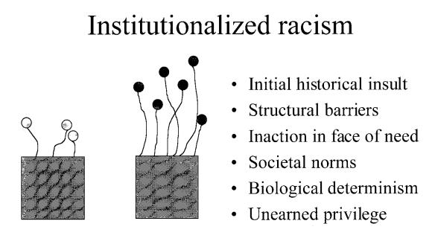
Jones, CP. Levels of racism: a theoretic framework. Am J Public Health. 2000 Aug;90(8):1212-5.
Notes:
One flower box has rich soil and one flower box has poor soil. The gardener has two packets of seeds – red and pink. The gardener prefers red flowers, so she plants the red flowers in the box with the nice rich soil and the pink flowers in the box with the poor soil.
Not as many pink flowers grow and those that do aren’t nearly as tall or as healthy.
The assumption is that red flowers are better than pink, and no one looks at the soil, that is, the structural barriers. There is no difference in the pink and red flower seeds, the difference lies in how they are perceived.
Jones’ definition of institutionalized racism: “differential access to goods, services, and opportunities of society by race.” it is “an inherited disadvantage.”
Red flowers have access to better soil and sun
Structural – integrated into cultural practices or customs, or even into law (Jim Crow)
It IS inaction in the face of need – we see that different communities have differing levels of access to goods/services/healthcare but do nothing about it
In fact, it feels normal and expected. We see that the pink flowers are not doing as well but do nothing about it.
Examples: differential access to housing (unable to get home loans, live in poorly maintained housing), education (schools are underfunded, cannot afford college), health care, voting rights

Slide 7
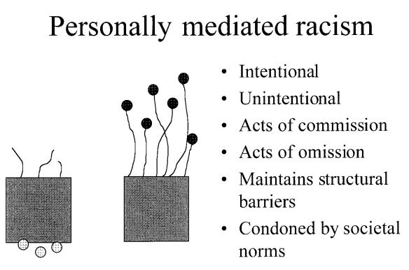
Jones, CP. Levels of racism: a theoretic framework. Am J Public Health. 2000 Aug;90(8):1212-5.
Notes:
Gardener removes pink flowers before they go to seed bc they don’t want them to keep growing
Personally mediated racism is “prejudice and discrimination”
Prejudice – “differential assumptions about abilities, motives, and intentions of others according to their race”
Discrimination – “differential actions towards others according to their race” – what we traditionally think of as racism
Can be intentional or unintentional
Unintentional = implicit
Intentional = explicit – example: forced sterilization
Example: lack of respect, poor customer service
Example: devaluation – surprise at competence

Slide 8
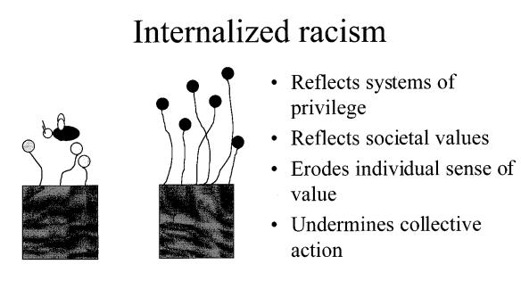
Jones, CP. Levels of racism: a theoretic framework. Am J Public Health. 2000 Aug;90(8):1212-5.
Notes:
Pink flowers want to be pollenated by red pollen bc they see how much better the red flowers are growing and want to be like them
Internalized racism “acceptance by members of the stigmatized races of negative messages about their own abilities and intrinsic worh.”
“not believing in others who look like them, not believing in themselves”
Dr jones example: wanting to use the white doctor over the black doctor bc they are “better”
Accepting the limits that society has placed on us

Slide 9
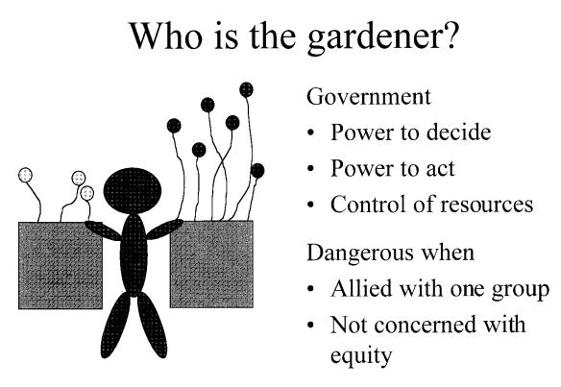
Notes:
How to we fix these problems?
“pink is beautiful” – combat internalized racism
Conduct workshops – raising awareness that pink is just as good as red and we don’t need to pluck those flowers before they go to seed
Need to address institutionalized racism/structural barriers: make sure both pink and red flowers have good soil – mix the soil together, or give fertilizer to the pink soil
Institutions are the gardener – government,
Power to decide: who gets the good soil
Power to act: to distribute the pink/red seeds, to give fertilizer
Pink flowers are not inherently any different than red flowers other than their color – but the system that they are grown in gives them less than a fair chance at being equal

Slide 10
What isn’t Implicit Bias?
Implicit bias is not the same as racism
Implicit bias is not overt
Implicit bias is not conscious or purposeful
Notes:
Now that we understand some of the social determinants of health – we need to move on to implicit bias.
Before we discuss what implicit bias is, it may be helpful to discuss what implicit bias is not. Implicit bias is not the same as racism. It is not overt. It is not conscious or purposeful.

Slide 11
Reproductive Coercion: An Example of Explicit Bias
Forced sterilization/Eugenics
  Race/Ethnicity
  IQ
Consent for sterilization
Access to Contraception
  IUD use restricted: Nulliparous, teenagers
Stern. Am J Public Health. 2005.
Reilly. An Rev Genomics & Human Genetics. 2015.
Notes:
Reproductive coercion and eugenics are examples of how explicit bias can be demonstrated in the field of women’s health care.
There is a long-standing history of disparate care in the provision of contraception and abortion services in this country, as well as internationally. Forced sterilization was a common practice in this country up through the 1970s, and is still present throughout the globe. In Los Angeles county, there were nearly 20,000 documented involuntary sterilizations between 1909 and 1979. Institutionalized women were forced to undergo sterilization in the name of quote “serving the public good.” By the 1930s, over 30 states had laws that permitted the involuntary sterilization of institutionalized women. One of these laws in Virginia was upheld by the US Supreme Court in 1927 in Buck v Bell.
Until the 1960s, many states had laws that prohibited sterilization unless the woman was married, had at least 2 children, and had written consent from her husband. The vestige of these practices is that in NY State we now have a mandatory 30 day waiting period before anyone can be sterilized. This waiting period was not enacted as a barrier, but was seen as a protection for women. Unfortunately, we now know that it can act as barrier to women seeking tubal ligations.
The first IUDs in this country were intended only for married women who had already had at least one child. There was legitimate concern that they may cause PID and subsequent infertility; these fears were borne out with the removal of the dalkon shield from the market after it was found to be associated with pelvic inflammatory disease. Even today, the mirena is not FDA approved for placement in nulliparous women or teenagers – this is why Bayer developed and marketed the skyla to teens – because they sought out, and gained, FDA approval for it.
ACOG definition of equitable: provides care that does not vary in quality because of personal characteristics, such as gender, ethnicity, geographic location, and socioeconomic status

Slide 12
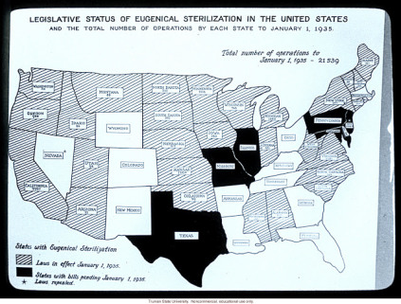
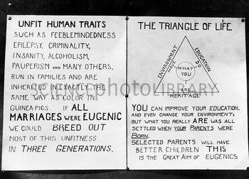
Notes:
Here you can see a map indicating which states had forced sterilization laws in place in 1935. On the left is an old piece of propaganda supporting eugenics and forced sterilization. These are examples of direct, explicit bias targeting women because of specific characteristics they had.

Slide 13
Implicit Biases
What are they?
How do they form?
How do they manifest themselves?
Notes:
So now that I’ve presented a little about how explicit biases still affect women, lets move on to implicit biases. What are implicit biases, how do they form, and how do they manifest themselves? The rest of the presentation will be dedicated to answering these questions, and to discussing what we can do about them.

Slide 14
Implicit Bias
Formed out of our lived experiences and exposures
Are the result of our subconscious assumptions
Everyone has them
They will vary from person to person
We cannot completely eliminate our biases
Notes:
Implicit biases are formed out of our lived experiences and exposures. Who we are, how and where we were raised, who our friends are, what media we are exposed to, where we went to school, everything that we have done in our lives has contributed to the implicit biases that we have. The life that you live forms your implicit biases. They are the result of subconscious assumptions, and everyone has them. Because was all lead different lives, so to will all of our implicit biases be slightly different. An important thing to keep in mind as we move forward is that there is nothing you can do to completely eliminate your biases but there are ways to acknowledge that they exist, and learn how to mitigate and manage them.

Slide 15
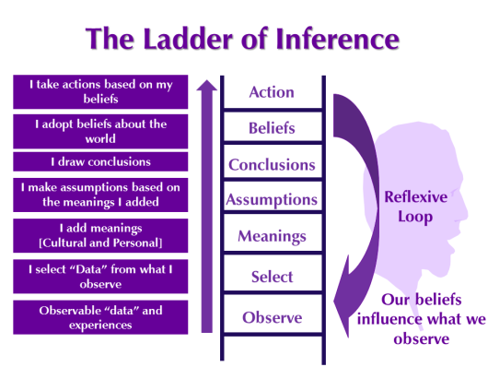
The Ladder of Inference
Our experiences influence how we think about and interpret the world around us
Notes:
Our lived experiences influence how we think about and interpret the world and form our implicit biases. Every day, we are exposed to people, places, and things that influence not only our perception of the world but also our actions within it. The ladder of inference is one way of understanding how our beliefs influence what we observe and what actions we take. We use our beliefs to make inferences out of our experiences which only serve to reinforce the very beliefs that we used in the first place to filter our interpretations. Sometimes these inferences are erroneous.
1. data, 2. filter, 3, meaning, 4, assumptions, 5. conclusions, 6. adjustment, 7. action

Slide 16
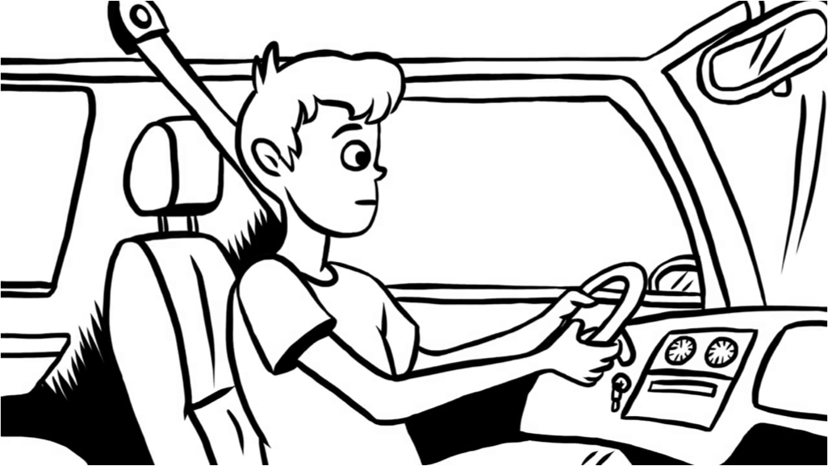
The Ladder of Inference
Notes:
This video presents an example of how making quick inferences can cause us to make false assumptions about our situation.
https://youtu.be/KJLqOclPqis

Slide 17
The Ladder of Inference
When I am experiencing something negative, undesirable or uncomfortable:
  What are the emotions I feel?
  What are the physical reactions I experience in my body?
  How does my behavior change?
Notes:
Next time you are in a situation where you are experiencing something negative, undesirable, or uncomfortable, consider your own ladder of inference and ask yourself these three questions:
What are the emotions I feel?
What are the physical reactions I experience in my body?
How does my behavior change?

Slide 18
Slow/Fast Thinking
Fast thinking: instinctive, emotional, subconscious
Slow thinking: deliberate, logical, conscious
Notes:
Our brains make decisions in two different ways. One way uses fast thinking, and one way uses slow thinking. Fast thinking is fast and automatic. It is frequently used and is instinctive, emotional, and subconscious. It is guided by our implicit biases. Slow thinking is slow and effortful. It is less frequently used, and is deliberate, logical and subconscious. It is what we can use to acknowledge and address our implicit biases.
System 1: Fast, automatic, frequent, emotional, stereotypic, subconscious
System 2: Slow, effortful, infrequent, logical, calculating, conscious
Implicit bias is present in our fast thinking

Slide 19
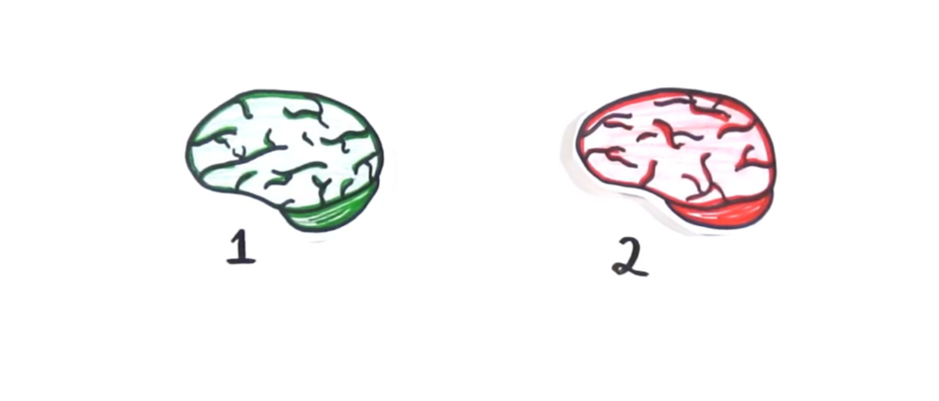
Slow/Fast Thinking
Notes:
This video shows you how your brain uses both slow and fast thinking.
https://youtu.be/JiTz2i4VHFw

Slide 20
Slow/Fast Thinking
An example of how implicit bias manifests itself
Fast thinking – our implicit biases at work
Slow thinking – our deliberate actions to counter these biases
Notes:
The concept of slow and fast thinking is an example of how our implicit biases manifest themselves. Fast thinking is our own implicit biases at work. Slow thinking can be thought of as our deliberate actions to counteract these biases.

Slide 21
So what can we do about implicit bias?

Slide 22
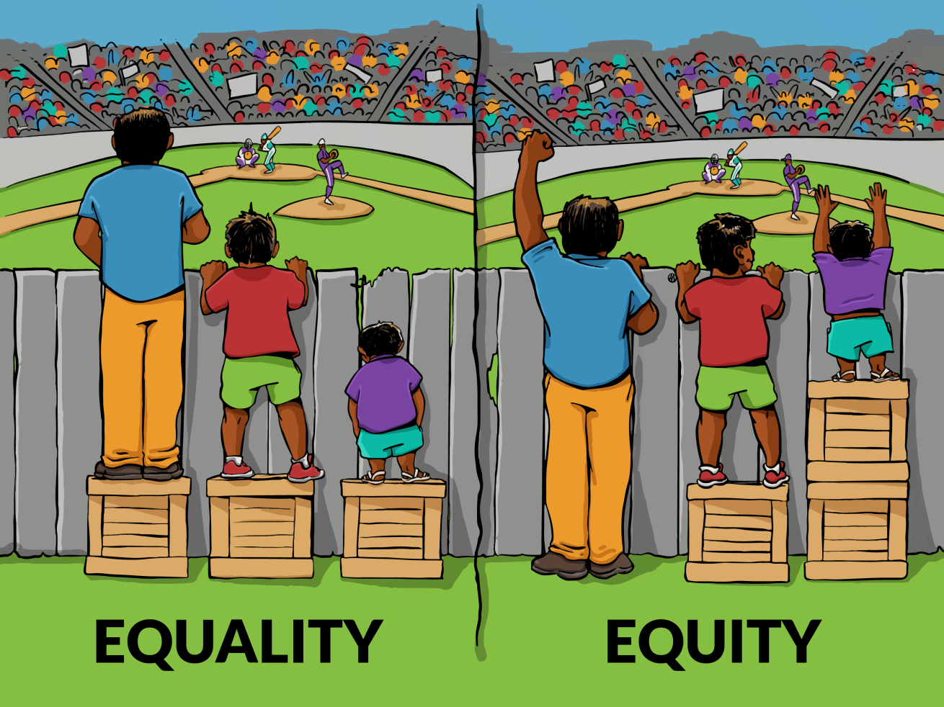
Equality and Equity
Notes:
I think it might be helpful for us to review the difference between Equality and Equity.
*acknowledge image is problematic but haven’t found a better visual
Equality equals the same. It gives everyone the exact same thing. But the problem is that not everyone starts out in the same place.
Equity equals fairness. It gives everyone different things that helps given them equal access so that they can get to the same place in the end. It gives people what they need to be successful, in this case, a different number of crates to stand on to see the baseball game.
By actively treating our patients equitably, we can acknowledge and mitigate our own implicit biases. The challenge is, as always, providing care in a system that is neither equal or equitable.
ACOG definition of equitable: provides care that does not vary in quality because of personal characteristics, such as gender, ethnicity, geographic location, and socioeconomic status

Slide 23
Implicit Bias Mitigation – Starbucks
Philadelphia – two Black men were arrested in a Starbucks while waiting for a friend before ordering
  White manager called the police
CEO responded within days with statement decrying the incident and stating that Starbucks will “make any necessary changes to our practices that would help prevent such an occurrence from ever happening again”
One month later, over 8,000 stores closed for an afternoon for training in implicit bias
  Training was also held at the corporate offices
Notes:
Top-down approach to addressing and mitigating implicit bias
Leader acknowledged problem
April 2018 incident
End of may – company-wide training

Slide 24
Implicit Bias Mitigation - Starbucks
Leadership acknowledged the problem
  Avoided defensiveness
Set the stage for safe dialogue
  Set up trainings in stores
Maintained organizational commitment to working to mitigate biases
  Training at all levels of the organization
  Quick acknowledgement of problem and work towards resolution

Slide 25
Implicit Bias Mitigation – American Airlines
A Black woman was kicked off a flight after an altercation with a gate agent over her seat assignment
NAACP issued travel advisory regarding safety when flying on American Airlines
American Airlines CEO worked with NAACP to address bias in their workforce
Generated four specific actions

Slide 26
Implicit Bias Mitigation – American Airlines
Conduct a diversity and inclusion gap analysis
Implement company-wide implicit bias training
Overhaul customer discrimination claims process
Sharpen focus on team member concerns
Notes:
Inclusion gap – not hiring a diverse workforce
Diversity and inclusion gap analysis: hire an independent firm to review the airline’s human resources and business policies related to diversity and inclusion – addressing hiring, training, career development, customer complaint resolution, team member experiences, supplier selection
Company wide implicit bias training – annual implicit bias training for every employee
Customer discrimination claims process – new team that focuses on discrimination claims
Sharpen focus on team member concerns – work to revamp internal discrimination claims

Slide 27
National Standards for Culturally and Linguistically Appropriate Services
“Provide effective, equitable, understandable and respectful quality care and services that are responsive to diverse cultural health beliefs and practices, preferred languages, health literacy and other communication needs.”
https://minorityhealth.hhs.gov/omh/browse.aspx?lvl=2&lvlid=53
https://www.thinkculturalhealth.hhs.gov
Notes:
How can we, as organizations, work to mitigate biases in the services that we provide? These national standards were developed to help organizations provide effective….
The aim is to “improve health care quality and advance health equity by establishing a framework for organizations to serve the nation's increasingly diverse communities.”
By adopting these standards, we can work to address how we provide care

Slide 28
CLAS Standards
Government, Leadership, and Workforce
Communication and Language Assistance
Engagement, Continuous Improvement, and Accountability
https://minorityhealth.hhs.gov/omh/browse.aspx?lvl=2&lvlid=53
https://www.thinkculturalhealth.hhs.gov
Notes:
Three sub-groups of 15 nationally-recognized standards that can be used to improve healthcare quality and advance health equity
Before we get into the standards I want to say that each standard has been extensively researched and is quite comprehensive – Due to time constraints, today’s talk will only provide a brief overview of the standards and identify some immediate strategies that you can take to start implementing these standards.

Slide 29
Why CLAS?
Use CLAS to take into account:
  Cultural health beliefs
  Preferred languages
  Health literacy levels
  Communication needs
https://www.thinkculturalhealth.hhs.gov/assets/pdfs/class-infographic-what-why-how.pdf
Notes:
Why CLAS? – providing culturally and linguistically appropriate services is a concrete way to work on reducing healthcare disparities and therefore improve healthcare quality and equity
Tailoring services to your community is good for you and good for your community – when you provide the services they need in the culturally appropriate way, and they are more likely to attend/return/recommend to others
Remember: always provide services that are respectful of the diversity of our communities

Slide 30
Why CLAS?
Use CLAS standards to help make services
  Respectful
  Understandable
  Effective
  Equitable
https://www.thinkculturalhealth.hhs.gov/assets/pdfs/class-infographic-what-why-how.pdf
Notes:
Provide individuals with assurances that disrespect or discrimination of any kind is intolerable.
Provide individuals with reasonable assistance to overcome language, cultural, physical, or communication barriers
The following standards that we will discuss all feed into the ultimate goal stated here and are considered the fundamental building blocks of CLAS that are required to achieve this overarching goal.

Slide 31
CLAS – Government, Leadership, Workforce
Advance and sustain organizational governance and leadership that promotes CLAS and health equity through policy, practices and allocated resources.
  CLAS at all levels of the organization
Recruit, promote and support a culturally and linguistically diverse governance, leadership and workforce that are responsive to the population in the service area.
  Diversity at all levels of the organization
  Recruit at minority health fairs
  Develop relationships with local schools and training programs
Educate and train governance, leadership and workforce in culturally and linguistically appropriate policies and practices on an ongoing basis.
  Review of, and emphasis on, honing existing communication or other related skills necessary to work effectively in cross-cultural encounters
  Importance of effective communication to health care outcomes; how to work with interpreters; how cultural differences affect clinical encounters
https://minorityhealth.hhs.gov/omh/browse.aspx?lvl=2&lvlid=53
https://www.thinkculturalhealth.hhs.gov
Notes:
Does your organizational structure and governance reflect a commitment to equity?
CLAS at all levels of the organization however requires commitment by the leadership through a top-down approach
Diversity at all levels – front office to senior leadership – not just hiring but also training
Also important to have governance, leadership and workforce that are responsive, not just representative, of the population in the service area
Health care providers are statistically not representative of the population they serve – increasing representation leads to increased access to care, higher levels of patient satisfaction and engagement, and improved patient-provider communication
How cultural differences affect clinical encounters – affect access to care, quality of care, health outcomes, patient satisfaction
Differences include economic status, race, ethnicity, disability status, sexual orientation, gender identity

Slide 32
CLAS – Governance, Leadership, Workforce
Train staff in CLAS – diversity awareness, cultural competence training
Promote CLAS and health equity through policy, practices, and allocated resources
Recruit a workforce representative of community
Create and support a designated CLAS position
https://minorityhealth.hhs.gov/omh/browse.aspx?lvl=2&lvlid=53
https://www.thinkculturalhealth.hhs.gov
Notes:
Summary slide
How can you operationalize the CLAS standards of governance, leadership, and workforce? Some examples include having trainings so that your staff are knowledgeable in the CLAS standards. Training at all levels of the organization, from the most senior to the most junior. Ensure that the trainings emphasize sensitivity to variations within populations including individual variations in beliefs, expectations and preferred modes of communication. You want trainings to allow all members of your workforce to develop knowledge and skills needed to explore these variations. Trainings need to be linked to a comprehensive organizational strategy around CLAS – link the trainings to be related to your organizational mission, goals, or objectives. Consider hiring a workforce that is representative of the community you serve. You might be able to create and support a designated CLAS person, or designate a portion of an existing employee’s time to monitoring adherence to CLAS standards. All of your good training efforts will be wasted if your organization does not continue to adhere to CLAS standards.

Slide 33
CLAS - Communication and Language Assistance
Offer language assistance to individuals who have limited English proficiency and/or other communication needs, at no cost to them, to facilitate timely access to all health care and services.
  Ensure all staff are aware of, and trained in the use of, available language services
  Develop a process for identifying the language(s) someone speaks – flashcards, signs hung at initial points of contact
Inform all individuals of the availability of language assistance services clearly and in their preferred language, verbally and in writing.
  Consider what languages you want available on your signage
  Signage should be at a low literacy level
  Publicize in local foreign language media
https://minorityhealth.hhs.gov/omh/browse.aspx?lvl=2&lvlid=53
https://www.thinkculturalhealth.hhs.gov
Notes:
One of the most important ways we can provide appropriate services is to have them available in the languages of our community
Initial point of contact – reception/check-in desk, waiting room, financial screening rooms, pharmacy, exam room
Publicize availability of language services in your local foreign language media – radio, newspaper, television

Slide 34
CLAS - Communication and Language Assistance
Ensure the competence of individuals providing language assistance, recognizing that the use of untrained individuals and/or minors as interpreters should be avoided.
Provide easy-to-understand print and multimedia materials and signage in the languages commonly used by the populations in the service area.
  Forms should be easy to fill out; provide assistance in completing forms
  Forms should be translated by a professional translator
https://minorityhealth.hhs.gov/omh/browse.aspx?lvl=2&lvlid=53
https://www.thinkculturalhealth.hhs.gov
Notes:
Competence for language: clear/understandable speech delivery, familiarity with slang in both languages, ability to identify difference in meaning of dialect, working knowledge of anatomy and physiology, extensive knowledge of medical vocabulary and terminology
Avoid using untrained individuals or minors – this may feel convenient or reasonable to have your medical assistant or a family member translate but it is not the recommendation. Using people unfamiliar with medical terminology who act as medical interpreters can lead to significant medical errors. Friends and family may also translate through a biased lens.
Relevant materials include: administrative/legal documents such as consent forms, living wills, financial documents; clinical information such as information about a patient’s treatment or instructions about a procedure or a medication; and education, health prevention and promotion, and outreach materials
Forms should be easy to fill out

Slide 35
CLAS - Communication and Language Assistance
Offer comprehensive language assistance services
Require interpreters’ skills to be certified or assessed
Use advanced technology for interpretation services
https://minorityhealth.hhs.gov/omh/browse.aspx?lvl=2&lvlid=53
https://www.thinkculturalhealth.hhs.gov
Notes:
Summary slide
What are some specific things you can do to address the communication and language assistance CLAS components?
Comprehensive language assistance – consider multiple languages, sign language, braille
Certified interpreters have gone through specialized training and typically also have requirements for continuing education for maintaining credentials. These interpreters are highly trained in medical knowledge and language.
Advanced technology – phone interpreters, video interpreters (can do sign language too!), allows access to less common languages

Slide 36
CLAS - Engagement, Continuous Improvement, and Accountability
Establish culturally and linguistically appropriate goals, policies and management accountability, and infuse them throughout the organizations’ planning and operations.
  Identify CLAS champions at every level of the organization
  Establish education and training requirements related to CLAS for ALL individuals in the organization
https://minorityhealth.hhs.gov/omh/browse.aspx?lvl=2&lvlid=53
https://www.thinkculturalhealth.hhs.gov
Notes:
Make sure that your services reflect the needs of the community – don’t assume you know what they need – go out and ask them!
Don’t assume you know what languages people speak – do a survey, check your patient records and get an accurate account
It’s not always just spanish! At my institution we have a lot of women from Bangladesh, Albania, and Yemen. Since starting I have learned that Yemeni Arabic is different than standard Arabic.

Slide 37
CLAS - Engagement, Continuous Improvement, and Accountability
Conduct ongoing assessments of the organization’s CLAS-related activities and integrate CLAS-related measures into assessment measurement and continuous quality improvement activities.
  Assessment phase
  Planning phase
  Implementation phase
  Evaluation phase
Notes:
assessment: accessibility of interpreter services, effectiveness of cultural and linguistic competency training for providers and nonclinical staff, differences in the use of services among diverse populations, impact of of culturally and linguistically competent service provision on health outcomes and health status on individuals’ satisfaction
Organizational assessment examples:
Perform “cultural audit” using existing cultural and linguistic competency assessment tools to inventory structural policies, procedures, and practices – use this information to determine if you have the core structures and processes necessary for providing CLAS
Core structures/processes include management, governance, delivery systems, and customer relation functions
Identify assets – bilingual staff members, existing relationships with community organizations
Identify weaknesses – lack of signage, no cultural competency training
Consider opportunities to improve your organization’s capacity to address cultural and liguistice competence – revise mission statement, enhance diversity in management positions
Planning phase – take information from the assessment and determine what needs to be done, and how best to do it
Implementation phase: rolling out of identified areas for improvement
Evaluation phase: provide CLAS-oriented feedback forms with SASE; conduct focus groups to monitor progress and identify continued barriers to implementation; assess standard of care provided for specific conditions to ensure services are uniformly provided across cultural groups; add CLAS-related questions to staff orientation; identify specific metrics related to cultural and linguistic competency and set regular assessment intervals

Slide 38
CLAS - Engagement, Continuous Improvement, and Accountability
Collect and maintain accurate and reliable demographic data to monitor and evaluate the impact of CLAS on health equity and outcomes and to inform service delivery.
  Information from clients: HHS provides data collection standards on race, ethnicity, language, disability – standardization is key
    Inform clients why you are collecting data and how it will be used
    Stress confidentiality of information that is being collected
  Information from organization: Total number of visits, total number of people requesting language services
https://minorityhealth.hhs.gov/omh/browse.aspx?lvl=2&lvlid=53
https://www.thinkculturalhealth.hhs.gov
Notes:
HHS data collection standards for race, ethnicity, sex, primary language
Standard collection instruments is key. You also need to ensure that you
Example: how well do you speak English: very well, well, not well, not at all
Do you speak a language other than English at home
Disability – questions about hearing or vision disabilities, question about mobility challenges (difficulty walking or climbing stairs, difficulty dressing or bathing)
We need accurate data in order to inform our service delivery
Information can be collected at the registration desk. Staff need to be trained in data collection and in a script to communicate the confidentiality of the information and that it cannot be used to discriminate against them.

Slide 39
CLAS - Engagement, Continuous Improvement, and Accountability
Conduct regular assessments of community health assets and needs and use the results to plan and implement services that respond to the cultural and linguistic diversity of populations in the service area.
  Needs assessment, resource inventory, gaps analysis
Notes:
What does your community need?
What resources are currently available?
What are the gaps in services?
Consider partnering with other community organizations to help learn what needs there are to be addressed
Consider focus groups with individuals from the community

Slide 40
CLAS - Engagement, Continuous Improvement, and Accountability
Partner with the community to design, implement and evaluate policies, practices and services to ensure cultural and linguistic appropriateness.
  Build coalitions with community partners
  Hold community meetings
  Cultural brokers, community health workers
Create conflict- and grievance-resolution processes that are culturally and linguistically appropriate to identify, prevent and resolve conflicts or complaints.
  Provide conflict-resolution training to staff
  Patient advocates
Communicate the organization’s progress in implementing and sustaining CLAS to all stakeholders, constituents and the general public.
  Present reports to the public on your progress in implementing CLAS
https://minorityhealth.hhs.gov/omh/browse.aspx?lvl=2&lvlid=53
https://www.thinkculturalhealth.hhs.gov
Notes:
Community partnership is essential! This will allow your organization to truly understand the needs of the diverse population you serve and allow you to allocate your resources appropriately
Cultural brokers – individuals from community who can serve as a bridge between an organization and people of different cultural backgrounds
CHW – very close understanding of the community; front-line public health workers – share cultural experiences of the community
Conflict and grievance resolution: patient advocates that can work with patients in setting of conflict

Slide 41
CLAS - Engagement, Continuous Improvement, and Accountability
Improve collection of race, ethnicity, and language data
Conduct organizational assessments
Incorporate CLAS into mission, vision, and strategic plans
https://minorityhealth.hhs.gov/omh/browse.aspx?lvl=2&lvlid=53
https://www.thinkculturalhealth.hhs.gov
Notes:
Summary slide
What are some specific things you can do to address the engagement, continuous improvement, and accountability CLAS standards?
Improve collection of race, ethnicity and language data – this will allow your organization to ensure you are providing the appropriate services, languages, etc
Conduct organizational assessments
Incorporate CLAS into mission, vision and strategic plans

Slide 42
CLAS – Mission statements
American Public Health Association: “Improve the health of the public and achieve equity in health status”
Harvard Medical School: “To create and nurture a diverse community of the best people committed to leadership in alleviating human suffering caused by disease.”
Mayo Clinic: “To inspire hope and contribute to health and well-being by providing the best care to every patient through integrated clinical practice, education, and research.”
Notes:
Here are some examples of how organizations have used CLAS in their mission statements
Note the dedication to equity, diversity, and inclusion

Slide 43
Things to Consider – Organizational Level
Diversity in staff – do you reflect the community you serve?
Organizational-level commitment to health equity – does your mission/vision statement reflect a commitment to equity?
Patient materials – do they reflect the community you serve?

Slide 44
Things to Consider – Individual Level
What about your life experience influences the way that you see the world?
What influences your preferences for or against different groups of people?
Consider the power/privilege/oppression of the system in which you grew up
  Privilege: benefits that help you make your way in the world that you didn’t necessarily work for or achieve

Slide 45
Personal Tips for Moving Forward
Acknowledge the potential for your life experience to bias your assumptions
Be wary of first impressions
  Ask yourself: “Why am I reacting like this?”
  Is your fast thinking taking over?
Learn about stereotypes and, more importantly, really get to know people as people
  Use your slow thinking to modify your ladder of inference
Individuation, perspective taking
Increase opportunities for contact with individuals from other groups
http://www.ihi.org/communities/blogs/how-to-reduce-implicit-bias accessed 5/20/19
Notes:
Individuation – Seeing the person as an individual rather than a stereotype (learn about personal history/context
Perspective taking – put yourself in someone else’s shoes
Increasing opportunities for contact with individuals from different groups – expand your network of friends and colleagues, attend events where other racial and ethnic groups, gender identities, sexual orientation, and other groups may be present

Slide 46

Thank you!
Any questions?

