Slide 1
The Cycle of Addiction
Paul Updike, MD
Medical Director for Substance Use Services,
CHS Buffalo
pupdike@chsbuffalo.org

Slide 2
Objectives
Review the opioid epidemic
Review the pathophysiology and consequences of Opioid Use Disorder
Review effective treatment options for OUD with particular attention to the chronic disease concept
Review special concerns regarding OUD in pregnancy

Slide 3
What are opioids?
Effects
All of these drugs have significant potential for causing “addiction”, or Opioid Use Disorder
They also share common effects, depending on dose:
Pain relief (analgesia)
Cough suppression
Constipation
Sedation (sleepiness)
Respiratory suppression (slowed breathing)
Respiratory arrest (stopping breathing)
Death
“Natural”, referred to as “opiates”
Derived from opium poppy
Morphine, codeine, opium
Synthetic (partly or completely):
Semisynthetic: heroin, hydrocodone, oxycodone
Fully Synthetic: fentanyl, tramadol, methadone
“Opioid” refers to both “natural” and synthetic members of this drug class
Notes:
An opioid is a compound that interacts with a set of 3 major opioid receptor systems in the human nervous system (mu, kappa, delta). Humans also make a type of opioid called an endorphin, which interacts with these receptors.
Clinical pearl: A urine drug screen for opiates detects morphine and codeine. Drugs such as heroin and hydrocodone are detected because they are metabolized to morphine and codeine, and so they will also show as a positive opiate test. However, opioids that are not metabolized to codeine (such as oxycodone, fentanyl, buprenorphine, or methadone) will not be detected by this test, and must be tested for separately.

Slide 5
Historical Perspective on How the Problem Started
Opium poppy cultivated in Mesopotamia in 3400 BC. Referred to as the “joy plant”
1803: Active ingredient of opium identified-morphine
1895: Heroin, diacetylmorphine is synthesized and marketed by Bayer as a medication with less side effects than morphine
Early 20th century: increases in morbidity associated with opioids leads to many countries passing laws restricting their use
Harrison Narcotics Tax Act 1914

Slide 6
Historical Perspective Continued
Second half of the 20th century physicians became more comfortable prescribing for acute and cancer pain
1980’s saw call for broader use for non-malignant chronic pain. Literature report of 38 chronic pain patients concluding opiate use is safe
1995- OxyContin introduced
1990’s – “The Decade of Pain” – Dramatic increase in the use of opiates coincident with the approval of new opioid formulations. Joint commission adapted, federally mandated patient satisfaction surveys based on how pain was addressed
BMJ 2011;343:d5142
From 1997-2007 the milligram per person use of prescription opiates increased 400 percent
Pain Physician. 13;401-435. 2010

Slide 7
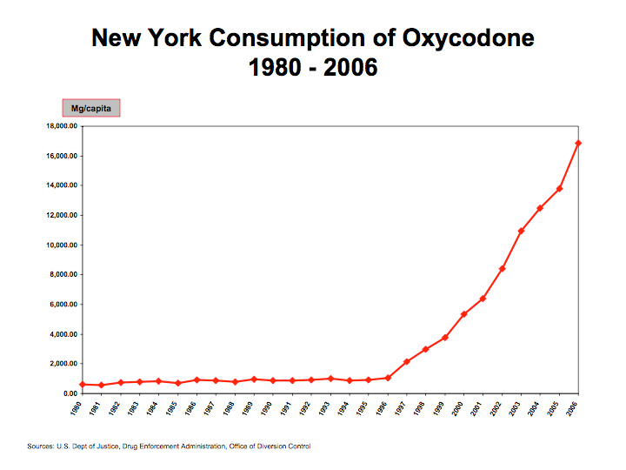

Slide 8
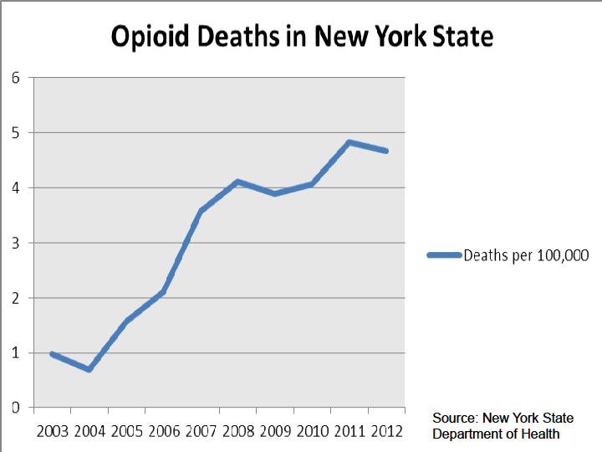

Slide 9
Total U.S. Drug Deaths
Provisional data,
National Center for Health Statistics
www.nytimes.com/interactive/2017/09/02/upshot/fentanyl-drug-overdose-deaths.html
Notes:
Drug overdoses killed ~64,000 people in US in 2016, according to NCSD provisional data. It’s a 22% increase over the 52,404 drug deaths reported in 2015.
Drug overdoses leading cause of death for Americans under 50.

Slide 10
Provisional data, National Center for Health Statistics
www.nytimes.com/interactive/2017/09/02/upshot/fentanyl-drug-overdose-deaths.html
20,100
Fentanyl and fentanyl analogues
Drugs involved in US overdose death, 2000-2016
15,400
Heroin
14,400
Prescription opioids
10,600
Cocaine
7,600
Meth
3,280
Methadone
Notes:
Fentanyl and its analogues continue to push the death count higher. Drug deaths involving fentanyl more than doubled from 2015 to 2016

Slide 11
Drug OD deaths involving specific drugs and drug classes, USA, 2015- 2016
 | Number of deaths for 12 months
Drug type | 2015 | 2016
Heroin | 13,219 | 15,446
Natural/semi-synthetic opioids (Codeine/Hydrocodone, Oxymorphone) | 12,726 | 14,427
Methadone | 3,276 | 3,314
Synthetic opioids excluding methadone (Fentanyl) | 9,945 | 20,145
www.cdc.gov/nchs/data/health_policy/monthly-drug-overdose-death-estimates.pdf

Slide 12
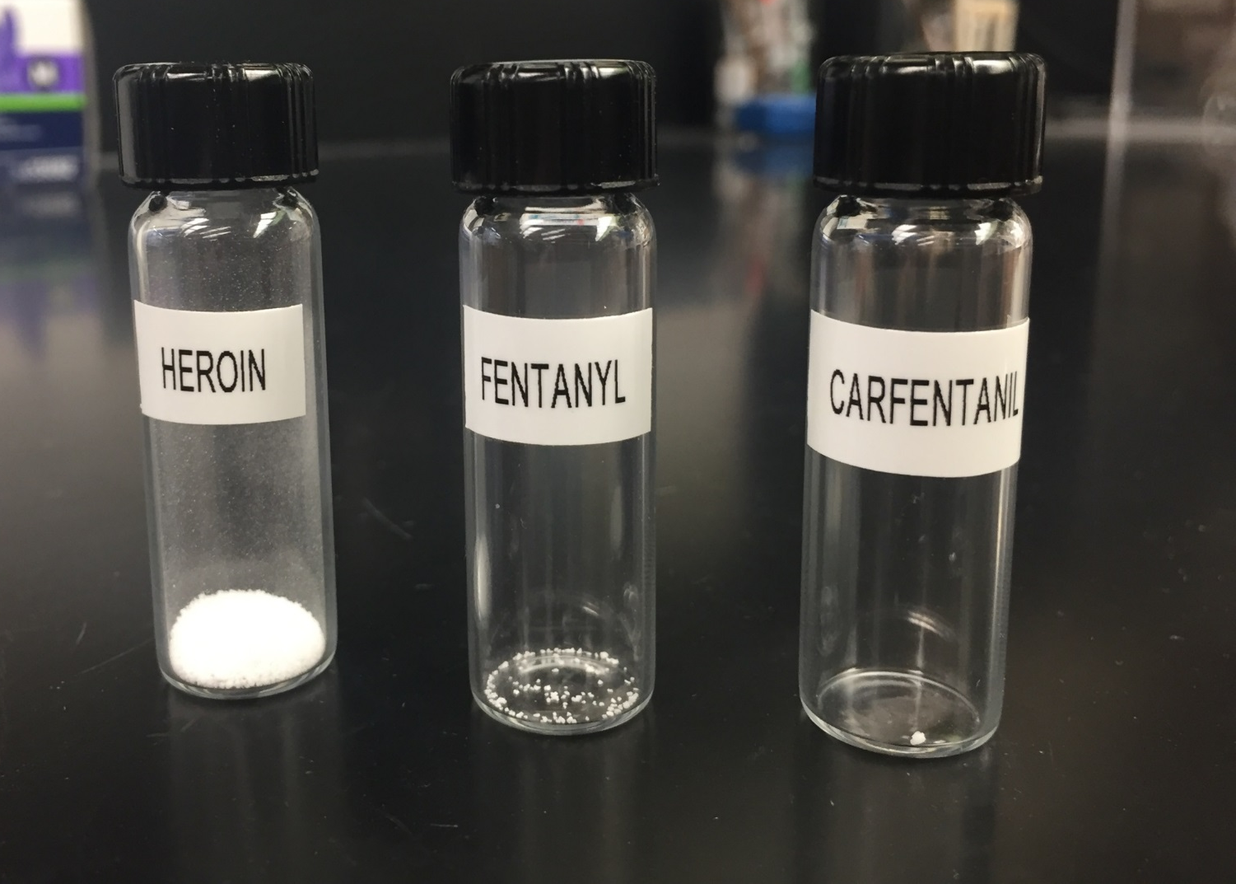
RELATIVE STRENGTH

Slide 13
2012 – 2017 Opioid Related Deaths
Erie County
17%↓

Slide 14
2016 and 2017* Erie County Opioid Related Deaths
by Type of Opioid
2017
N=233
(35 pending)
2016
N=301
Fentanyl = 78%
Heroin = 28%
Fentanyl = 76%
Heroin = 25%
¹ No Fentanyl; possible other drugs involved
² No Heroin; possible other drugs involved
³ No Fentanyl or Heroin; possible other drugs involved
⁴ Possible other drugs involved

Slide 15
ASAM Definition of Addiction
Short Definition of Addiction:
Addiction is a primary, chronic disease of brain reward, motivation, memory and related circuitry. Dysfunction in these circuits leads to characteristic biological, psychological, social and spiritual manifestations. This is reflected in an individual pathologically pursuing reward and/or relief by substance use and other behaviors.
Addiction is characterized by inability to consistently abstain, impairment in behavioral control, craving, diminished recognition of significant problems with one’s behaviors and interpersonal relationships, and a dysfunctional emotional response. Like other chronic diseases, addiction often involves cycles of relapse and remission. Without treatment or engagement in recovery activities, addiction is progressive and can result in disability or premature death.

Slide 16
Biologic and Social Factors Involved in Addiction
Minority (~10%) who use drugs become addicted
Risk factors that ↑ vulnerability
early exposure to drug use
adolescence
legitimate prescriptions
Other risks factors
family history
exposure to high-risk environments
socially stressful environments with poor familial and social supports
easy access to drugs and permissive normative drug taking attitudes mental illnesses
mood disorders, ADHD, psychoses, anxiety disorders

Slide 17
What is the definition of opioid use disorder? (also know as opioid “addiction”)
Notes:
If you have time you can ask the audience for some suggestions

Slide 18
How do you diagnosis OUD Mild/Moderate/Severe
Using larger amounts/longer than intended
Much time spent using
Activities given up in order to use
Physical/psychological problems associated with use
Social/interpersonal problems related to use
Neglected major role in order to use
Hazardous use
Repeated attempts to quit/control use
Withdrawal *
Tolerance *
Craving
*Does not count if taken only as prescribed and constitutes the sole criteria
DSM 5, American Psychiatric Association
Notes:
2-3 criteria qualifies for mild OUD; 4-5 = Moderate OUD; >5=Severe OUD
Ask audience what is withdrawal
Withdrawal= symptoms that develop if an opioid is stopped abruptly
When people are prescribed opioids around the clock for weeks-to-months they will develop withdrawal if they stop them suddenly.
What is tolerance? Tolerance = the need for increasing doses of a medication in order to achieve the same effect
Tolerance also develops when people are prescribed opioids around the clock for weeks to months
Therefore, the criteria of Tolerance and Withdrawal are excluded (don’t count) when diagnosing OUD in patients who are only using opioids that have been prescribed for them, if they are taken only as prescribed and other criteria for OUD are not present
“Opioid use disorder” has replaced the concepts of opioid abuse and dependence, which were confusing terms that were not used consistently

Slide 19
4 C’s
Loss of control
Compulsive Use
Craving
Continued use despite harm

Slide 20
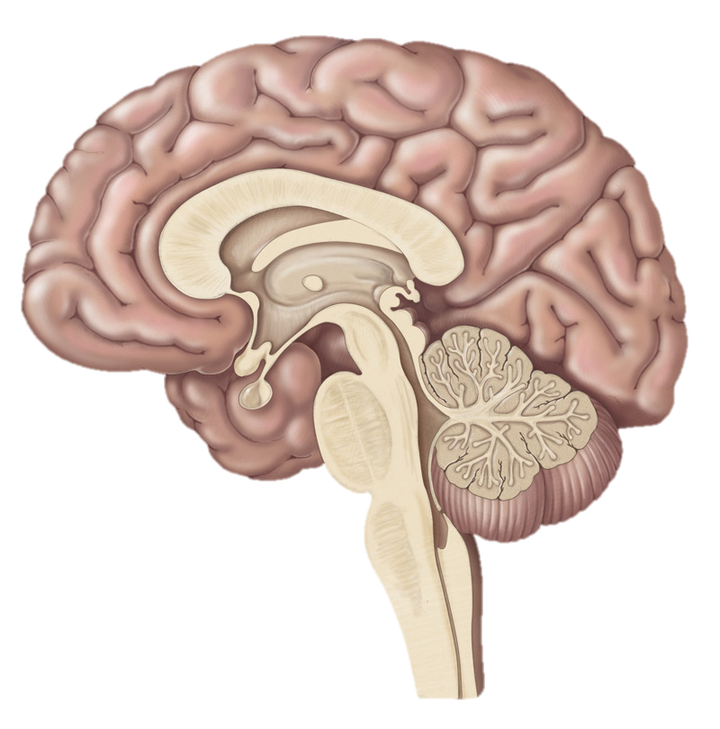
Opioid Neurobiology
Limbic System
Prefrontal Cortex
PREFRONTAL CORTEX: Executive Functions
LIMBIC SYSTEM: Pleasure, reward. This area is responsible for development of addiction.
BRAIN STEM:
Respiration; Cough Suppression
SPINAL CORD: Analgesia
Brain Stem
Spinal
Cord
Notes:
The mu-opioid system is very dynamic. Patients with tissue damage expose receptors on the spinal cord; when available opioids preferentially bind there. An excessive dose of opioids, or opioids given to someone who is not in pain will result in activation of the cerebral cortex and limbic system causing the pleasurable experience but also priming the brain for addiction. If a large excess of opioids are taken they will bind to receptors on the brain stem, resulting in respiratory arrest.
Patients in pain can tolerate MUCH HIGHER doses of opioids without intoxication or overdose than those who are not in pain. Treating patients in pain with opioids is safe as long as the dose is monitored. Patients who are getting high from their dose are receiving too large a dose and should be cut back.

Slide 21
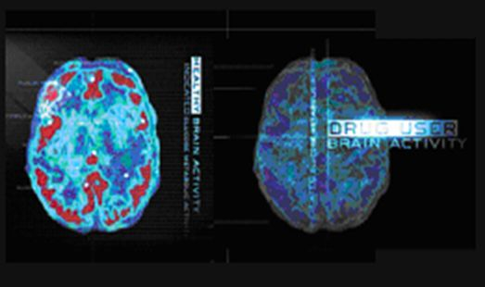
What is Addiction? Addiction is A Brain Disease
Characterized by:
Compulsive Behavior
Continued abuse of drugs despite negative consequences
Persistent changes in the brain’s structure and function
Notes:
Decades of research have revealed addiction to be a disease that alters the brain. We now know that while the initial decision to use drugs is voluntary, drug addiction is a disease of the brain that compels a person to become singularly obsessed with obtaining and abusing drugs despite their many adverse health and life consequences.

Slide 22
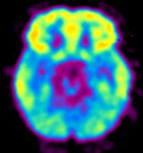
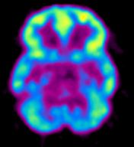
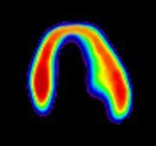
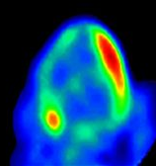
Addiction is Like Other Diseases…
It is preventable
It is treatable
It changes biology
If untreated, it can last a lifetime
Decreased Brain Metabolism
in Drug Abuser
Decreased Heart Metabolism in Heart Disease Patient
High
Low
Healthy Heart
Healthy Brain
Diseased Brain/
Cocaine Abuser
Diseased Heart
Research supported by NIDA addresses all of these
components of addiction.
Notes:
Addiction is similar to other chronic diseases. Using imaging technology to measure metabolism (in this case, glucose uptake) in the brain and heart, one can see that both addiction and heart disease produce observable changes in organ function. In each pair of images shown above, the healthy organ shows greater activity (reds and yellows) than the diseased organ. In drug addiction, the frontal cortex, which is a part of the brain associated with judgment and decision-making, is significantly affected. Like heart disease, drug addiction can be prevented and treated successfully. If left untreated, however, its effects can last a lifetime.

Slide 23
Addiction Involves Multiple Factors
Notes:
Research has also taught us that addiction is a complex disease, influenced by a multitude of highly entangled factors. No single factor determines whether someone will or will not become addicted to drugs.

Slide 24
Stages of the Addiction Cycle
1st stage (binge/intoxication) involves opiate-induced reward sensations in the brain.
2nd stage (withdrawal/negative affect) is elevation in threshold for experiencing reward sensation after drug use (i.e., ↑exposure to drug required) and withdrawal state develops when drug cannot be obtained.
3rd stage (preoccupation-relapse) is chronic relapse in drug use, often triggered by environmental and emotional cues.
Chronic opioid use induces neurochemical changes that alter brain circuits, which reduces the reward sensation experienced during the initial stage and increases the stress and compulsivity associated with chronic drug addiction.
Volkow ND et al. N Engl J Med 2016;374:363-371
Notes:
Figure 1
Stages of the Addiction Cycle.
There are 3 stages of addiction
1. binge and intoxication
2. withdrawal
3. Preoccupation and anticipation
During intoxication, drug-induced activation of the brain’s reward regions (in blue) is enhanced by conditioned cues in areas of increased sensitization (in green) which are the hippocampus that controls impulse and the prefrontal cortex that controls planning and impulse control.
During withdrawal, the activation of brain regions involved in emotions (in pink) results in negative mood and enhanced sensitivity to stress.
During preoccupation, the decreased function of the prefrontal cortex leads to an inability to balance the strong desire for the drug with the will to abstain, which triggers relapse and reinitiates the cycle of addiction.
The compromised neurocircuitry reflects the disruption of the dopamine and glutamate systems and the stress-control systems of the brain, which are affected by corticotropin-releasing factor and dynorphin.
The behaviors during the three stages of addiction change as a person transitions from drug experimentation to addiction as a function of the progressive neuroadaptations that occur in the brain.

Slide 25
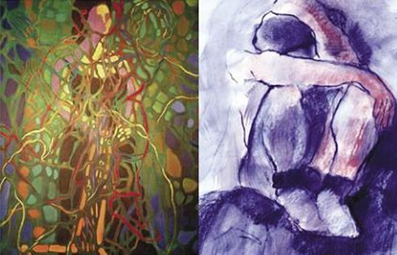
Why Do People Take Drugs in The First Place?
To Feel Good
To have novel:
feelings
sensations
experiences
AND
to share them
To Feel Better
To lessen:
anxiety
worries
fears
depression
hopelessness
Notes:
Why would anyone abuse drugs? Research has shown that people generally take drugs to either feel good (i.e., sensation seekers or anyone wanting to experiment with feeling high or different) or to feel better (i.e., self-medicators or individuals who take drugs in an attempt to cope with difficult problems or situations, including stress, trauma, and symptoms of mental disorders).
Images: courtesy of Vivian Felsen

Slide 26
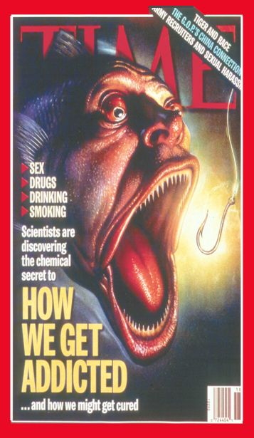
Why Do People
Abuse Drugs?
Drugs of Abuse
Engage Motivation and
Pleasure Pathways
of the Brain
Notes:
Why do drugs make people feel good or feel better—because of what they do to their brain. Drugs exert their effects largely on the motivation and pleasure pathways of the brain.

Slide 27
Natural Rewards Elevate
Dopamine Levels
Food
Sex
200
200
NAc shell
150
150
% of Basal DA Output
DA Concentration (% Baseline)
100
100
Empty
50
Box Feeding
Female Present
0
0
60
120
180
Sample
Number
1
2
3
4
5
6
7
8
Time (min)
Di Chiara et al., Neuroscience, 1999.,Fiorino and Phillips, J. Neuroscience, 1997.
Notes:
27
Natural rewards stimulate dopamine neurotransmission. Eating something that you enjoy or being stimulated sexually can cause dopamine levels to increase. In these graphs, dopamine is being measured inside the brains of animals. Its increase is shown in response to food or sex cues. This basic mechanism of controlled dopamine release and reuptake has been carefully shaped and calibrated by evolution to reward normal activities critical for our survival.

Slide 28
Effects of Drugs on Dopamine Release
Amphetamine
Cocaine
1100
Accumbens
400
Accumbens
1000
900
300
DA
800
DA
DOPAC
700
DOPAC
HVA
600
HVA
% of Basal Release
% of Basal Release
200
500
400
300
100
200
100
0
0
0
1
2
3
4
5 hr
0
1
2
3
4
5 hr
Nicotine
Morphine
250
Accumbens
250
Dose
200
Accumbens
200
0.5
mg/kg
Caudate
1.0
mg/kg
150
2.5
mg/kg
150
10
mg/kg
100
% of Basal Release
% of Basal Release
100
0
0
0
1
2
3 hr
0
1
2
3
4
5 hr
Time After Drug
Time After Drug
Di Chiara and Imperato, PNAS, 1988
Notes:
Nearly all drugs of abuse increase dopamine neurotransmission. This slide shows the increase in brain dopamine (DA) levels (measured in animals) following exposure to various drugs of abuse. All of the drugs depicted in this slide have different mechanisms of action, however they all increase activity in the brain reward pathway by increasing dopamine neurotransmission. It is because drugs activate these brain regions⎯usually more effectively and for longer periods of time than natural rewards⎯that they have an inherent risk of being abused.

Slide 29
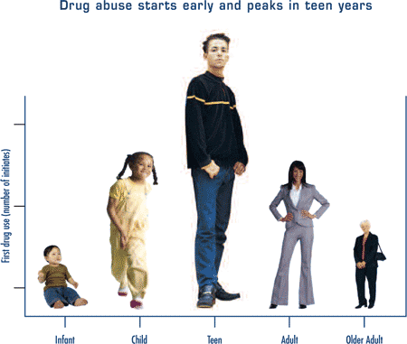
Addiction is a disease of the youth

Slide 30
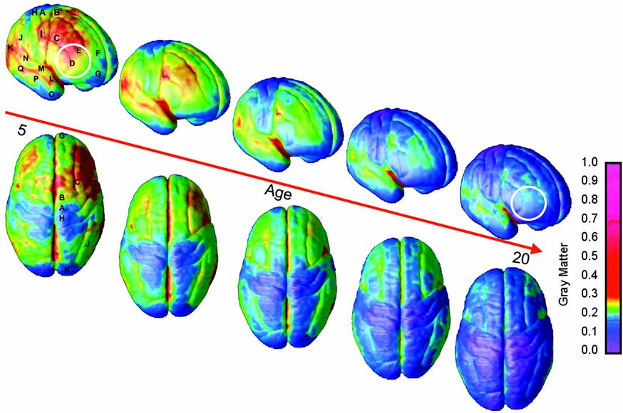
MRI Scans of Healthy Children and Teens Over Time
Gogtay, Giedd, et al. Proc. Natl. Acad. Sci., 2004
Copyright ©2004 by the National Academy of Sciences
Notes:
Magnetic Resonance Imaging (MRI) Scans allow us to map the maturation of the brain. This slide illustrates brain development through early adulthood, with blue indicating the mature state. The prefrontal cortex (white circle), which governs judgment and decision-making functions, is the last part of the brain to develop. This may help explain why teens, who are more prone to participating in risk-taking behavior, are particularly vulnerable to drug abuse.

Slide 31
Consequences of OUD are Wide Ranging
Physical (Withdrawal, intoxication, overdose)
Medical
Psychological
Spiritual
Social
Legal
It’s not fun

Slide 32
Behavioral manifestations and complications of addiction, primarily due to impaired control
These can include:
Excessive use and/or engagement in addictive behaviors, at higher frequencies and/or quantities than the person intended, often associated with a persistent desire for and unsuccessful attempts at behavioral control;
Excessive time lost in substance use or recovering from the effects of substance use and/or engagement in addictive behaviors, with significant adverse impact on social and occupational functioning (e.g. the development of interpersonal relationship problems or the neglect of responsibilities at home, school or work);
Continued use and/or engagement in addictive behaviors, despite the presence of persistent or recurrent physical or psychological problems which may have been caused or exacerbated by substance use and/or related addictive behaviors;
A narrowing of the behavioral repertoire focusing on rewards that are part of addiction; and
An apparent lack of ability and/or readiness to take consistent, ameliorative action despite recognition of problems.
http://www.asam.org/for-the-public/definition-of-addiction

Slide 33
Principles of Management
Recovery from addiction is best achieved through a combination of self-management, mutual support, and professional care provided by trained and certified professionals.
As in other health conditions, self-management, with mutual support, is very important in recovery from addiction.
Chronic disease management is important for minimization of episodes of relapse and their impact. Treatment of addiction saves lives
http://www.asam.org/for-the-public/definition-of-addiction

Slide 34
Treatment
Is Biopsychosocial-spiritual
Addresses the whole person
Addresses cross addiction
Isn’t necessary to know the total cause
Effective treatment acknowledges the brain disease and individualizes care

Slide 35
Accessing Treatment
The decision to get help is a big deal!
Treatment should be supported
Some amount of ambivalence is common
Motivation for treatment is not always that important. Usually self directed but can also be through a referral or mandate.
Several attempts are often necessary
Access can be limited
People can and do get better.

Slide 36
Medication Assisted Treatment
Recognizing that addiction is a chronic brain disease
Dramatically increases the abstinence rates and outcomes for patients vs psychosocial treatments alone
Important tool to aide a patients recovery
Not replacing one addiction for another
Effective for all opiates (prescription and heroin)

Slide 37
Euphoria
Normal
Medication Assisted
Therapy
Withdrawal
Tolerance & Physical Dependence
Acute Use
Chronic Use
Alford, Boston University, 2012
Notes:
Early on in drug use, euphoria is the main effect and functioning is relatively normal. With chronic use and the development of tolerance and physical dependence, euphoria disappears and is replaced by drug seeking in order to avoid withdrawal. Medication treatment for opioid use disorder restores normal functioning by eliminating both euphoria and withdrawal, and returning the person to a psychological and physiologic state that is similar to their pre-drug-use condition.

Slide 38
Gender and Opioid Use Disorder
Opioid Use among Women
Between 2004 and 2010: opioid-related overdose deaths increased more rapidly among Women (400%), then Men (276%)(1)
In 2015 there were more past-year initiates of prescription opioid misuse among Women (1.2 million – 0.9%) than Men (0.9 million – 0.7%)(2)
There are still more male than female adults who use heroin, heroin use is increasing twice as fast among women than men(2)
Today 50% of new heroin initiates are Women (3)
NAS cases 1.5/1000 in 1999 to 6/1000 in 2013 (MMWR 2016)
Notes:
(1) Vital Signs: Overdoses of Prescription Opioid Pain Relievers and Other Drugs Among Women — United States, 1999–2010 [Internet]. [cited 2016 Dec 27]. Available from: https://www.cdc.gov/mmwr/preview/mmwrhtml/mm6226a3.htm
(2) Key Substance Use and Mental Health Indicators in the United States: Results from the 2015 National Survey on Drug Use and Health - NSDUH-FFR1-2015.pdf [Internet]. [cited 2016 Dec 21]. Available from: https://www.samhsa.gov/data/sites/default/files/NSDUH-FFR1-2015/NSDUH-FFR1-2015/NSDUH-FFR1-2015.pdf
(3) Cicero TJ, Ellis MS, Surratt HL, Kurtz SP. The changing face of heroin use in the United States: a retrospective analysis of the past 50 years. JAMA Psychiatry. 2014 Jul 1;71(7):821–6.

Slide 39
Pregnancy and Opioid Use Disorder (OUD)
Nearly 50% of Pregnant substance use disorder treatment admissions are for Opioids(1)
Overdose mortality has surpassed hemorrhage, pre-eclampsia and sepsis as a cause of pregnancy-associated death(2)
Notes:
TEDS 2004-2014 National Admissions to Substance Abuse Treatment Services - 2014_teds_rpt_natl.pdf [Internet]. [cited 2016 Dec 21]. Available from: https://wwwdasis.samhsa.gov/dasis2/teds_pubs/2014_teds_rpt_natl.pdf
O’Malley M, Brown AG, Sharfstein JM. MARYLAND MATERNAL MORTALITY REVIEW. [cited 2016 Dec 19]; Available from: http://phpa.dhmh.maryland.gov/mch/documents/2011mmrrpt.pdf
A maternal death is defined by the World Health Organization’s (WHO) International Classification of Diseases Ninth and Tenth Revisions (ICD-9 and ICD-10) as “the death of a woman while pregnant or within 42 days of termination of pregnancy, irrespective of the duration and site of the pregnancy, from any cause related to or aggravated by pregnancy or its management but not from accidental or incidental causes.”
-The maternal mortality ratio(MMR)is the number of maternal deaths per 100,000 live births in the same time period.
-A pregnancy-associated death is defined by the Centers for Disease Control and Prevention (CDC) as “the death of a woman while pregnant
or within one year or365 days of pregnancy conclusion, irrespective of the duration and siteof the pregnancy, regardless of the cause of
death.”
-The pregnancy-associated mortality ratio is the number of pregnancy-associated deaths per 100,000 live births.
-A pregnancy-related death is defined by the CDC as “the death of a woman while pregnant or within one year of conclusion of pregnancy, irrespective of the duration and site of the pregnancy, from any cause related to or aggravated by her pregnancy or its management, but not from accidental or incidental causes.”
-The pregnancy-related mortality ratio is the number of pregnancy-related deaths per 100,000 live births.

Slide 40
Gender, Pregnancy and OUD
86% of pregnant opioid-abusing women report pregnancy was unintended (1)
In general population: 31%–47% are unintended
Pregnancy can be a powerful catalyst for women to engage in treatment
During Pregnancy
Adolescents report the highest illicit substance use in the prior month
Reported substance use decreases with increasing maternal age (NSDUH 2012-2013)
Trend toward reduction of use over gestation
Reported substance use decreases with increasing gestational age (SAMHSA TEDS 2014)
Notes:
(1) Heil SH, Jones HE, Arria A, Kaltenbach K, Coyle M, Fischer G, et al. Unintended pregnancy in opioid-abusing women. J Subst Abuse Treat. 2011 Mar;40(2):199–202.

Slide 41
Medically Assisted Withdrawal in Pregnancy (Detoxification)
Not recommended in pregnancy (1)(2)(3)
Withdrawal management has been found to be inferior in effectiveness over pharmacotherapy with opioid agonists and increases the risk of relapse without fetal or maternal benefit (ASAM)
Increased rate of relapse with associated overdose mortality following detoxification
Increased access to opioid agonist treatment was associated with a reduction in heroin overdose deaths(4)
Offering pharmacotherapy for OUD in pregnancy increases*
Treatment retention
Number of obstetrical visits attended
In-hospital deliveries
Notes:
ASAM National Practice Guideline | May 27, 2015
WHO. Guidelines for the identification and management of substance use and substance use disorders in pregnancy. 2014
ACOG Statement on Opioid Use During Pregnancy - ACOG [Internet]. [cited 2016 Nov 21]. Available from: http://www.acog.org/About-ACOG/News-Room/Statements/2016/ACOG-Statement-on-Opioid-Use-During-Pregnancy
*Jones, H. E., O'Grady, K. E., Malfi, D. and Tuten, M. (2008), Methadone Maintenance vs. Methadone Taper During Pregnancy: Maternal and Neonatal Outcomes. The American Journal on Addictions, 17: 372–386. doi:10.1080/10550490802266276

Slide 42
TREATMENT OPTIONS FOR OUD IN PREGNANCY
METHADONE
BUPRENORPHINE
Has been the Gold Standard for opioid use disorder in pregnancy
Pregnancy category C
Limited dosing flexibility
Split dosing in pregnancy is preferred due to increased clearance in later gestation
May contribute to lower birth weights when compared to Bup-exposed newborns
Gaining First-line recognition for treatment of opioid use disorder in pregnancy
Pregnancy category C
When compared to methadone:
Lower preterm delivery rate*
Higher birth weight*
Larger head circumference*
Allows for adjustable dosing (split dosing)
Treatment retention for pregnant women may favor buprenorphine over methadone(2).
Notes:
(*) Zedler BK, Mann AL, Kim MM, Amick HR, Joyce AR, Murrelle EL, et al. Buprenorphine compared with methadone to treat pregnant women with opioid use disorder: a systematic review and meta-analysis of safety in the mother, fetus and child. Addict Abingdon Engl. 2016 May 25;
(2) Meyer MC, Johnston AM, Crocker AM, Heil SH. Methadone and buprenorphine for opioid dependence during pregnancy: A retrospective cohort study. J Addict Med. 2015;9(2):81–6.

Slide 43
Medication Assisted Treatment Should be Continued after the Delivery

Slide 44
Breastfeeding
Methadone and buprenorphine are safe for breastfeeding
<1% of maternal opioid intake transmitted to breastmilk (1)
*Published guidelines from the American Academy of Pediatrics (AAP), the American
College of Obstetricians and Gynecologists (ACOG), and the Academy of Breastfeeding Medicine (ABM) all support breastfeeding for women on opioid pharmacotherapy
Maternal benefits: increased oxytocin levels are linked to lower stress, increased maternal-infant bonding both lower the risk of postpartum relapse (2)
Newborn benefits: reduction in pharmacologic treatment for NAS, shorter hospital stays (2)
Notes:
Breastfeeding should be encouraged for all HIV negative women
HCV+ status is not a contraindication for breastfeeding: careful attention to prevent nipple breakdown is critical (if HCV+ women have cracked or bleeding nipples, they should pump/dump until healed)
Glatstein MM, Garcia-Bournissen F, Finkelstein Y, Koren G. Methadone exposure during lactation. Canadian Family Physician. 2008;54(12):1689-1690.
Saia KA, Schiff D, Wachman EM, Mehta P, Vilkins A, Sia M, et al. Caring for Pregnant Women with Opioid Use Disorder in the USA: Expanding and Improving Treatment. Curr Obstet Gynecol Rep. 2016;1–7.

Slide 45
Reducing stigma
Individuals with substance use disorders (SUDs) are highly stigmatized
Although addiction is a brain disease, people with SUDs are often regarded as simply needing more willpower, rather than treatment
Language use perpetuates stigma in healthcare and in society at large
Stigma prevents people from seeking care
Health care teams can send a powerful message by avoiding stigmatizing language and behavior
Notes:
Another thing that primary care teams can do to address opioid use disorder is to address stigma
Examples of stigmatizing language in healthcare related to addiction: urine sample or person is “clean or dirty”; the term “clean and sober”
Confronting inadvertent stigma and pejorative language in addiction scholarship: a recognition and response.
Broyles LM, Binswanger IA, Jenkins JA, Finnell DS, Faseru B, Cavaiola A, Pugatch M, Gordon AJ.
Subst Abus. 2014;35(3):217-21
Changing the language of addiction. Botticelli MA, Koh HK. JAMA October 4, 2016;316(13):1361

Slide 46
Summary
Addiction is a complicated biopsychosocial disease
There are effective treatments that dramatically decrease the harms associated with untreated addiction
Treatment of addiction during pregnancy while potentially complicated is very effective and rewarding.

