Slide 1
Community Safety:
Reducing Violence through
Creating Protective Environments
Elise Lopez, DrPH, MPH
University of Arizona

Slide 2
Agenda
Risk factors vs protective factors
What are protective environments?
Using risk and protective factors to design protective environments
Assessing physical safety of environments
Wrap up

Slide 3
What’s the difference?
Risk Factors: Things that make it more likely that a negative event will happen.
Ex: Sedentary lifestyle (physical inactivity) is a risk factor for heart attack.
Protective Factors: Things that make it less likely that a negative event will happen.
Ex: A physically active lifestyle is a protective factor against heart attack.
PRO TIP! Protective Factors can also be things that make it more likely that a positive event will occur.

Slide 4
Activity:
With the person next to you, brainstorm 3 risk factors and 3 protective factors specific to your area of public health.
Notes:
Instructions: give participants 5-10 minutes to brainstorm RFs and PFs. Then ask people to share what they came up with.
What was harder, risk or protective factors?

Slide 5
Who wants to share?
What was harder to come up with: risk factors, or protective factors?
Notes:
Instructions: give participants 5-10 minutes to brainstorm RFs and PFs. Then ask people to share what they came up with. Then ask the group, what was harder, risk or protective factors?

Slide 6
Two things for us to think about today:
How do we re-focus from risk factors to protective factors?
How do we re-focus from individual/relational level to include community, policy, and environment levels?

Slide 7
Reduce Risk Factors
Increase Protective Factors

Slide 8
Policy/ Environment
Community
Interpersonal
Individual
But policy, physical environment, and community/ social norms can also be leveraged to facilitate behavior.
Most prevention focuses here.
Notes:
Think back to the activity we just completed: what level did most of our risk and protective factors fall into?

Slide 9
Protective Environments… what does that mean?

Slide 10
Physical Space
Norms
Policy
Protective Environments are those that reduce opportunities for unwanted behavior and make it easier to engage in positive behavior.
In other words, they increase protective factors through policy, conscientious physical space design, and social norms change.

Slide 11
Protective Environments… how do we create them?

Slide 12
Risk Factors For Violence
Perpetration
  Substance misuse
  Previous victimization
  Hostility toward women
  Preference for impersonal sex
  Peer support for rape; Peer support for conquest behavior
  Rape-supportive beliefs and attitudes
  Low education; Low SES
  Gang membership
  Career/life stress
  Traditional gender role ideology
Victimization
  Substance misuse
  Previous victimization; other siblings removed (child abuse)
  Low education; Low SES
  Low self-esteem; other mental health concerns
  Financial dependency on abuser
  Gang membership
  Unintended pregnancy
  Low social support
  Traditional gender role ideology
What environmental characteristics facilitate these risk factors?
How can we minimize those environmental factors?
Notes:
These are all individual and relational risk factors. To move to the environmental level, we need to figure out what kind of environments might facilitate these risk factors.

Slide 13
Protective Factors For Violence
Perpetration
  Low Rape-supportive beliefs and attitudes
  Higher educational and career attainment
  Satisfaction in education and career
  Gang avoidance; healthy peer group associations
  Stress management; anger management skills
  Mental health management
  Rejection of traditional gender roles
  Low/manageable substance use
Victimization
  Low/manageable substance use
  Higher educational and career attainment
  Satisfaction in education and career
  Higher self-esteem; mental health management
  Financial independence/parity
  Gang avoidance; strong social network of support
  Planned pregnancy; reproductive control
  Rejection of traditional gender roles
  Access to preventive care and services
What environmental characteristics could make it easier to build these protective factors?
How can we maximize those environmental factors?
Notes:
These are all individual and relational risk factors. To move to the environmental level, we need to figure out what kind of environments might facilitate these risk factors.

Slide 14
Enhancing The Protective Environment:
Encouraging Healthy Social Norms
It’s Signage that encourages healthy behavior; encourages help-seeking
Geo-fenced, targeted digital marketing
  It’s not enough to post a Facebook message and hope that it resonates with everyone!
Talk about parental stress management in MCH programs
Include self-esteem building and life options discussions across the lifespan; this protective factor isn’t only for youth!
Teach clinic and health education staff to model consent and healthy conflict resolution in everyday work

Slide 15
Enhancing The Protective Environment: Leveraging Policy
Could public policies be used to increase protective factors?
  Consider: safe and affordable housing, economic security, services for DCS- involved families, liquor licensing training and fees, school safety, and school-to-prison pipeline disruption?
Policy at the organization or school levels:
  School policies/practices that increase surveillance at high-traffic areas of the school
  Does our organization train people at all levels, including first contacts (such as receptionists) to make it easy for community members to access services and receive support?

Slide 16
Using Design Thinking
Brainstorm all possible solutions; then throw most of them out.
  The most obvious solutions are the least likely to work.
Think outside the box. Ask your team…
  How would… a teenager think to increase protective factors in this environment?
  An immigrant for whom English is a 2nd language?
  A person in a wheelchair?
  A politician?

Slide 17
Protective Environments Should Also Include Ensuring General Safety. How Can We Do This?

Slide 18
What is CPTED?
Crime Prevention Through Environmental Design
Goal is to use design principles to reduce opportunities for people to commit crimes
Key concepts are natural surveillance, natural access, territorial reinforcement, and maintenance.

Slide 19
Natural Surveillance
  Low hedges; see through barriers; eliminate hiding spots
Natural Access
- Channel visitors into a defined area
- Use paths to guide movement
Territorial Reinforcement
  Feeling of ownership of space for people who belong; make it easier to single out intruders
Maintenance
  Well-maintained areas show people care about what happens in these areas

Slide 20
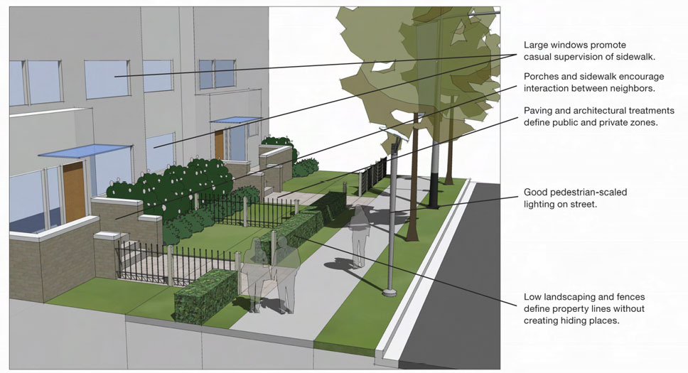

Slide 21
How Does This Translate To Reducing Violence?
Consider environmental attributes that…
  Make it easier to perpetrate violence (e.g., facilitate perpetration)
  Reinforce social norms that condone violence
  Make it harder to surveil for violent/abusive situations, such as in schools and clinics
  Make it harder for people to seek help

Slide 22
How Does This Translate To Reducing Violence?
Consider environmental attributes that…
  Make it harder to perpetrate violence
  Reinforce social norms that condone consent, conflict resolution, and healthy relationships
  Make it easier to surveil for violent/abusive situations, such as in schools and clinics
  Make it easier for people to seek help

Slide 23
Assessing Physical Safety
Needs Assessment in Specific Locations
  Mapping activities (red/yellow/green) with community members; works especially well in schools
  On-site, quick “pop up” interviews with people
  CPTED physical space checklists
    Use volunteers to assess physical safety of spaces using a CPTED checklist. Where can violence/abuse be hidden out of sight?
Notes:
The goal is to identify gaps and risk factors, as well as existing protective factors that can be leveraged.

Slide 24
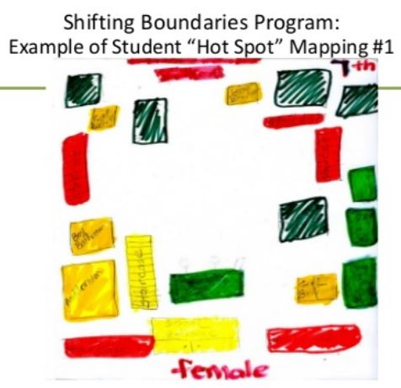
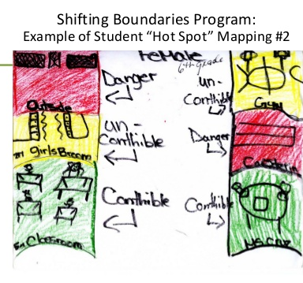

Slide 25
Assessing Physical Safety
Community-Wide Assessment
  Do public spaces, such as parks and community college campuses, use CPTED principles?
  Are there accessible, safe public spaces for healthy, fun child-parent visitation for
  DCS-involved families?
  Do public housing facilities include a central courtyard or other features to facilitate communal child-watching, and natural surveillance to prevent or quickly intervene in abusive situations?
  Do public drinking spaces have policies and practices that facilitate aggression?
Notes:
The goal is to identify gaps and risk factors, as well as existing protective factors that can be leveraged.

Slide 26
Takeaways
Harm reduction tends to focus on risk factors
Public health goals can be better met when we minimize risk factors AND maximize protective factors
To build protective environments…
  Think about individual/relational risk and protective factors.
  Think about how the environment facilitates these factors; what could change?
  Include safety assessment of physical space

Slide 27
Thank you!
Questions?
Elise Lopez, DrPH, MPH
Director
UA Consortium on
Gender-Based Violence
University of Arizona
eclopez@email.Arizona.edu

