Slide 1


Person-Centered Reproductive Desires Counseling Workshop
September 23, 2024
Patty Cason, MS, FNP-BC
Assistant Clinical Professor UCLA School of Nursing
www.path-framework.com
Patty@maddala.com

Slide 2
Disclosures
  Advisory Board/Consultant
    Sebela
  Trainer/speaker
    Organon
    Merck
Developed the PATH questions and ASA Cycles
She receives no monetary compensation for this intellectual property
It is fully and freely in the public domain

Slide 3
Learning Objectives
Describe the PATH questions to discuss reproductive desires with clients
Demonstrate use of Affirm/Share/Ask cycles
Address reproductive desires with people of all genders
Demonstrate skillful, efficient, person-centered questioning

Slide 4
Learning Objectives
Discuss the potential impact of using the word “planned pregnancy” when discussing reproductive desires
List 6 relevant characteristics about contraception

Slide 5

INTRODUCTIONS

Slide 6
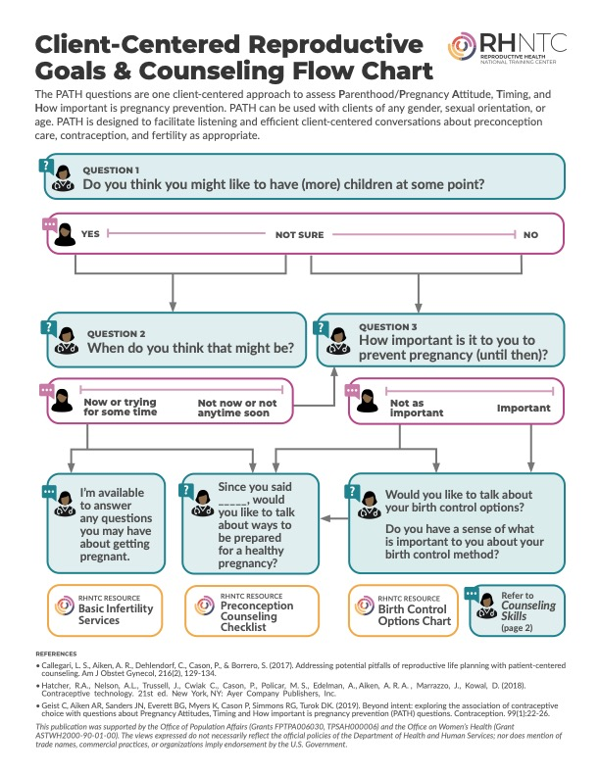

Slide 8
https://www.fpntc.org/sites/default/files/resources/fpntc_eff_qs_path_card_2019-03.pdf

Slide 9
https://www.fpntc.org/sites/default/files/resources/fpntc_preconcptn_counsel_chklst_2019-06.pdf

Slide 10
What is the goal of reproductive health counseling?
Help clients clarify what they want or need
Facilitate discussion
Provide relevant information
Offer services
(Callegari 2017 | Stevens 2015 | Dehlendorf 2016)

Slide 11
Active Listening
“It is called “active” because the listener has a very definite responsibility. He does not passively absorb the words which are spoken to him. He actively tries to grasp the facts and feelings in what he hears, and he tries, by his listening, to help the speaker work out his own problems.”
Rodgers, C. (2015)
Notes:
Rogers C, Farson R. Active Listening. Connecticut: Martino Publishing, 2015.

Slide 12
Shared Decision Making
“…clinicians provide patients with information about all the (relevant) options and help them to identify their preferences in the context of their values.”
(Fried, 2016 | Chewning, 2012)
Notes:
Fried, T. R. (2016). Shared Decision Making--Finding the Sweet Spot. N Engl J Med, 374(2), 104-106. doi:10.1056/NEJMp1510020
Chewning, B., Bylund, C. L., Shah, B., Arora, N. K., Gueguen, J. A., & Makoul, G. (2012). Patient preferences for shared decisions: a systematic review. Patient Educ Couns, 86(1), 9-18. doi:10.1016/j.pec.2011.02.004

Slide 13
Shared Decision Making
Patient Contribution:
Provider Contribution:
Their values
Their preferences
Their goals
Their past experiences
Friends, family and community experiences
Assist in clarifying patient’s goals and preferences
Provide scientific/medical information that is:
      relevant
      assimilated/integrated by the patient

Slide 14

PATH
QUESTIONS
(Contraceptive Technology 22nd ed. 2023 | Contraception 2023 | Annals of Internal Medicine 2023 | Health Services Research 2022 | JAMA Pediatrics 2022 | Likes 2022 | CDC 2021 | SFP 2020 | Hatcher 2018 | Contraception 2019 |Am J Obstet Gynecol 2017)

Slide 15
PATH Questions
PA: Parenting/Pregnancy Attitudes:
Do you think you might like to have (more) children at some point?
T: Timing: When do you think that might be?
H: How Important: How important is it to you to prevent pregnancy (until then)?

Slide 16
PA: Parenting/Pregnancy Attitudes:
“Do you think you might like to have (more) children at some point?”
“YES…” or open to it
THEN ASK:
T: When do you think that might be?
Answers that indicate no time soon, then ASK:
H: How Important: How important is it to you to prevent pregnancy (until then)?

Slide 17
When can you skip the timing question?
T: Timing: When do you think that might be?
When they have already given a timeframe during their reply to “do you think you might like to have (more) children at some point?”
Younger Teens
If the answer to the first question is NO

Slide 18
If you don’t know, don’t assume
“I don’t want to make any assumptions but if you ever have sex with someone with whom pregnancy could happen…
H: How Important: How important is it to you to prevent pregnancy (until then)?”

Slide 19
H: How Important
Individualize the question
H: How important is it to you to prevent pregnancy________________________:
until then (for teens and if you have no other information)
until you are out of school
for the next 5 years
until you’re married
(Valdez, 2019)

Slide 20
T:Timing “Now”
PA: Parenting/Pregnancy Attitudes
Do you think you might like to have more children at some point?
“Yes, we’ve been trying for a while actually.”
T: Timing When do you think that might be?
H: How Important: How important is it to you to prevent pregnancy (until then)?

Slide 21
“Now”
Do you think you might like to have more children at some point?
“Yes, we’ve been trying for a while actually.”
“So would you like to discuss ways to be prepared for a healthy pregnancy?”

Slide 22
“Now”
Do you think you might like to have more children at some point?
“Yes, we’ve been trying for a while actually.”
“I’m available to answer any questions you may have about pregnancy.”

Slide 23


Offer Contraceptive Services
“So, would you to talk more about options for contraception?”
“It’s very important to me to not get pregnant right now”
“Since you’ve said this is important to you, would you to talk more about options for contraception?”

Slide 24
Offer Preconception Care
“ IF it happens, it happens”
“would you like to discuss ways to be prepared for a healthy pregnancy?”

Slide 25
Offer both preconception care & Contraceptive services
“I’M HEARING YOU SAY THAT IDEALLY YOU DON’T WANT ANY MORE CHILDREN RIGHT NOW, BUT IF YOU WERE TO GET PREGNANT, YOU’D BE OK WITH THAT, TOO.
“ IF it happens, it happens”
“IN THAT CASE, WOULD YOU LIKE TO TALK ABOUT WAYS TO PREVENT PREGNANCY, AND ALSO HOW TO BE PREPARED FOR A HEALTH PREGNANCY IF IT DID HAPPEN?

Slide 26
Language is key!
Use open-ended focused questions
Use open ended time-frames— “at some point”
Ask “to you” instead of “for you”
"Important" not "Most important"
Avoid plan-based questions

Slide 27

Time to Practice

Slide 28

debrief

Slide 29
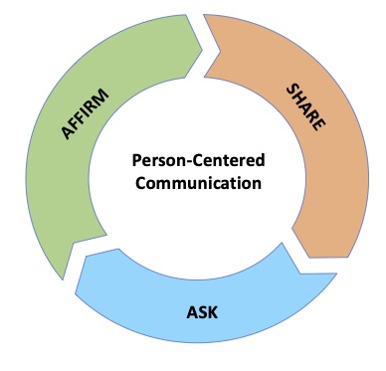
Affirm – Share – Ask
(ASA) Cycle

Slide 30

AFFIRM/
Acknowledge

Slide 31

1st step
START with either:
Display of empathy
Validation
Strength-based positive
Agreement

Slide 32
Empathy Without Labeling Feelings
Rather than using a negative label:
“You sound angry” (or anxious)
Use neutral words:
“It sounds like this is really concerning to you”
“Wow, anyone would find that really hard to deal with!”
“Wow…”
Not: “I know how you feel.”
(Hatcher. 2018)
Notes:
Hatcher, R.A., Nelson, A.L., Trussell, J., Cwiak C., Cason, P., Policar, M. S., Edelman, A., Aiken, A. R. A. , Marrazzo, J., Kowal, D. (2018). Contraceptive technology. 21st ed. New York, NY: Ayer Company Publishers, Inc.

Slide 33
Try NOT to Correct or disagree
“Find the YES”
First step is to find something in what the client is saying to agree with or support
Avoid saying “No” or “But”
“Yes! …. And_____________”

Slide 34
Point out “Strengths-based” positives
Point out behaviors that they are proud of, not that they are complying with what they are supposed to do. For example:
  They are adherent to a treatment plan that they have chosen
  Quit smoking
  Negotiate consistent condom use

Slide 35
Validation
“I hear that all the time!”
“I can understand why you would think that!”
“Lots of people have that question.”
“I was confused about that too!”
“Anyone would have found that hard to deal with!”
“Many clients I see wonder about that too”
“Yeah, that's a great way to put it. I wouldn't have thought about it that way.”

Slide 36

SHARE
Information

Slide 37
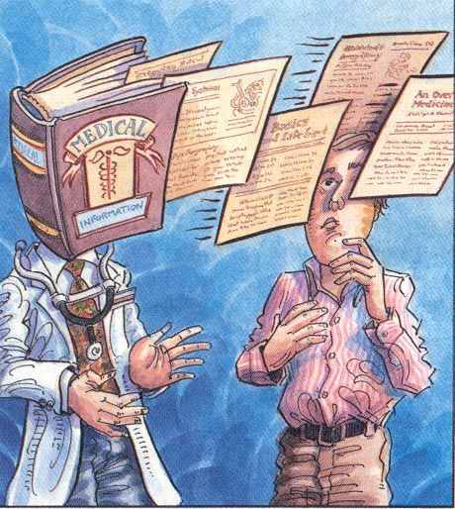
Support Integration of New Knowledge
Present information that is relevant to the individual
Use plain language
Limit the amount of information
Use the patient’s words
5 out of 100 people rather than 5%

Slide 38
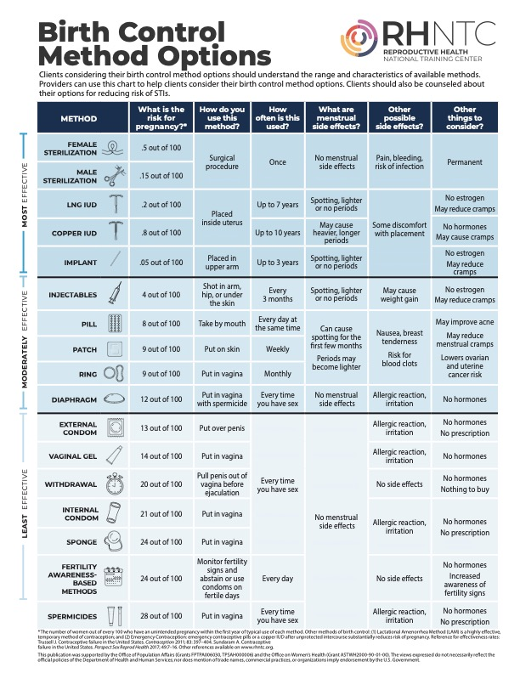

Slide 39
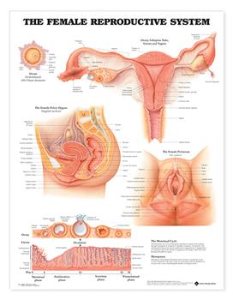
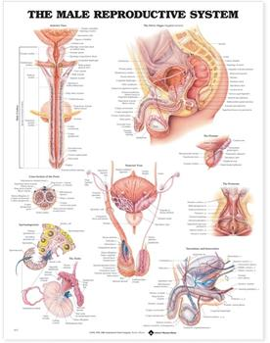

Slide 40
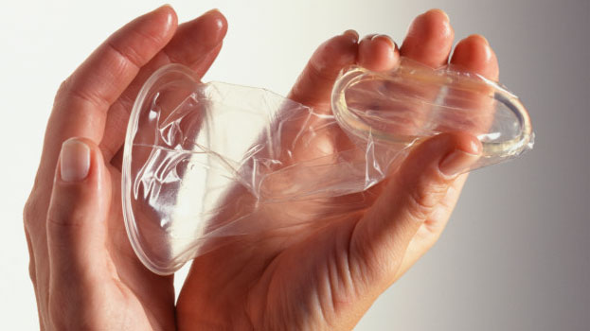

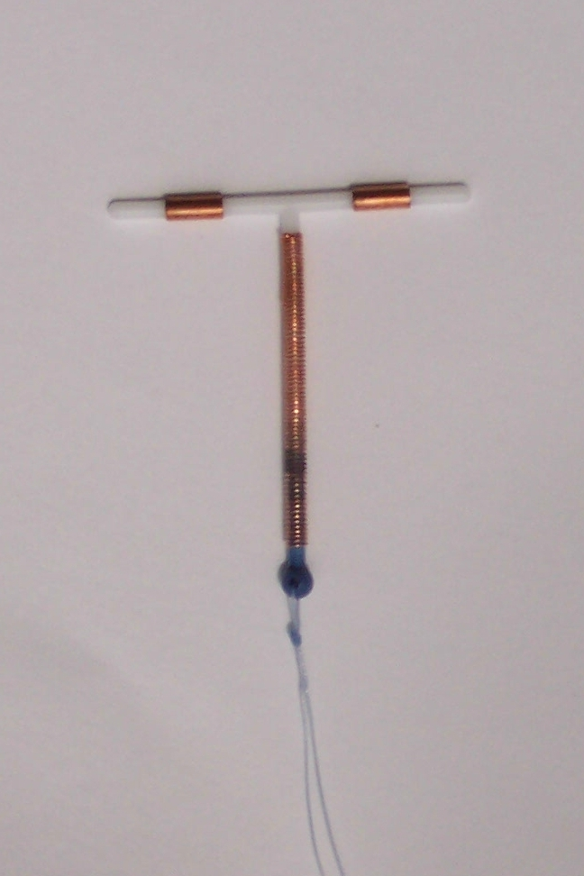
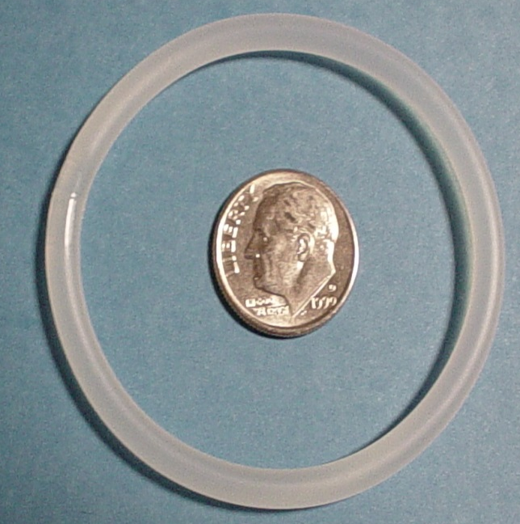
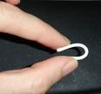
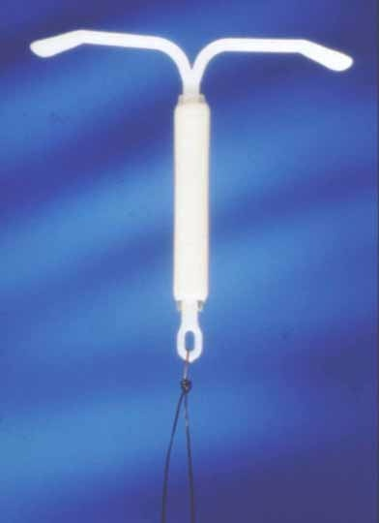
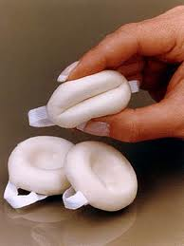

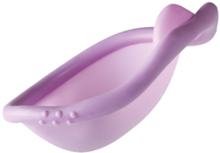
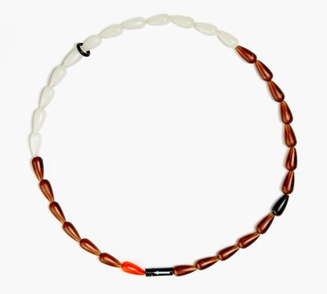
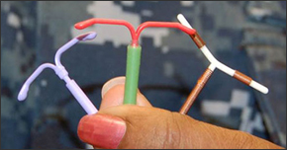
Use Tactile Aids

Slide 41

ASK a Follow Up Question

Slide 42
A follow up question requires the client to Integrate Information
How would that be for you?
Has that ever happened before?
How did you manage it?
Do you have a sense of how you would manage it?
Knowing that, how would it be?
(Hatcher. 2018)
Notes:
Hatcher, R.A., Nelson, A.L., Trussell, J., Cwiak C., Cason, P., Policar, M. S., Edelman, A., Aiken, A. R. A. , Marrazzo, J., Kowal, D. (2018). Contraceptive technology. 21st ed. New York, NY: Ayer Company Publishers, Inc.

Slide 43
What QUESTIONS do you have about___________?
Better than: “Do you have any questions?”
Better than: “What questions do you have?”

Slide 44
Time to Practice

Slide 45

De-brief

Slide 46
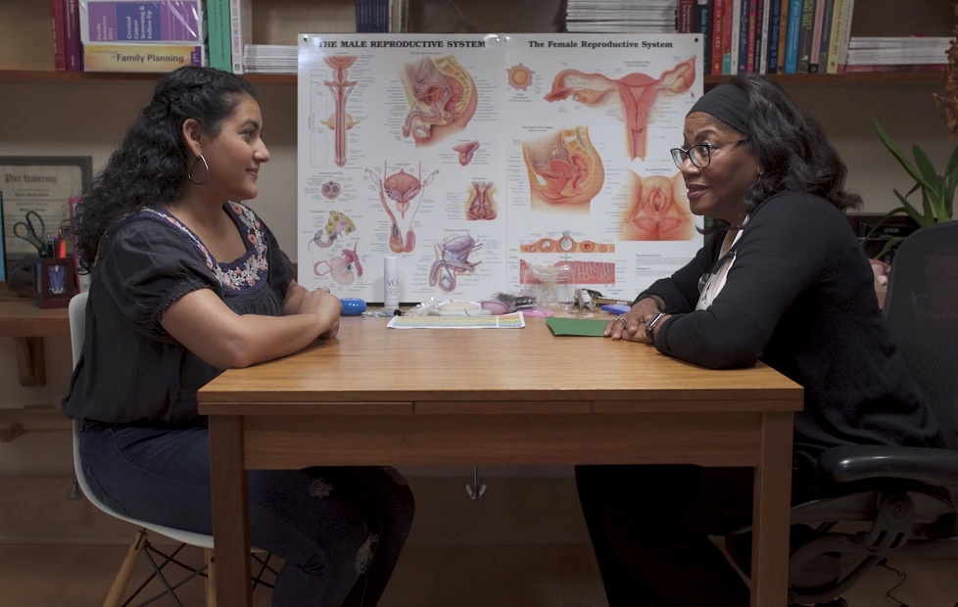
Question for Contraception Counseling
“Can you tell me something that is important to you about your contraception?”
“What else are you looking for?”

Slide 47
Question for Contraception Counseling
“It sounds like you would like birth control that works very well to prevent pregnancy”
“What else is important to you?”

Slide 48
“For example___ is that important to you?”
Characteristic | Plain Language
Effect on the menstrual cycle/bleeding profile | “How this might change your period”
Ability to use the method confidentially | “Some methods are easier to hide than others.”
Avoiding methods that require “supplies”
Needing a bleeding pattern that is unchanged | “No change in when your period comes”
Return to fecundity | “Once you stop using ___ , your ability to get pregnancy goes back to whatever is normal for you” (for all methods except DMPA)
Non-contraceptive benefits | “Things contraception can do you for in addition to preventing pregnancy”

Slide 49
“For example…”
Characteristic | Plain Language
Effectiveness | “how well it works to prevent pregnancy”
Sexual Acceptability | “effect on your sexual life/sexuality”
A foreign object in the body | “this method is placed in your uterus/arm/vagina”
Control over discontinuation/removal | “can you stop the method without a provider visit?”
Hormones, whether or not and which ones
Length of (potential) use | “This methods is good for up to x amount of time”

Slide 50
Time to Practice

Slide 51
De-brief

Slide 52

Paraphrasing
“It sounds like you’re not interested in kids any time soon with so much on your plate! Do I have that right?”
“I am hearing you say you would love a method you can forget about and can help with your periods. Is that correct?”
“Many of my patients say you they’re concerned with weight gain with hormonal birth control. Is that what you mean?”
Notes:
Hatcher, R.A., Nelson, A.L., Trussell, J., Cwiak C., Cason, P., Policar, M. S., Edelman, A., Aiken, A. R. A. , Marrazzo, J., Kowal, D. (2018). Contraceptive technology. 21st ed. New York, NY: Ayer Company Publishers, Inc.

Slide 53
Reflective Listening/Paraphrasing /Rephrasing
Has 3 parts
Introduce that you are going to be reflecting back to them what they have said.
So, I’m hearing you say…
It sounds like…
Am I right that…

Slide 54
Reflective Listening/Paraphrasing /Rephrasing
2) reflection
Listen to client and rephrase the content of what they have said:
This is your best expression of what you have heard the person say or what you know based on the visit & what you know about them
Not a repetition
A reflection of what they meant
The reflection may be used to summarize as the patient moves toward decision making.
GATHER technique
Notes:
Hatcher, R.A., Nelson, A.L., Trussell, J., Cwiak C., Cason, P., Policar, M. S., Edelman, A., Aiken, A. R. A. , Marrazzo, J., Kowal, D. (2018). Contraceptive technology. 21st ed. New York, NY: Ayer Company Publishers, Inc.

Slide 55
Reflective Listening/Paraphrasing /Rephrasing
3) check for accuracy
They know you have heard them
Gives them the opportunity to correct, clarify, or confirm your reflective listening.
Builds rapport by demonstrating that you are listening and that you care about what is important to them
If they correct you --because you didn’t get it exactly right --this is an opportunity to show the client that your priority is understanding, not being right
Helps patients clarify what matters to them
Notes:
Hatcher, R.A., Nelson, A.L., Trussell, J., Cwiak C., Cason, P., Policar, M. S., Edelman, A., Aiken, A. R. A. , Marrazzo, J., Kowal, D. (2018). Contraceptive technology. 21st ed. New York, NY: Ayer Company Publishers, Inc.

Slide 56
Reflective Listening/Paraphrasing /Rephrasing
Benefits
Shows that you are listening
Demonstrates that you are on their side
Gives clients the opportunity to hear their own priorities, preferences, and desires spoken out loud.
Allows you to synthesize various things they have said or to put an interpretation or spin on the information & then extend the learning from there as a jump off point
Allows you to be efficient and control the length and focus of the conversation
Notes:
Hatcher, R.A., Nelson, A.L., Trussell, J., Cwiak C., Cason, P., Policar, M. S., Edelman, A., Aiken, A. R. A. , Marrazzo, J., Kowal, D. (2018). Contraceptive technology. 21st ed. New York, NY: Ayer Company Publishers, Inc.

Slide 57
“Many of my patients say _____”
This phrase is akin to reflective listening, but you are not actually reflecting or rephrasing, you are speculating on what you think they might mean.
Floating the idea
Way to efficiently move towards understanding
Fill in with your best guess
“Many of my clients say you they’re concerned with weight gain with hormonal birth control. Is that what you mean?”
“Many of my clients are worried about pain with an IUD placement. Is that part of your concern?”

Slide 58
On the one hand, on the other hand
Working with ambivalence
This is a type of reflective listening
Helpful when clients appear to be experiencing ambivalence
Tension between competing feelings/thoughts/obstacles/needs
  Want vs Should
  Head vs Heart
  Beliefs vs Circumstances
  Acknowledge that these feelings and thoughts are common and normal
On the one hand reflect the stated goal, on the other hand reflect the behavior or obstacle that may be getting in the way

Slide 59
Teach Back
“I’ve just gone over a ton of information and I’m not always as clear as I would like to be...
“Just to be sure I didn’t forget to tell you something...
...can you tell me how you are going to take generic Aleve before your period starts to lessen your bleeding with the copper IUD?”

Slide 60
Time to Practice

Slide 61
De-brief

Slide 62

Pregnancy Planning:
A very deliberate act
Two partners; Both partners discuss and reach consensus about the timing of pregnancy
They then take concrete steps to prepare for pregnancy including “getting your finances in order”
(Gomez 2021 | Arteaga 2019 | Aiken 2016 | Aiken 2015 | Borrero 2015)
Notes:
Aiken, A. R., Borrero, S., Callegari, L. S., & Dehlendorf, C. (2016). Rethinking the Pregnancy Planning Paradigm: Unintended Conceptions or Unrepresentative Concepts? Perspect Sex Reprod Health, 48(3), 147-151. doi:10.1363/48e10316
Aiken, A. R., Potter, J. E. (2013). Are Latina women ambivalent about pregnancies they are trying to prevent? Evidence from the Border Contraceptive Access Study. Perspect Sex Reprod Health 45(4):196–203.
Borrero, S., Nikolajski, C., Steinberg, J. R., Freedman, L., Akers, A. Y., Ibrahim, S., & Schwarz, E. B. (2015). "It just happens": a qualitative study exploring low-income women's perspectives on pregnancy intention and planning. Contraception, 91(2), 150-156.
Aiken, A. R., Dillaway, C., & Mevs-Korff, N. (2015). A blessing I can't afford: factors underlying the paradox of happiness about unintended pregnancy. Soc Sci Med, 132, 149-155. doi:10.1016/j.socscimed.2015.03.038

Slide 63
Why avoid asking about pregnancy planning?
A planned behavior perspective may be limiting, inappropriate, and triggering among low-income populations
“Planned pregnancy” has a meaning
Many people express happiness with a pregnancy, regardless of their intention
A pregnancy doesn’t need to be planned to be healthy
The goal is to have pre-pregnancy care be relevant
(Gomez 2021 | Arteaga 2019 | Aiken 2013 | Dehlendorf 2016 | Aiken 2016 | Aiken 2015 | Borrero 2015 | Edin 2005 |Gomez 2019 )
Notes:
Aiken, A. R., Borrero, S., Callegari, L. S., & Dehlendorf, C. (2016). Rethinking the Pregnancy Planning Paradigm: Unintended Conceptions or Unrepresentative Concepts? Perspect Sex Reprod Health, 48(3), 147-151. doi:10.1363/48e10316
Aiken, A. R., Potter, J. E. (2013). Are Latina women ambivalent about pregnancies they are trying to prevent? Evidence from the Border Contraceptive Access Study. Perspect Sex Reprod Health 45(4):196–203.
Borrero, S., Nikolajski, C., Steinberg, J. R., Freedman, L., Akers, A. Y., Ibrahim, S., & Schwarz, E. B. (2015). "It just happens": a qualitative study exploring low-income women's perspectives on pregnancy intention and planning. Contraception, 91(2), 150-156.
Aiken, A. R., Dillaway, C., & Mevs-Korff, N. (2015). A blessing I can't afford: factors underlying the paradox of happiness about unintended pregnancy. Soc Sci Med, 132, 149-155. doi:10.1016/j.socscimed.2015.03.038

Slide 64
Pregnancy Planning:
“Few, if any, actually achieved either relationship or financial stability so Pregnancy planning seemed irrelevant and rarely occurred”
(Gomez 2021 | Borrero 2015)
Notes:
Aiken, A. R., Borrero, S., Callegari, L. S., & Dehlendorf, C. (2016). Rethinking the Pregnancy Planning Paradigm: Unintended Conceptions or Unrepresentative Concepts? Perspect Sex Reprod Health, 48(3), 147-151. doi:10.1363/48e10316
Aiken, A. R., Potter, J. E. (2013). Are Latina women ambivalent about pregnancies they are trying to prevent? Evidence from the Border Contraceptive Access Study. Perspect Sex Reprod Health 45(4):196–203.
Borrero, S., Nikolajski, C., Steinberg, J. R., Freedman, L., Akers, A. Y., Ibrahim, S., & Schwarz, E. B. (2015). "It just happens": a qualitative study exploring low-income women's perspectives on pregnancy intention and planning. Contraception, 91(2), 150-156.
Aiken, A. R., Dillaway, C., & Mevs-Korff, N. (2015). A blessing I can't afford: factors underlying the paradox of happiness about unintended pregnancy. Soc Sci Med, 132, 149-155. doi:10.1016/j.socscimed.2015.03.038

Slide 65
Desires pregnancy
Strength of desire to avoid pregnancy

Slide 66
Desires pregnancy
Wants to avoid pregnancy
Strength of desire to avoid pregnancy

Slide 67
Desires pregnancy
Ambivalent
Wants to avoid pregnancy
Strength of desire to avoid pregnancy

Slide 68
Desires pregnancy
Ambivalent
Indifferent
Wants to avoid pregnancy
Strength of desire to avoid pregnancy

Slide 69
Desires pregnancy
Ambivalent
Offer Preconception Counseling
Indifferent
Wants to avoid pregnancy
Strength of desire to avoid pregnancy

Slide 70
Desires pregnancy
Ambivalent
Offer Preconception Counseling
Offer Preconception Counseling
Indifferent
Wants to avoid pregnancy
Strength of desire to avoid pregnancy

Slide 71
Desires pregnancy
Ambivalent
Offer Preconception Counseling
Consider Offering Preconception Counseling
Offer Preconception Counseling
Indifferent
Wants to avoid pregnancy
Strength of desire to avoid pregnancy

Slide 72
Desires pregnancy
Ambivalent
Offer Preconception Counseling
Consider Offering Preconception Counseling
Offer Preconception Counseling
Carefully Consider Preconception Counseling
Indifferent
Wants to avoid pregnancy
Strength of desire to avoid pregnancy

Slide 73
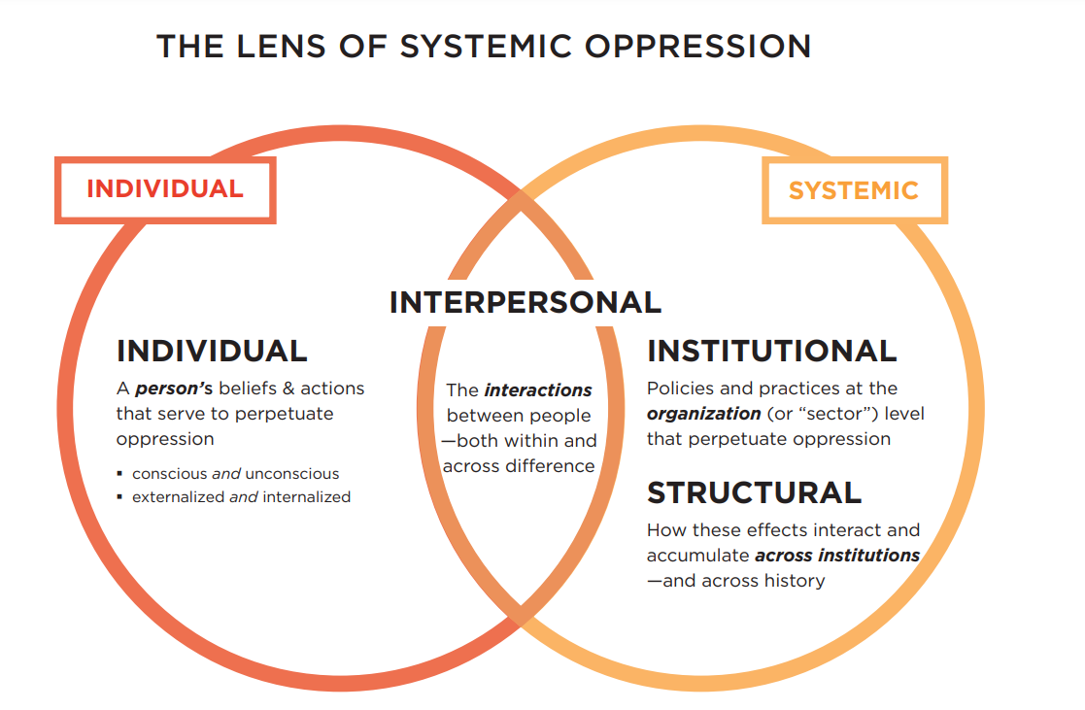

Slide 74
Resources
Specific to trainings on Implicit bias and structural racism with focus on education:
https://www.nationalequityproject.org/
https://static1.squarespace.com/static/5e32157bff63c7446f3f1529/t/5f173bc8da7d1115210824c0/1595358153358/National-Equity-Project-Implicit-Bias.pdf
Reference to intersectional RJ frameworks & policies
https://californialatinas.org/about-us/what-we-do/
For more organizational unlearning/reflection on structural/interpersonal racism
https://www.afroresistance.org/capacity-building-and-training

Slide 75
Time to Practice

Slide 76
De-brief

Slide 77

SUMMARY & REFLECTIONS

Slide 78

Time to practice

Slide 79



Movie time
Notes:
https://www.path-framework.com/path-training-videos
https://www.nationalfamilyplanning.org/telehealth-video-guide

