Slide 1
Use the Least Invasive, High-Quality Recommended Laboratory Technologies for Chlamydia Screening, with Timely Turnaround
Chlamydia Screening Change Package
Best Practice 3
December 19, 2018
Last Updated March 2018
Notes:
Welcome everyone to the session.
Today we will be discussing using the least invasive, high-quality recommended laboratory technologies for chlamydia screening, with timely turnaround.

Slide 2
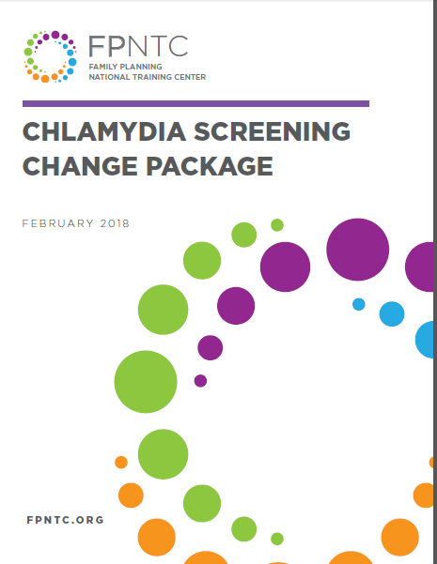
Best Practice 3 of the Chlamydia Screening Change Package
Include screening as part of routine care
Use normalizing and opt-out language
Use least invasive, high-quality test
Reduce cost as a barrier
Link: https://www.fpntc.org/resources/chlamydia-screening-change-package
Notes:
Over the past several years, the recommendations for pelvic exams and pap testing have changed; an annual pelvic exam and pap test are no longer recommended routinely for all clients.
Test technologies and national recommendations now allow for screening without a pelvic exam, which allows for additional options.
Today’s focus is on Best Practice 3: using the least invasive, high-quality recommended laboratory technologies for chlamydia screening, with timely turnaround. The best practice includes making all optimal urogenital specimen types available, including self-collected vaginal swabs for women. This is the third best practice outlined in the Chlamydia Screening Change Package.
Source (for reference)
Chlamydia Screening Change Package https://www.fpntc.org/resources/chlamydia-screening-change-package

Slide 3
Meeting Objectives
By the end of today, you should be able to:
Describe the current recommended laboratory technologies for chlamydia screening (for women and men)
Identify at least two options for specimen collection for women
Identify at least two strategies for streamlining the specimen collection process at your health center
Notes:
Here’s what we’re planning to cover on today’s call. Today we’ll:
First describe the current recommended laboratory technologies for chlamydia screening. While our focus is on female patients, we will also talk about recommended screening options for men.
Then we’ll have the chance to discuss implementing these options and strategies for streamlining the specimen collection processes at your health center
We’ll also share some examples of resources, such as patient instructions that you can adapt for your site.

Slide 4
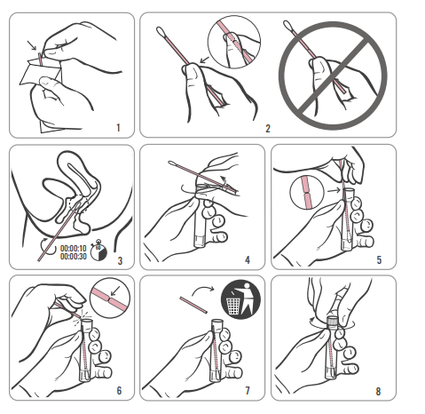
Overview of Strategies
Make client-collected screening options available
Establish routine clinic flow processes and systems for routine screening
Procure lab services with timely turnaround
Establish recall systems to retest clients three months after treatment of a positive result
Notes:
At a high level, the strategies for this best practice recommendation are to:
Make client-collected screening options available
Establish routine clinic flow processes for screening
Procure lab services with timely turnaround
Establish recall systems to retest clients three months after treatment

Slide 5
Evidence
Shafer et al.—Proportion of positives identified by specimen type for C. trachomatis were:
Endocervix 65%
Urine72%
Vagina 81%
Schacter et al.—Among CT+ women NAAT sensitivity:
Endocervix 91%
Urine 80%
Vagina 93%
Notes:
First, why are we even discussing this? There is sometimes some confusion about why we’d even want to consider different specimen types.
The advantage of using urine over endocervical specimens is clear: it is a way to screen without having do to a pelvic exam
But, the advantages to using vaginal swabs – especially the self-collected vaginal swab option – and how it compares to the other options, isn’t always quite as clear. So, lets start with the evidence.
Shafter et al did a study of a large and diverse national sample of non-health-care-seeking young women entering the military; they sought to compare the abilities of three different techniques of collecting specimens (first-void urine, self-collected vaginal swab, and clinician-collected endocervical swab) to identify a positive specimen. The proportion of positives identified by specimen type for C. trachomatis were:
Endocervix 65%
Urine 72%
Vagina 81%
Schachter et al. conducted another multi-center study, they assumed that because self-collected vaginal swabs (VS) were potentially very useful for screening asymptomatic women for Chlamydia trachomatis infection, they wanted to determine whether VS are equal; so among CT + women (by culture) they compared the NAAT sensitivity using the following specimen types and found:
Endocervix 91%
Urine 80%
Vagina 93%
Source:
Shafer et al. JOURNAL OF CLINICAL MICROBIOLOGY, Sept. 2003,
Schachter et al. JOURNAL OF CLINICAL MICROBIOLOGY, Aug. 2003

Slide 6
Specimen Collection Using NAATs
CDC STD Treatment Guidelines, 2015:
C. trachomatis urogenital infection can be diagnosed in women by:
Testing first-catch urine
Collecting swab specimens from the endocervix or vagina
A self- or clinician-collected vaginal swab is the recommended sample type
An endocervical swab is acceptable
A first-catch urine specimen is acceptable
Link: https://www.cdc.gov/std/tg2015/
Notes:
The recommendations from CDC’s 2015 STD Treatment Guidelines include the recommended and acceptable test technologies.
The gold standard for diagnostic testing of chlamydia and gonorrhea is the nucleic acid amplification test (referred to as NAAT).
The 2015 STD Treatment Guidelines recommendation for women is: first-catch urine or collecting swab specimens from the endocervix or vagina using a NAAT.
A self- or clinician-collected vaginal swab is the recommended sample type, which may be performed by the client herself or by the provider during a pelvic exam.
A first-catch urine specimen is an acceptable specimen type for screening of both men and women. Although first void urine was the least sensitive sampling method, it is also the least invasive method.
Urine is the preferred specimen type for testing males with NAATs.
Previous evidence suggests that the liquid-based cytology specimens collected for Pap smears might be acceptable specimens for NAAT testing, although test sensitivity using these specimens may be lower than that
associated with use of cervical or vaginal swab specimens.
The CDC states that for NAAT testing in females that vaginal self-swabs are the specimen of choice. Vaginal swabs and cervical are equal in sensitivity/specificity. Vaginal is preferred over cervical swab because it is less invasive and does not require a pelvic exam by clinician. Female urine specimen is acceptable but may have reduced performance compared to genital swabs.
Although vaginal swabs are the recommended sample type, a urine specimen is also acceptable if it supports other clinic efficiency goals.
Sources (for reference)
https://www.cdc.gov/std/laboratory/2014labrec/default.htm
https://www.cdc.gov/std/tg2015/

Slide 7
Extragenital Screening (Kent, Chaw, Wong 2003)
A 2003 study that assessed NAATs for CT/GC infections in multiple anatomic sites in MSM in STD Clinic used BD ProbeTec NAAT test
More than half (53%) of C. trachomatis and 64% of N. gonorrhoeae infections were at nonurethral sites and would have been missed if the traditional approach to screening
Kent CK, Chaw JK, Wong W, et al. Prevalence of rectal, urethral, and pharyngeal chlamydia and gonorrhea detected in 2 clinical settings among men who have sex with men: San Francisco, California, 2003. Clin Infect Dis 2005;41:67–74.
Notes:
A common question asked about specimen collection is whether to do extragenital screening.
In a study by Kent et al: Among 6,434 MSM attending an STD clinic or a gay men’s clinic, the study found that the prevalence by site for C. trachomatis was 7.9% for the rectum, 5.2% urethral, and 1.4% pharyngeal was 6.9% for the rectum, 6% urethral, and 9.2% pharyngeal. The great majority (84%) of the gonococcal and chlamydial rectal infections were asymptomatic.
Source
Kent CK, Chaw JK, Wong W, et al. Prevalence of rectal, urethral, and pharyngeal chlamydia and gonorrhea detected in 2 clinical settings among men who have sex with men: San Francisco, California, 2003. Clin Infect Dis 2005;41:67–74.

Slide 8
Extragenital Screening (cont.)
No recommendations for routine extragenital screening in women because studies have focused on genitourinary screening, but rectal and oropharyngeal infections are not uncommon. Routine oropharyngeal screening is not recommended.
Infections are common in extragenital sites in certain populations, such as MSM.
Routine annual screening of extragenital sites in MSM is recommended because extragenital infections are common in MSM, and most infections are asymptomatic
Notes:
At this time, routine oropharyngeal screening is not recommended for women.
Rectal and oropharyngeal C. trachomatis infection in persons engaging in receptive anal or oral intercourse can be diagnosed by testing at the anatomic site of exposure.
Infections are common in extragenital sites in certain populations, such as men who have sex with men (MSM). Because extragenital infections are common in MSM, and most infections are asymptomatic, routine annual screening of extragenital sites in MSM is recommended.

Slide 9
Screening men
Although evidence is insufficient to recommend routine screening for C. trachomatis in sexually active young men because of several factors (e.g., feasibility, efficacy, and cost-effectiveness), the screening of sexually active young men should be considered in clinical settings with a high prevalence of chlamydia (e.g., adolescent clinics, correctional facilities, and STD clinics) or in populations with high burden of infection (e.g., MSM).
Source: https://www.cdc.gov/std/tg2015/chlamydia.htm
Notes:
Another common question, is why there isn’t more of a focus is not on screening all young men –as this is, obviously, where most young women get their infections.
Although evidence is insufficient to recommend routine screening for C. trachomatis in sexually active young men because of several factors (e.g., feasibility, efficacy, and cost-effectiveness), the screening of sexually active young men should be considered in clinical settings with a high prevalence of chlamydia (e.g., adolescent clinics, correctional facilities, and STD clinics) or in populations with high burden of infection

Slide 10
Establish Clinic Flow Processes and Systems
Develop a protocol for the collection of a self-collected specimen from clients for express visits
Use all accepted options for specimen collection—including urine and self-collected vaginal swab
Provide clear instructions on how to collect a vaginal or urine sample properly
Assess efficiency of clinic systems and identify opportunities for improvement
Notes:
One of the most important strategies you can work toward when using the least invasive, high-quality recommended laboratory technologies is to establish routine clinic flow processes and systems for routine screening.
You can do this by:
Systematizing the collection of a self-collected specimen from clients for express visits
Developing a protocol for a standardized clinic workflow to ensure access to screening with self-collected vaginal swabs as default care for clients 24 years of age and younger
Using all accepted options for specimen collection—including urine and self-collected vaginal swab
Providing instructions on how to collect a vaginal or urine sample properly
Assess efficiency of clinic systems, including specimen collection, and identify opportunities for improving clinic flow and increasing efficiencies

Slide 11
Instructions for Client
“We can test from a swab you put in your vagina yourself or we can test from urine. The vaginal swab is preferred because it seems to be a bit more accurate than urine testing.”
“To do the test, put the cotton end of this swab 2-3 inches into your vagina and swish it around for about 30 seconds, making sure it hits the walls of your vagina. Then put the cotton end of the swab into the tube.”
Notes:
Provide instructions to the client on how to properly collect a vaginal or urine sample.
Here is an example of the instructions to give:
“We can test from a swab you put in your vagina yourself or we can test from urine. The vaginal swab is preferred because it seems to be a bit more accurate than urine testing. To do the test, put the cotton end of this swab 2-3 inches into your vagina and swish it around for about 30 seconds, making sure it hits the walls of your vagina. Then put the cotton end of the swab into the tube.”
Making sure staff is comfortable providing clear instructions will be critical to successful and widespread use of self-collected swabs.

Slide 12
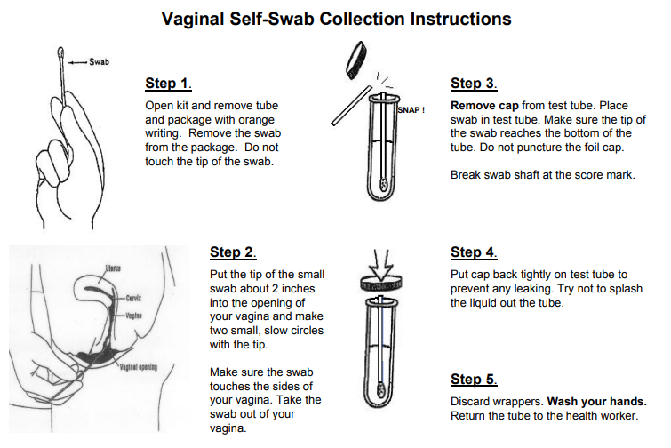
Sample Instructions
http://www.sfcityclinic.org/providers/
Notes:
Posting clear patient instructions is a good idea
Here’s an example of patient instructions for collecting a self swab from the San Francisco City Clinic
They also have sample instructions for Pharyngeal Swab, Rectal Self-Swab Collection, as well as this Vaginal Self-Swab Collection
All of their samples are in English and Spanish

Slide 13
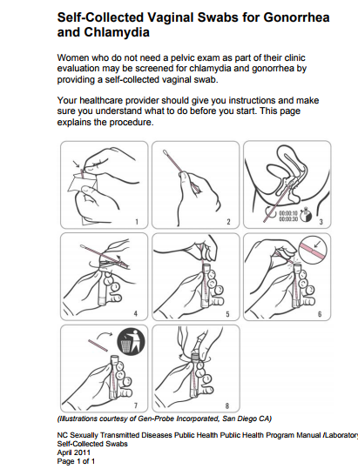
Client Education Resources
Instructions for Self-Collected Vaginal Swabs (NC Public Health)
STD/STI Patient Education (available in English and Spanish)
Notes:
There are also additional other sample instructions for self-collected vaginal swabs, here – available from North Carolina Public Health
The Clinical Training Center for Family Planning has other client education materials for reference
Sources (for reference)
Instructions for self-collected vaginal swabs http://epi.publichealth.nc.gov/cd/lhds/manuals/std/labtesting/selfcollectedswabs.pdf
STD/STI Patient Education (English and Spanish) https://www.fpntc.org/resources/sti-patient-education-tool

Slide 14
Success Story: Nevada Health Centers
Introduced vaginal swabs for chlamydia screening
Adjusted the workflow and addressed implementation challenges
Secured buy-in from the Chief Medical Officer, and rolled out new process at an all-staff meeting
Staff and clients highly satisfied
“We used to have women in the waiting room just waiting until they had to pee. Now, with vaginal swabs, either the provider does it during the exam, or they can do it themselves no matter what—and they’re much happier about that. No more waiting.”
Notes:
Here is a success story of Nevada Health Centers, where they recently introduced vaginal swabs for chlamydia testing.
After adjusting the workflow with this new testing technology and addressing the implementation challenges associated with any new service, staff said it was working well.
One frontline staff person said, “We used to have women in the waiting room just waiting until they had to pee. Now, with vaginal swabs, either the provider does it during the exam, or they can do it themselves no matter what—and they’re much happier about that. No more waiting.”
They said that having buy-in from the Chief Medical Officer, in conjunction with rolling out the new process at an all-staff meeting, was what helped Nevada Health Centers make this change.

Slide 15
Procure Lab Services with Timely Turnaround
Labs should be able to process vaginal, urine, and liquid-based cytology specimens with nucleic acid amplification tests (NAATS)
Transport to lab within 1-2 days
Provide timely turnaround within 2-3 days of specimen receipt
Notes:
In addition to establishing routine clinic flow processes, routine screening, and testing guidelines, it is also important to procure lab services with timely turnaround.
CDC provides the following recommendations for procuring lab services with timely turnaround:
Labs should be able to process vaginal, urine, and liquid-based cytology specimens with NAATs
Transport a specimen to lab within 1-2 days
Provide timely turnaround within 2-3 days of specimen receipt
Prompt questions:
Do your systems align with this timeline?
If not, what are the barriers or challenges?
What changes are needed to align with this timeline?
Source (for reference)
Centers for Disease Control and Prevention. Comprehensive STD Prevention Systems, Prevention of STD-Related Infertility, and Syphilis Elimination Program Announcement. 2006.

Slide 16
Client Notification and Treatment
Contact client with a positive chlamydia test within 24 hours of receiving results
Counsel client on importance of:
abstaining from sex for 7 days after finishing meds
safer sex practices
partner notification and treatment
returning for retest in 3 months
Link: https://www.cdc.gov/std/treatment/2010/std-treatment-2010-rr5912.pdf
Notes:
When a client tests positive, the first attempt to contact a client with a positive chlamydia test result should be within 24 hours of receiving results.
Persons treated for chlamydia should be instructed to abstain from sexual intercourse for 7 days after single-dose therapy or until completion of a 7-day regimen.
Counsel your client about safer sex practices.
Remind your client to make a follow-up appointment before she/he leaves the clinic to return for retesting in three months.
To minimize the risk for reinfection, clients also should be instructed to abstain from sexual intercourse until all of their sex partners are treated, and until they and their sex partners no longer have symptoms.
Discuss a plan to get partners treated. Let’s discuss this more.
Source (for reference)
https://www.cdc.gov/std/tg2015/chlamydia.htm

Slide 17
Partner Notification and Treatment
Concurrent client/partner treatment
Provider Referral
Health Department partner notification
Expedited partner therapy (EPT)
Link: https://www.cdc.gov/std/ept/
Notes:
Treating partners of positive clients is critical in reducing transmission of chlamydia and gonorrhea.
Clients who present as exposed partners of a positive client should be tested, or treated presumptively—regardless of symptoms, age, or gender.
There are several options for partner treatment.
The gold standard is concurrent client/partner treatment: At the time the client is first contacted about her positive test result (e.g., via the telephone), she is asked to bring her partner into the clinic with her so that both can be treated at the same visit.
There is also the option for Health Department Partner Notification (maybe not for CT) & Provider Referral but these are both shown to have lower rates of success than concurrent partner treatment or EPT.
Examination of the partner by a clinician is the gold standard; however if there is concern that sex partners will not seek evaluation and treatment, or if other management strategies are impractical or unsuccessful, then partners may sometimes be treated without being tested.
Sources (for reference)
https://www.cdc.gov/std/ept/
https://www.cdc.gov/std/tg2015/chlamydia.htm

Slide 18
EPT in NY State
EPT is permissible for CT in NY State
1 g Aizthromycin to sexual partner(s) of a person with chlamydia
Not recommended for MSM
NYS DOH https://www.health.ny.gov/diseases/communicable/std/ept/
Notes:
This is called expedited partner therapy (EPT). Without examining the partner, a provider can give the client prescriptions or medications to deliver to the client’s partner (or partners). Because EPT has been found to reduce barriers to partner treatment and decrease reinfection rates, CDC encourages this practice.
According to CDC, clients whose partners received EPT were 29% less likely to be re-infected than those who simply told their partners to visit the doctor.
In NY State EPT is permissible for CT (not for GC, Syphilis, etc.)
It lets a health care provider prescribe 1g of Azithromycin to the sexual partner(s) of a person with Chlamydia.
Expedited Partner Therapy is exempt from the NYS e-prescribing mandate at least through March 2018.
The client should be instructed to refer all sex partners for evaluation, testing, and treatment if they had sexual contact with the client during the 60 days preceding onset of the client’s symptoms or chlamydia diagnosis.
Note: EPT is not recommended for men who have sex with men (MSM) due to lack of study of EPT effectiveness in MSM partnerships and risk of STD/HIV co-infection among partners.
Summary:
https://www.cdc.gov/std/ept/legal/newyork.htm
Everything you would need to know is here:
https://www.health.ny.gov/diseases/communicable/std/ept/

Slide 19
Repeat Test After Three Months
Instruct women with a diagnosis should to return three months after treatment for repeat testing
Include recommendations for partner treatment and retesting at three months in client education materials and counseling
Counsel clients about high risk of reinfection and potential sequelae
Notes:
Another important recommendation from CDC is that women and men with a specific diagnosis of chlamydia, gonorrhea, or trichomonas should be instructed to return in 3 months after treatment for repeat testing.
Most post-treatment infections do not result from treatment failure, but rather from reinfection caused by failure of sex partners to receive treatment or the initiation of sexual activity with a new infected partner, indicating a need for improved education and treatment of sex partners.
Repeat infections elevate risk for PID and other complications in women.
If retesting at 3 months is not possible, clinicians should retest whenever individuals next present for medical care in the 12-month period following initial treatment.
Provide comprehensive counseling to inform clients with chlamydia and/or gonorrhea about their high risk for repeat infections and subsequent higher risk of complications, the importance of getting all partners treated, and their need for retesting.

Slide 20
Establish Recall Systems
Create a follow-up system for clients with previous positive results (e.g.):
Make 3-month advance appointments
Provide appointment cards
Offer mail reminders to clients
Ask clients to add reminders in their calendars before leaving the clinic
Follow up with clients who do not return for a retest when recommended
Add more or higher alert prompts to client charts
20
Notes:
The rates are often low of how many clients with a positive actually come back and get retested.
To support rescreening clients three months after treatment, create a follow-up system for clients with previous positive results.
Options you may consider are to:
Create appointment and reminder systems to assist clients in remembering to retest
Make three-month advance appointments at the time of initial treatment (if possible)
Provide appointment cards
Offer to provide clients with reminders by mail (self-addressed letters or postcards), telephone, text messages, and /or emails, informing them that it is time to make (or come in for) their retest appointment
Before clients leave the clinic on the day that they are treated, ask them to think about how they might remember to return to the clinic in three months to retest
Ask clients to add a reminder in their own calendars (e.g., mobile phone calendars) before they leave the clinic
Follow up with clients who do not return for a retest at the recommended time (i.e., three months after treatment)
Add additional or higher alert prompts to these clients’ charts to indicate to staff that these clients need follow-up if they return to the clinic for any reason

Slide 21
Establish Recall Systems (cont.)
Consider providing clients with alternative retesting options that do not require a visit, such as:
Offer the option for clients to mail in self-collected specimens
Offer the option to use online, downloadable lab slips for testing at local lab sites
Multiple options are available through private companies that charge a fee
Notes:
In addition, consider the feasibility of providing clients with alternative retesting options that do not require a clinic visit, as available locally.
For instance, some things different locations have tried:
Offer the option for clients to mail in self-collected specimens
Offer the option to use online, downloadable lab slips for testing at local lab sites
Multiple options are available through private companies that charge a fee
At least, it is usually possible to offer quick walk-in visits that they can just come in, pee in a cup/swab, hand it in and go.

Slide 22
Staff Training Resources
2015 STD Treatment Guidelines (CDC)
2015 STD Treatment Guidelines App
Pocket Guide
Wall Chart
Overview Webinar
NYC STD/HIV Prevention Training Center
Notes:
The CDC has resources to support implementation of the STD Treatment guidelines, including a wall chart or pocket guide, an app for your Apple or Android products, and online training modules.
There is also the STD Prevention Training Centers funded by CDC (both national and regional) which offer STD specific specialized training, so you can check out the NY PTC at Columbia if interested.
Sources (for reference)
2015 STD Treatment Guidelines print version https://www.cdc.gov/std/tg2015/tg-2015-print.pdf
2015 STD Treatment Guidelines app for android (https://play.google.com/store/apps/details?id=gov.cdc.stdtxguide&hl=en) and Apple Devices (https://itunes.apple.com/us/app/std-tx-guide/id655206856?mt=8)
2015 STD Treatment Guidelines overview webinar https://www.cdc.gov/std/training/webinars.htm#tg-overview
FPNTC STD Services Training Package https://www.fpntc.org/training-packages/sexually-transmitted-disease-services
New York City STD/HIV Prevention Training Center
https://nnptc.org/locations/new-york-city-stdhiv-prevention-training-center

Slide 23
Thank you!
Contact:
nysfptraining@jsi.com

