Slide 1
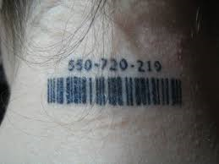
Intersection of
Human Trafficking and Public Health
Dana Kaplan, MD, FAAP
Director of Child Abuse and Neglect
Associate Program Director Pediatrics Residency Training Program
Site Director, Child Abuse Pediatrics Fellowship Training Program, Maimonides Medical Center
Department of Pediatrics
Staten Island University Hospital
Northwell Health Physician Partners
Assistant Professor of Pediatrics
Donald and Barbara Zucker School of Medicine at Hofstra-Northwell
Notes:
Say something about experience in hospital setting but many of the case examples, etc are applicable to the settings the providers work in.

Slide 2
Financial Disclosures
Dana Kaplan, MD, FAAP
Has no financial interest in or affiliation with
any commercial supporter to disclose.

Slide 3
Learning Objectives
At the conclusion of this presentation participants should be able to:
Develop a survivor-centered, informed & collaborative approach to victims of human trafficking
Summarize the dynamics that influence victims of human trafficking, with a specific focus on sex trafficking
Explore the intersection of public health and human trafficking

Slide 4
Trafficking Prevention and Intervention
There are moments of vulnerability and opportunities
throughout the lifespan
for prevention efforts or interventions.
Many of the programs in this room
have these opportunities to intervene.
That’s why its so important that you have
the information and resources to take action.
Notes:
Please do a disclaimer that the video and presentation may bring up feelings because both talk about traumatic situations and that folks should leave the room and take care of themselves if they need to during the video or at any point of your presentation.

Slide 5



Intro
School
Foster care
Child sexual abuse
RUNAWAY
Birth into inequality
Immigration
Entry into the life
The long exit
Medical emergency
Law enforcement
Trauma & addiction
motherhood
housing
Notes:
https://thelifestory.org/

Slide 6
Human Trafficking in the United States
As defined under Federal Trafficking Victims Protection Act (TVPA), victims of human trafficking can be divided into three populations:
      Children under age 18 induced into commercial sex
      Adults aged 18 or over induced into commercial sex through force, fraud, or coercion
      Children and adults induced to perform labor or services through force, fraud, or coercion
PolarisProject.org, TVPA 2000

Slide 7
Human Trafficking in the United States
Sex trafficking of minors
Commercial Sexual Exploitation of Children (CSEC), Domestic Minor Sex Trafficking (DMST)
Minor is induced to engage in a sex act in exchange for something of value
Victims by definition
Form of sexual abuse
Sex trafficking is illegal under any circumstances in the USA
https://www.ojjdp.gov/mpg/litreviews/child-labor-trafficking.pdf

Slide 8
Sex Trafficking

Slide 9
Sex Trafficking
Domestic
Sex Trafficking
International
Sex Trafficking

Slide 10
Sex Trafficking
Domestic
Sex Trafficking
International
Sex Trafficking
Pornography
Stripping
Erotic massage
Escort services
Internet based
Street based
Gang based
Pimp controlled
Interfamilial pimping
Sex Tourism
Survival Sex

Slide 11
Human Trafficking in the United States
Labor Trafficking
Need to prove force, fraud, coercion for both minors AND adults
Minors are typically allowed to work legally when they are between 14 and 16
https://www.ojjdp.gov/mpg/litreviews/child-labor-trafficking.pdf

Slide 12
Labor Trafficking
Labor Exploitation
    Person is working legally, but denied basic legal rights (such as fair compensation)
Child Labor
    Minor under the legal working age and is engaging in illegal work and/or work that is harmful to his/her health, development, or education
Labor Trafficking
    Many of the same components as labor exploitation, and child labor in the case of minors.
    Distinguished by the use of force, fraud, or coercion (e.g., forcing a person to work by threatening harm)
Owens et al. 2014

Slide 13
Labor Trafficking
USA
International
Domestic servitude
Construction
Janitorial or cleaning
Door-to-door magazine sales
Agriculture
Health and beauty services
Begging or peddling
Hotel and restaurant businesses
Gang-involved drug sales and gun carrying
Construction
Mines and quarries
Brick kilns
Fisheries
Farms
Soldiers in armed conflicts
Drug trafficking
Greenbaum 2017

Slide 14
Sex and Labor Trafficking Overlap
17 year old found exchanging sex for money by law enforcement after advertising on social media
Exchanging sex for money for approximately 2 years
Disclosed over time they began trafficking drugs and guns
Notes:
We will talk more about this case later but…

Slide 15
Human Trafficking vs. Smuggling: Legal Distinctions
Smuggling
Purpose: Transportation across an international boundary in exchange for payment
Transaction: Voluntary
Crime: against a state
Always involves crossing international borders
Concludes once the destination is reached
Trafficking
Purpose: Exploitation
Transaction: Force, fraud, coercion, vulnerability
Crime: against a person
Does not always involve crossing international (or even local) borders
Ongoing (does not conclude upon reaching a destination)
www.massmed.org/humantrafficking

Slide 16
Human Trafficking and Smuggling: Overlap
16 year old smuggled into Mexico from Guatemala
Once in Mexico, they were forced to exchange sex for money by the coyotes
They are smuggled across the US border, placed in a detention camp
www.massmed.org/humantrafficking
Notes:
Father gives money to smuggler – smuggler then forces into drug trafficking – gets away but is ultimately sexually assaulted prior to crossing the border

Slide 17
Incidence and Prevalence
Reliable estimates of the incidence and prevalence of trafficking globally are not available
Due to:
      Lack of uniform definitions among those collecting data
      Lack of a centralized database
      Under recognition of victims
Sound familiar?
Greenbaum 2017

Slide 18
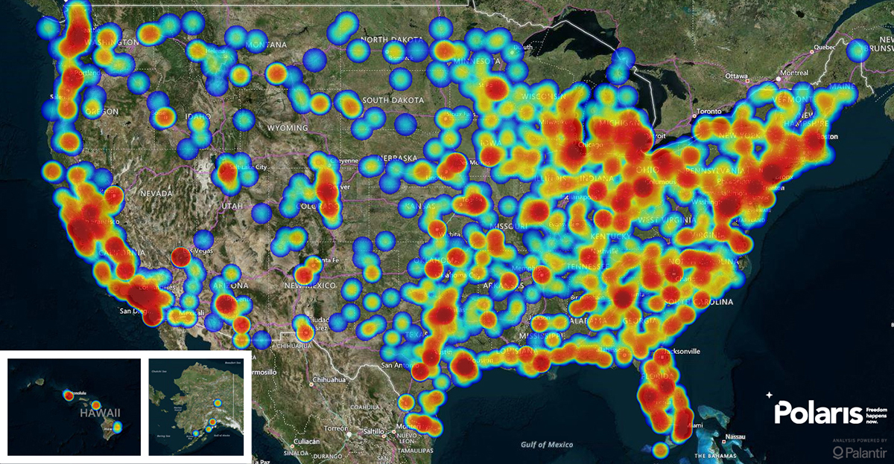
Human Trafficking in the U.S.
2017 Statistics, Polaris
Notes:
Today’s presentation willl focus on sex trafficking

Slide 19
Sex Trafficking: Recruitment
Important to recognize that children become adults!
Face to face
Social Media
            Facebook
            Snapchat
            Instagram
            Twitter
            Kik
            WhatsApp
Notes:
Grooming occurs face to face or through social media commonly used by adolescents. However, sex sold online, not on the street, increases vulnerability. And the solicitation is done through websites like backpage.

Slide 20
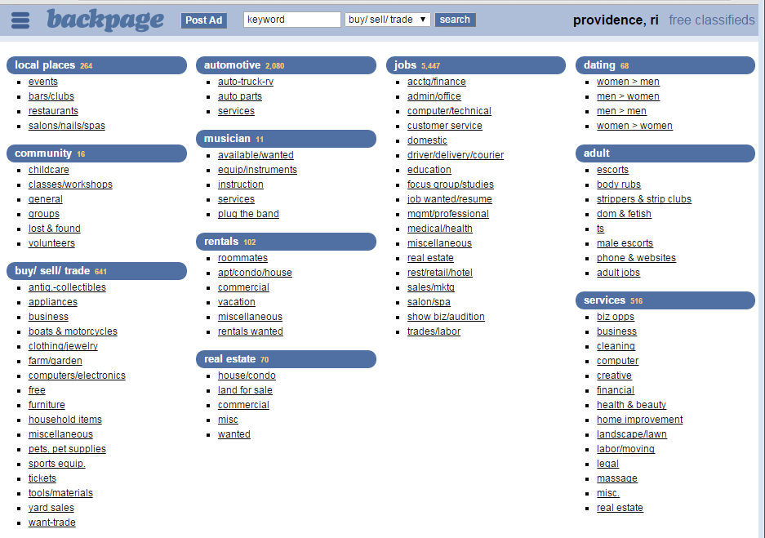
Notes:
This is backpage RI, where you can see the adult menu of services

Slide 21
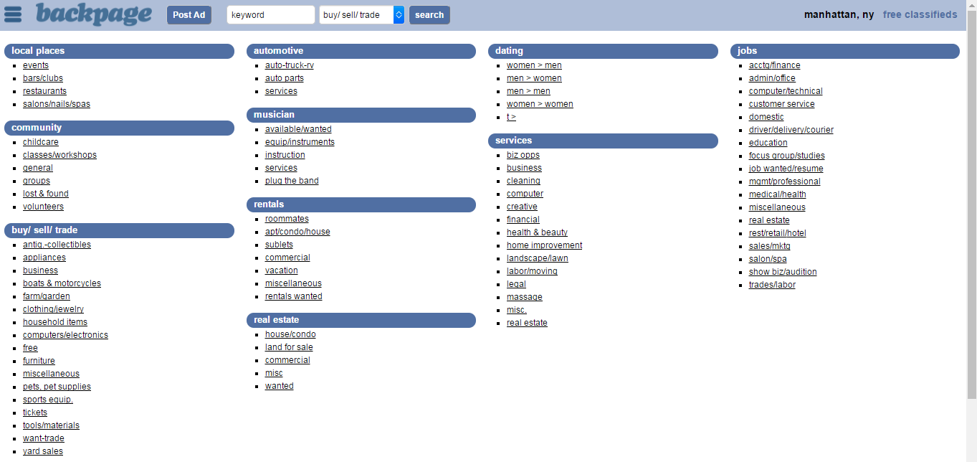
Notes:
On April 6, 2018 Backpage and affiliated websites were seized as part of an enforcement action by the Federal Bureau of Investigation, the United States Postal Inspection Service, the United States Department of Justice,^{[3]} the Internal Revenue Service Criminal Investigator Division, with analytical assistance from the Joint Regional Intelligence Center.
Its CEO, Carl Ferrer, pleaded guilty to charges of facilitating prostitution and money laundering

Slide 22
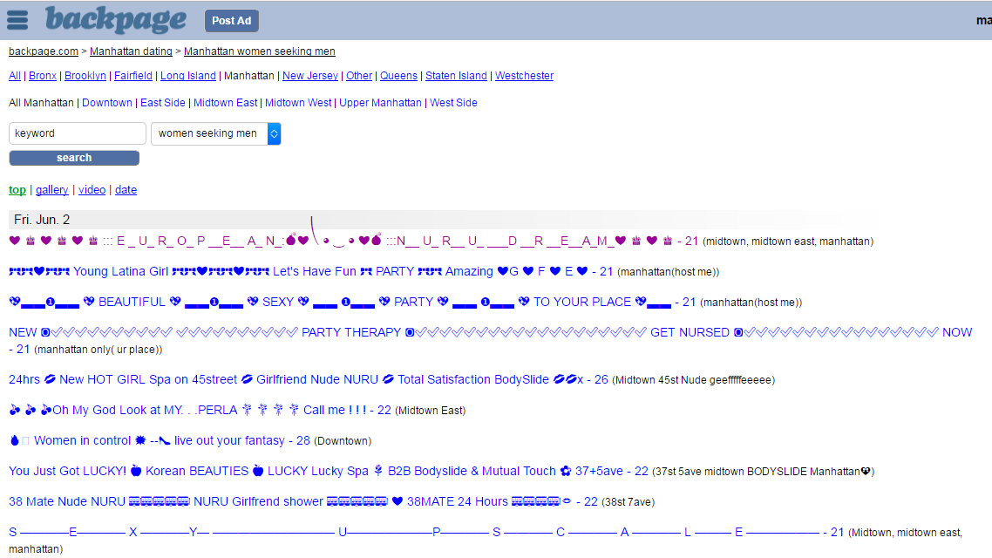

Slide 23
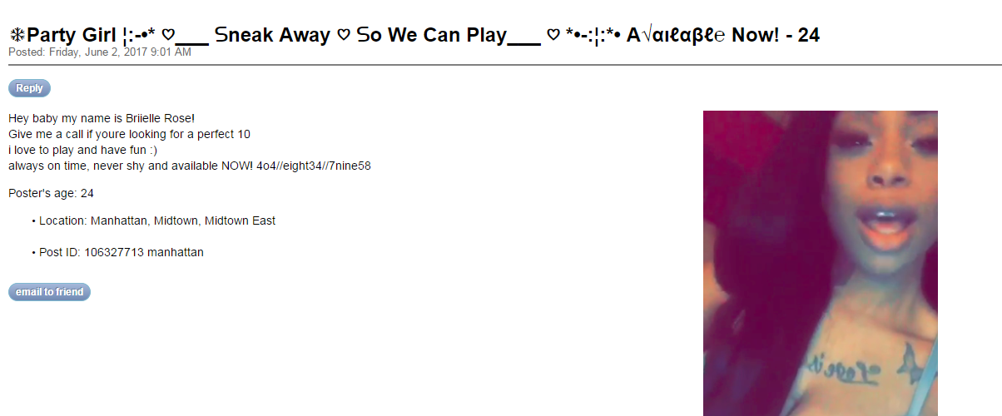

Slide 24
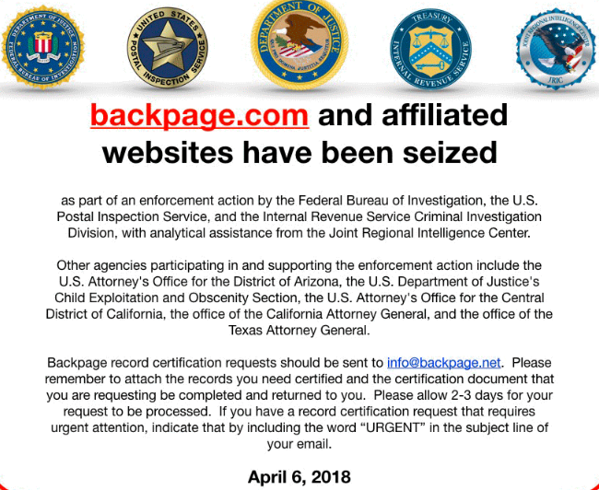

Slide 25

Now What?
Other sites with classified ads
Dating sites

Slide 26

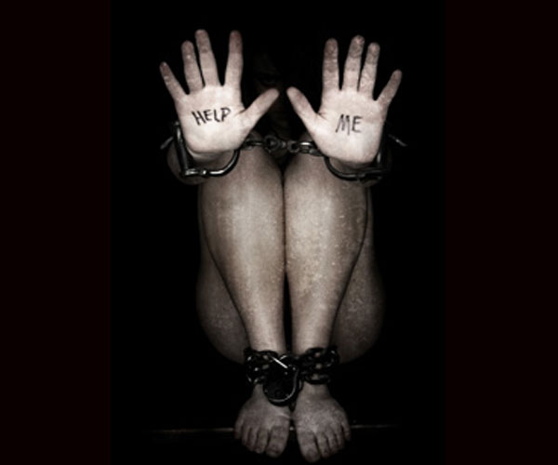
Notes:
On
Facilitators: It is important to realize that human trafficking operations often intersect or exist alongside legitimate businesses. As a result, certain industries may help to enable, support, or facilitate human trafficking. This “support structure” may include a wide range of individuals, organizations, businesses and corporations, and Internet sites and practices. Common facilitators on which traffickers frequently rely include:
Hotels and Motels
ce a meeting is arranged, these victims are largely out of sight, waiting in hotel rooms for a revolving door of customers. These victims are not chained to the bed…

Slide 27

Notes:
61% living at home; 2/3 going to school and half of them doing well/passing
They are not invisible. A lot of them are going to school, but truancy is a big risk factor. Kids are also being recruited in school.

Slide 28
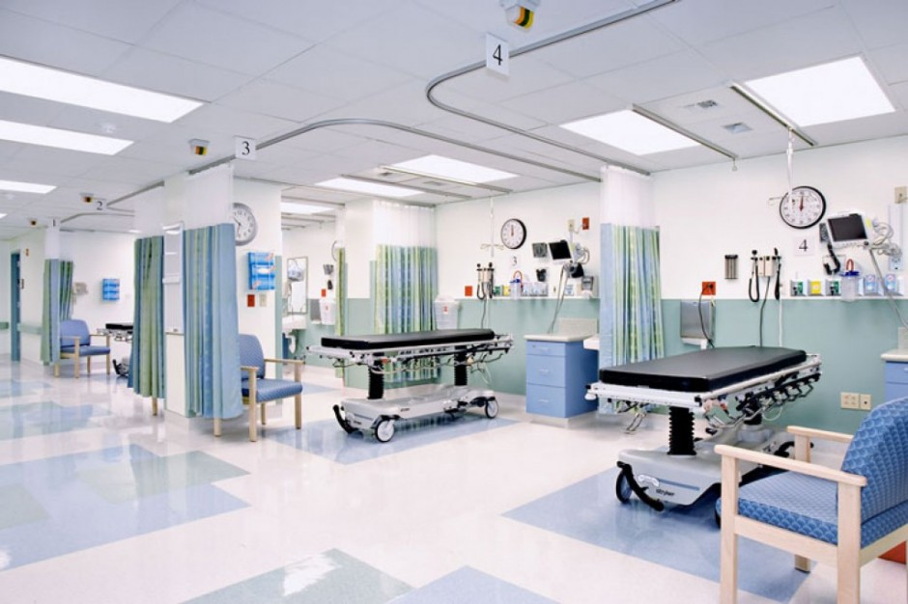
Notes:
They are in our clinics. This is the Aubin Center, where I currently work. And what we know is that these kids have contact with the medical community while they are exchanging sex for money. We need to improve our ability to identify these patients, and we will discuss this in depth later in the presentation.

Slide 29
Why Should Healthcare be Concerned?
68% of victims access health care
The health care setting is thought to be one of the most promising places to identify victims of trafficking
Chisolm-Straker et al., 2016
Notes:
According to the state department, we are only identifying 1% of victims

Slide 30
Case #1
16 year old female brought to Emergency Department by Homeland Security (HSI)
Found advertised on social media for a “two girl special”
Detectives reserved a hotel room in an attempt to find the victim
Set up an encounter
Exchanged $350 in anticipation of having sex with both girls

Slide 31
Case #1
Detectives brought both girls to the Emergency Department
The “pimp” was arrested
Child Protection Services called and both girls were placed into county custody due to lack of a safe discharge plan
Admitted to the hospital

Slide 32
Case #1
Angry, agitated
Disclosed exchanging sex for money
        Did not want to provide details
        Said it was her choice
Major concern is her “boyfriend”
        Says she should be arrested, not him
“Everyone here is looking at me like I’m a ho”
Responded that she is not a ho, she is a victim
        “I am not a victim”

Slide 33

Case #1
Upon discharge, noted clothing
    Provided new clothing
Discharged to group home after 5 day admission
    She did not run
    Came for follow-up 3 months after discharge
    Then ran
  Lost to follow-up

Slide 34
Teaching Points
Who is this “boyfriend”?
Why do victims stay in “the life”?

Slide 35

“I’m in love with you. There is nobody else, Nobody can make me feel this way. I love you unconditionally.”
-51 year old male to 7 year old female
Tiger Tiger: page 94
Notes:
This quote sounds like what we just saw in that video which demonstrates adolescent grooming. Until you see that this is a 51yo male talking to a 7yo female and comes from the book Tiger Tiger which is an autobiography about child sexual abuse and grooming. This is the same process at different developmental stages.

Slide 36

Grooming in Child Sexual Abuse
Build trust with child and the adults around the child
Create a “safe” relationship
Gain access and time alone with the victim
Offer love, currency
Plays on the victim’s vulnerabilities and needs
Notes:
To reduce the likelihood of a disclosure.
To reduce the likelihood of the child being believed.
To reduce the likelihood of being detected.
To manipulate the perceptions of other adults around the child.
To manipulate the child into becoming a cooperating participant which reduces the likelihood of a disclosure and increases the likelihood that the child will repeatedly return to the offender.

Slide 37

Grooming in Human Trafficking
  Gain trust and loyalty
  Offer “love”
  Currency
  Befriend and seduce in order to recruit
  Play on the victim’s vulnerabilities and needs
Notes:
A common situation is for a pimp to establish a relationship similar to a bf/gf or befriending the victim as is the case with many female pimps then seducing them with $$$
DMST victim still loves and protects her “boyfriend

Slide 38
Finesse Pimp/Romeo Pimp
One who prides himself on controlling others primarily through psychological manip­ulation
Sharedhope.org

Slide 39
What is a Pimp?
A recruiter, an exploiter, an abuser, a trafficker
Pimps capitalize on a victim’s vulnerably as the grounds to become exploited
        Using tools like befriending, seduction

Slide 40
Automatic
Term used to describe when a victim still complies with a pimp’s rules even when he is not around (ex. incarcerated)
aka “learned loyalty” to an exploiter
Sharedhope.org
Notes:
What would prevent a victim from seeking care even if it is much needed

Slide 41
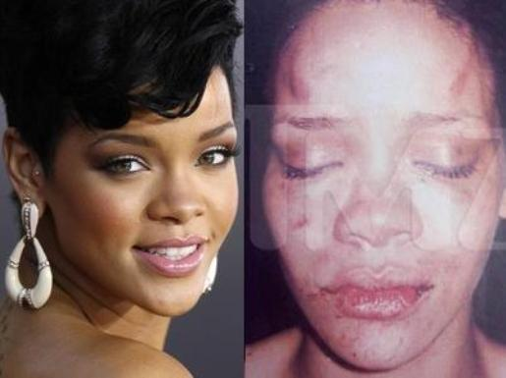
Learned Loyalty - 2009
Notes:
2009 assault
Briefly got back together 2013 and subsequently broke up again

Slide 42

Learned Loyalty – November 2015
“I was very protective of him, I felt that people didn’t understand him. Even after."
"I don’t hate him. I will care about him until the day I die. We’re not friends, but it’s not like we’re enemies. We don’t have much of a relationship now."

Slide 43
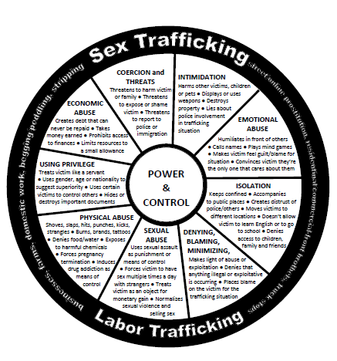
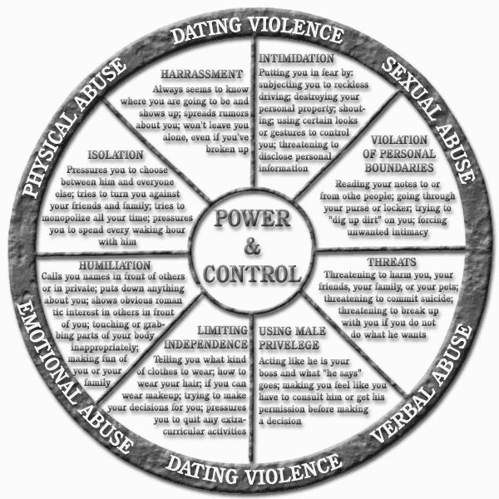

Slide 44
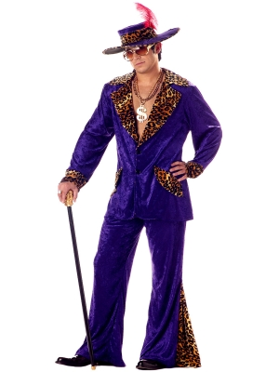

Automatic
Accompanied/monitored by exploiter
Notes:
This girl who is working for the pimp and is the recruiter, this is evolving; the friend in the room with her is she an exploiter? (can we make this gender neutral?) I want to be sure we acknowledge that pimps can be men or women and they can pimp men, women, children, etc

Slide 45

Bottom
Female appointed by the trafficker/pimp to supervise and report rule violations
    Help instruct victims
    Collect money
    Book hotel rooms
    Post ads
    Inflict punishments
Sharedhope.org

Slide 46
So What Should You Do?
Similar to what you would do if you suspected Intimate Partner Violence/Domestic Violence situation
Observe the interaction
            Separate the client
                To ask more questions
                To assess safety
                Consider your safety and the client’s safety
Notes:
I am telling you this information about the language so you can understand the context. Why am I telling you this? I am telling you this to inform your observation, interaction and assessments, similar to what we do in IPV/DV.

Slide 47
Case #2
17 year old
Met 34 year old online via Instagram
Victim is advertised on social media
Discloses 6 “clients”
Admitted to the hospital due to sexually transmitted infection
Father came to the hospital
        Supportive, engaged, no history of abuse/neglect
“Everyone is doing this”

Slide 48
Teaching Points
Who is at risk?
Is this a “thing”?

Slide 49
Risk
The total number of human-trafficking victims in the United States is unknown
In 2014 there were 8,414 victims identified in the Western Hemisphere, including Canada, the United States, Mexico, Central and South America
In 2014 the U.S. Department of Justice charged 335 defendants (exploiters) with trafficking through 208 prosecutions
U.S. Department of State, 2015
Notes:
Wide range because there are many factors – moving around, not always agreed upon definition, lack of awareness, lack of common database

Slide 50
Risk
Tremendous difficulty in identifying victims
    Law enforcement overall does not have the widespread ability to investigate potential cases
    May be responsible for the low number of identified victims
    Farrell, McDevitt, & Fahy, 2010

Slide 51
Why are Children and Adolescents Particularly at Risk?
Want more independence
        Separate from their parents
        Friends most important
        Romantic relationships
Test boundaries
Take risks
Experiment

Slide 52

Who is at Risk?
Adolescents are at higher risk!!!
Notes:
It is consistent with the development of an adolescent to experiment

Slide 53
If all adolescents are at risk…
Is this a thing…?
Notes:
Is this another high risk behavior teens will start engaging in

Slide 54

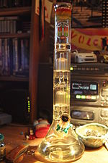
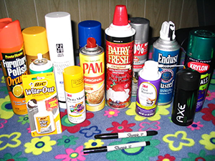
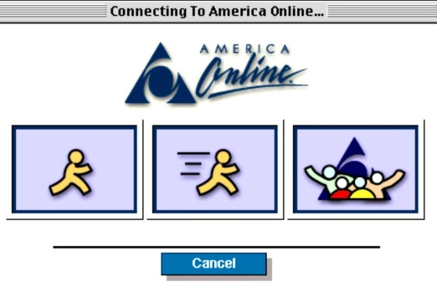
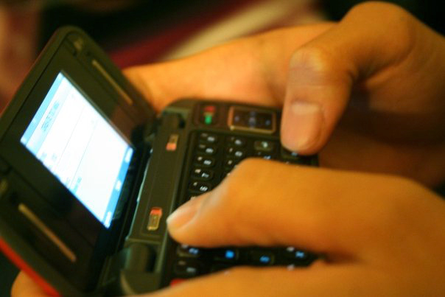

“Things”
Notes:
Is this another high risk behavior teens will experiment with?

Slide 55
Is this a thing?
Among a nationally representative sample of more than 13,000 7th to 12th graders in the United States, 3.5% admitted to exchanging sex for money or drugs
Edwards 2006

Slide 56
Risk in Adolescence
All adolescents are looking for love, acceptance
        They also experiment
Pimps capitalize on an adolescent’s vulnerably as the grounds to become exploited
Not a normal “thing”
What makes some adolescents more vulnerable than others?
Notes:
This is not a normal “thing” At first we thought this is a possibility, but clinically speaking this is not consistent with normal adolescent developmental exploration. This is a variation of adolescent behavior that is gone array– if you notice I have a picture of smoking pot. I do not have a picture of injecting heroin, which would not be considered along the spectrum of normal experimentation. We would be concerned about that. We should be concerned about this. So that brings us to the fact that some adolescents are more vulnerable than others…

Slide 57
Known Risk Factors
Domestic violence
Death/abandonment of a parent
Parental or self substance abuse/addiction
Homelessness or runaway youth
Any vulnerability!
Clawson, et al. 2009
Notes:
The lessons that girls have been taught, implicitly and explicitly, about family and relationship dynamics are all fuel for the exploiters' fire. The greater their need for attention and love, the easier it is to recruit them....Growing up with an alcoholic or drug addicted parent sets the stage for caretaking and codependency patterns that are helpful in making girls feel responsible for taking care of their pimp. Girls who had non-existent fathers or abusive relationships with fathers are easily drawn to a pimp who calls himself Daddy. In these situations there is an overall sense of abandonment. Leaving them easily drawn to an unhealthy situation.

Slide 58
Known Risk Factors
Sexual abuse
      Increased risk-taking behavior in victims of childhood sexual abuse
      Altered emotional development increasing vulnerability
      Grooming
Varma 2015
Notes:
This relates to grooming – grooming in child sexual abuse places them at risk for grooming in adolescent – it is familiar and known.

Slide 59
Adverse Childhood Experiences (ACEs)
Abuse
    Emotional
    Physical
    Sexual
Neglect
    Emotional
    Physical
Household Challenges
    Mother treated violently
    Household substance abuse
    Mental illness in the household
    Parental separation or divorce
    Criminal household member
Notes:
Definition of an ACE
A potentially traumatic event occurring
before the age of 18 that can have
negative, lasting effects on health and
well being
More ACEs, increased risk of long term physical and mental health sequelae

Slide 60
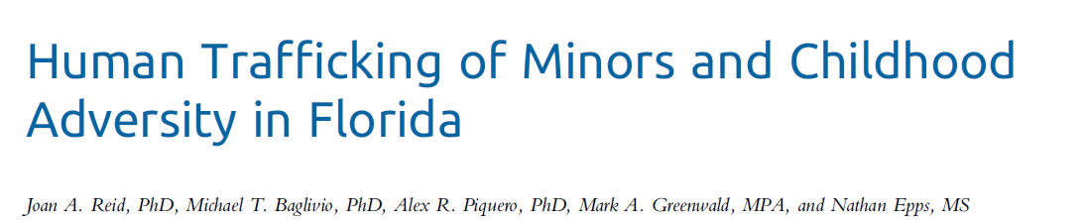
Examined the link between human trafficking of minors and childhood adversity
6 ACEs indicative of child maltreatment were more prevalent among youths who had human trafficking abuse reports
Sexual abuse was the strongest predictor of human trafficking

Slide 61

Highest Risk Populations
Youth in group homes/foster care system
Homeless/runaway youth
Targeted by a pimp to become exploited
Estes & Weiner, 2001 &2002
Notes:
What we have learaned is that these children have so many of these risk factors and living in a place where they are not as supervised or cared for by someone who is not invested. Not all kids in foster homes/group homes are going to be trafficked.

Slide 62
Need for “Family”
Individuals under the control of the same pimp
The pimp plays the role of “Daddy” while the group fulfills the need for a “family”
Part of grooming
And remember these children become adults, the needs do not change!
Sharedhope.org
Notes:
Again, part of the grooming process is to give a vulnerable kid what they are looking for. And here they are looking for a family.

Slide 63
Case #3
15 year old female evaluated after an acute sexual assault by a 44 year old male (a friend of a friend)
States she found out her friend’s mother was paid to set this up

Slide 64

Case #3
Denies previous sexual activity (consensual or nonconsensual)
Denies Sex Trafficking
On physical exam:

Slide 65
Follow-up
Returns to clinic requesting STI testing, denies sexual activity and sex trafficking
States there are rumors
Requests birth control

Slide 66
Follow-up
When asked if someone she knows has ever had sex for money she states her sister did
Her sister is currently pregnant
Her sister is the patient who presented with:

Slide 67
Teaching Points
Identification
Medical care

Slide 68
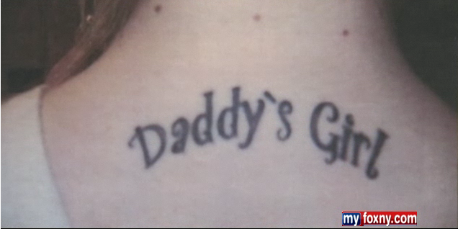
Identification: Physical
Dressed in inappropriate clothing*
Visible signs of injury without plausible explanations/medical care
Change in physical appearance
Reluctant to explain a certain tattoo

Slide 69
Identification: Behavioral
Unexplained/multiple absences from home, school or group home
        Including running away
Controlling relationships
History of abuse/neglect

Slide 70
Identification: Psychological
Self injury
Suicidal ideation
Substance abuse

Slide 71
Identification: Medical
History of multiple STI’s
Multiple pregnancies
        Miscarriages
        Terminations
Multiple sexual/physical assaults
Untreated medical conditions
Notes:
The medical context is how we have been gaining trust

Slide 72
Identification – ASK!
Has someone you know ever been asked to have sex for something?
      Did they do it?
Notes:
Given that I work in an environemnt where every patient we encounter is potentially at high risk, we have started to screen all adolescents with the following questions.

Slide 73
Identification – ASK!
Have you ever been asked to have sex for something?
      Did you do it?
Has someone ever asked you to have sex with someone else?

Slide 74
If they answer “no?”
May not be ready to disclose
      You are someone who can talk about this
A minute of prevention…

Slide 75
Identification: Confirmed
Self-disclosed
Found by law enforcement exchanging sex for money
Found by law enforcement advertised on social media
Found by relative/friend with objective evidence
Goldberg, et al. 2016
Notes:
You asked because of suspicion and risk – provide something
PREVENTION AND OPEN DOOR TO COME BACK

Slide 76
Identification: Suspected
Disclosure of solicitation but denies involvement
Disclosure of a friend who was solicited and/or involved
Denies solicitation and/or involvement however concerning features from medical evaluation
Goldberg, et al. 2016
Notes:
You asked because of suspicion and risk – provide something
PREVENTION AND OPEN DOOR TO COME BACK

Slide 77
Acute Sexual Assault vs. Sex Trafficking
Similar to Acute Sexual Assault
Key differences
    Ongoing exposure to violence
      -Psychological implications (eg. suicidality)
      -Risk for injury/death
    Ongoing exposure to substance use
      -Risk for death/overdose
    Ongoing HIV Risk
    Ongoing STI risk
    Ongoing pregnancy risk
Farley, M. 2008

Slide 78
Other Key Differences
  Ongoing general health risks
    Malnutrition
    Sleep deprivation
    Extreme stress
    Untreated bodily injuries
    Neglect of underlying medical conditions
Farley, M. 2008, APSAC

Slide 79
Follow-up Care
How can we follow these clients?
How should we follow these clients?
What are their specific medical needs?
What are their specific psychological needs?
What about their safety?

Slide 80
Follow-up Care: Medical Intervention
Contraception
STI screening and treatment
General medical care
    Ex. dental referral

Slide 81
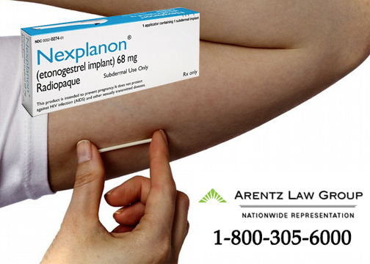
Follow-up Care: Intervention
  Contraception
  LARC (long acting reversible contraception)
        IUD, Nexplanon
        <0.1% failure
  Nexplanon
        Prevents pregnancy for 3 years

Slide 82

Most Important Ingredient for Follow-up?
GAIN RAPPORT AND TRUST
Notes:
Doubt of the system, time not on our side (7 year mortality!)

Slide 83
Gaining Rapport
Expect lies
        True story may not emerge until there have been multiple encounters, or ever!
Do not dispute facts
Do not judge

Slide 84


DO NOT
  Try to rescue the client
Notes:
Similar to IPV

Slide 85

DO NOT
  Try to rescue the client
Notes:
Similar to IPV

Slide 86

Notes:
If you do that, you will find success with follow-up

Slide 87
Follow-up Care: Psychological
Ongoing safety assessments
Ongoing assessment of needs
Ongoing assessment for Suicidal Ideation, Homicidal Ideation, Self Injurious Behaviors

Slide 88
Follow-up: Psychological
Victims of Trafficking are at risk for:
        Mood disorders
        Anxiety disorders
        Dissociative disorders
        Substance use disorders
        Impulse control
        Conduct Disorder
        ADHD
        Antisocial personality traits
        PTSD
Williamson 2008
Notes:
Approx ¾ of patients we saw had psychiatric comorbidity

Slide 89
Follow-up: Psychological Intervention
Trauma informed care
        Long term, comprehensive care
Barriers:
        Transient
        Have been through counseling before, didn’t work
        Do not yet view these behaviors as a problem

Slide 90
Case #4
17 year old female found exchanging sex for money by law enforcement after advertising on social media
Also disclosed drugs, guns, gangs
In CPS custody since the age of 6
Brought to the emergency department
Admitted to hospital for one day due to lack of discharge plan

Slide 91
Case #4
Talked to her all day
        Not about trafficking
Collaborated with law enforcement
Provided safety net
Asked her to follow-up in 2 weeks
        Regardless if still on the run
Discharged to shelter
        Ran 20 minutes later

Slide 92
Case #4
Found exchanging sex for money 3 weeks after discharge
        Seen in emergency department
        Placed in a shelter
        Followed-up in clinic next afternoon

Slide 93
Case #4
  Discussed her goals, needs
  Placed a Nexplanon
  Recommended follow-up 2 weeks
    But she came back one week later, to talk
    And the next week, to talk
    She did not run for 3 weeks
    And then ran…
    And then came back for medical care…

Slide 94
Case #4
Wanted her own apartment
        Waiting list
And to go to cosmetology school
        Waiting list
Still in contact with her “family”

Slide 95
Case #4
Turned 18 years old, signed herself out of CPS custody
Left the state
Returned for medical care
        Positive Chlamydia
Left the state again
Called to keep in touch
Came back

Slide 96
Teaching Points
Motivators to not run
Leaving “the life”
Multidisciplinary approach

Slide 97
Motivators
Different for each victim
Need to ask the right questions to assess
Must act fast!
The victim must be ready
        Cannot force change

Slide 98
Our Response Should be Automatic
Do not give up on them
Be present
Meet their immediate needs
        Ex. Food, comfy clothes, phone charger
Meet them on their terms

Slide 99
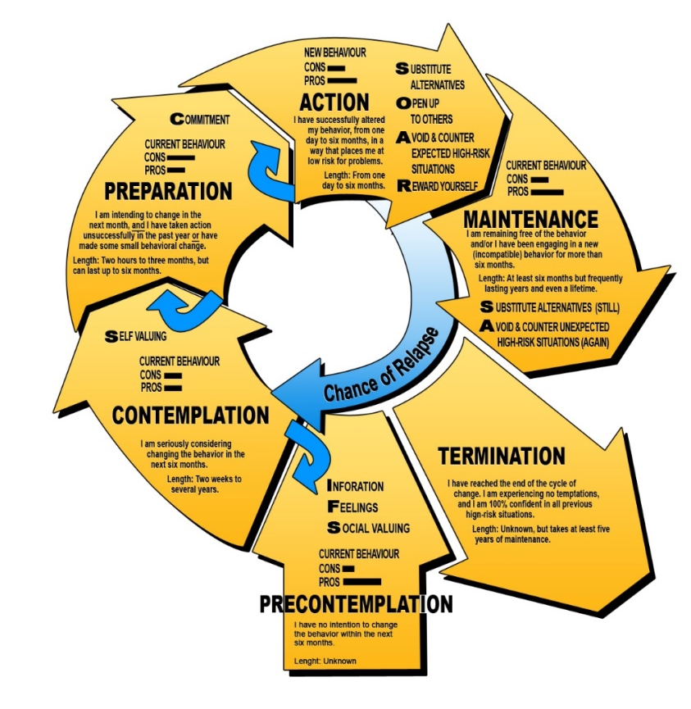
Motivators - Cycle

Slide 100
Staying in “the life”
Still in love with their “boyfriend”
Money
        “Can you make $50 in 5 minutes?”
Lack of an alternative
        We need to work to provide these!
Hurry up and wait

Slide 101
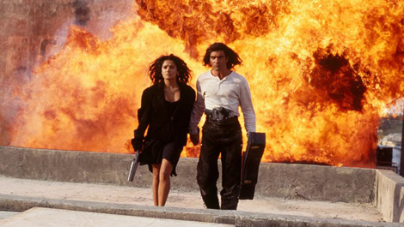
From…
Notes:
Coming from extreme circumstances with lots of danger, adrenaline, HIGH DRAMA

Slide 102
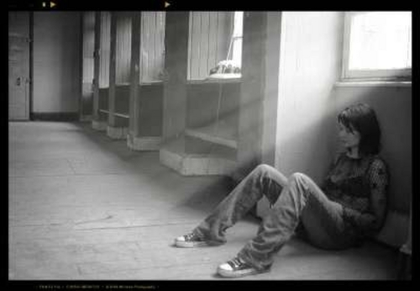
To…

Slide 103
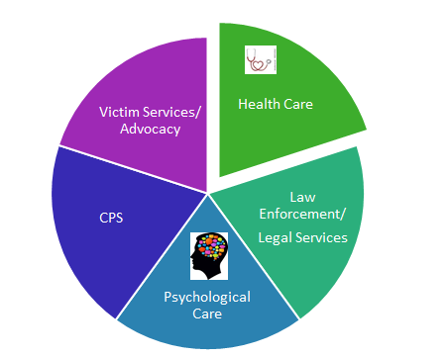
Multidisciplinary Approach

Slide 104
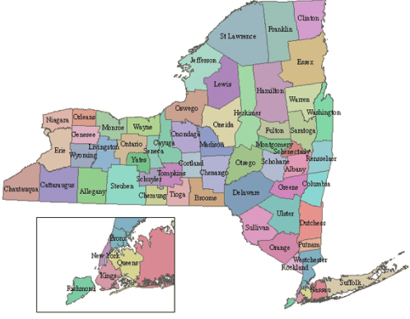
Legal Intersections

Slide 105
Top States: Sex Trafficking
California
Texas
Florida
Ohio
New York
Polaris.org

Slide 106
NY State Laws
NYS Anti-Trafficking Law – 2007
  Criminalized exploiters/traffickers
  Established ways to “confirm” victims
  Provided immunity for victims
  Established services for victims via social service departments
Notes:
On January 12th, 2015, the Trafficking Victims Protection and Justice Act, which would enhance protection for sex trafficking victims and increase accountability for pimps and buyers, passed the New York State Senate unanimously.
In order to become law, the bill must be passed by the New York State Assembly before the legislative session ends on June 17. Click here to help make that happen.
To provide services, not to prosecute
When New York State enacted the Safe Harbour for Exploited Children Act, it became the first state in the nation to recognize that minors who are commercially sexually exploited are victims - not perpetrators - of crimes. This and other relevant legislation recognize what child-serving professionals OCFS have long known: children and youth who have been exploited and trafficked have endured significant, compounding traumas and need supportive, holistic services to aid them in their many challenges.

Slide 107
NY State Laws
NYS Safe Harbour Law – 2008
  Defines a “sexually exploited child” as someone under 18 who engages in sexual conduct in exchange for something of value
  Protects sexually exploited children from being charged with a juvenile delinquent/criminal offense
  Defines children who are involved in these crimes as victims, not perpetrators
  Provides services to children who have been sexually exploited
Notes:
On January 12th, 2015, the Trafficking Victims Protection and Justice Act, which would enhance protection for sex trafficking victims and increase accountability for pimps and buyers, passed the New York State Senate unanimously.
In order to become law, the bill must be passed by the New York State Assembly before the legislative session ends on June 17. Click here to help make that happen.
To provide services, not to prosecute
When New York State enacted the Safe Harbour for Exploited Children Act, it became the first state in the nation to recognize that minors who are commercially sexually exploited are victims - not perpetrators - of crimes. This and other relevant legislation recognize what child-serving professionals OCFS have long known: children and youth who have been exploited and trafficked have endured significant, compounding traumas and need supportive, holistic services to aid them in their many challenges.

Slide 108
Trafficking Victims Protection and Justice Act (TVPJA)
New York State criminalized sex trafficking and labor trafficking in 2007
New York strengthened its criminal justice response to trafficking with the TVPJA in 2015
    Comprehensive legislation that increases accountability of traffickers, patronizers and other exploiters, while providing necessary protection to victims
    Replaces all references in the Penal Law to “prostitute” with the phrase “person for prostitution”
    Brings State law in line with Federal law by removing the New York State’s requirement of coercion in prosecutions for the sex trafficking of children

Slide 109
Other Laws/Bills Relating to Human Trafficking in NY
Law (S8874) requires facilities such as hotels, inns, and motels to provide informational cards on the services available to victims of human trafficking.
Law (S7836) will help expand the availability of the Human Trafficking Intervention Court (HTIC) Initiative to reach more victims. The Courts were created to provide alternatives to incarceration for people arrested on prostitution charges, since many of the defendants were also victims of human trafficking.
Bill (S8305) has also been delivered to the Governor for review and helps establish short-term and long-term safe house residential facilities to be operated by not-for-profit agencies for victims of human trafficking.

Slide 110
New York Public Health Law 2805-y
Identification and Assessment of Human Trafficking Victims
      Requires every general hospital, public health center, diagnostic center, treatment center or outpatient department to provide identification, assessment, and appropriate treatment or referral of persons suspected as human trafficking victims
          Develop policies and protocols
          Deliver training to staff
Notes:
Signed November 2016 by governor Cuomo
NY Bill A.8650-B/S.6835-B
Mandated Report: This will launch an investigation to determine possible abuse and/or neglect, and also provide assistance with safety and service planning.

Slide 111
New York Public Health Law 2805-y
Identification and Assessment of Human Trafficking Victims
      Mandatory report of human trafficking to the NYS State Central Register (CPS report) if the victim is under the age of 18
              If perpetrator is parent/caregiver
              If there is concern for neglect
              If neither, can still call SCR, may make this a law enforcement referral, but consider age/consent of the patient!
              Resource referral
              Note: if imminent danger call 911!
Notes:
Signed November 2016 by governor Cuomo
NY Bill A.8650-B/S.6835-B
Mandated Report: This will launch an investigation to determine possible abuse and/or neglect, and also provide assistance with safety and service planning.

Slide 112
What Do You Do If You Identify an Adult Victim?
If they consent, you can make a referral to the Office of Temporary and Disability Assistance and Division of Criminal Justice Services for the victim to be confirmed.
If they consent, you can refer them to law enforcement.
If they do not consent to the two options above, you can:
    Provide them with local trafficking resources or other local agencies who can provide assistance/support.
    Provide them with the National Trafficking Hotline number for them to reach out for services when ready.
Notes:
Also provide medical follow up

Slide 113
Resources
Department of Health Human Trafficking Webpage:
https://www.health.ny.gov/prevention/human_trafficking/
Office of Temporary and Disability Services Assistance to Trafficking Victims Program: http://otda.ny.gov/programs/bria/trafficking.asp
Office of Children and Family Services Child Trafficking Webpage: https://ocfs.ny.gov/main/humantrafficking/resources.asp

Slide 114
Resources
Polaris- National Trafficking Resource Center:
https://polarisproject.org/human-trafficking
      National Human Trafficking Hotline 1 (888) 373-7888
      BeFree Textline Text "BeFree" (233733)

Slide 115
The Long Exit
STEPS TOWARD
change
How can individuals and systems work to provide long-term, trauma-informed support that victims need to take a different path

Slide 116

Thank You
dkaplan2@northwell.edu
718-226-3224

Slide 117
References
http://www.againstourwill.org/
Amsterdam prostitution - Amsterdam.info, www.amsterdam.info › Red Light District
APSAC. The Commercial Sexual Exploitation of Children: The Medical Provider’s Role in Identification, Assessment and Treatment.
Beck M, Lineer M, Melzer-Lange M, Simpson P, Nugent M, Rabbitt A. Medical providers' understanding of sex trafficking and their experience with at-risk patients. Pediatrics. 2015;135(4):e895-e902
Campos, et. Al. Reaching the Unreachable: Providing STI Control Services to Female Sex Workers via Mobile Team Outreach. PLOS ONE. November 2013, Volume 8, Issue 11.
Clawson, et al. Human Trafficking Into and Within the United States: A Review of the Literature. Study of HHS Programs Serving Human Trafficking Victims. 2009. http://aspe.hhs.gov/hsp/07/HumanTrafficking/LitRev/
Edwards JM, Iritani BJ, Hallfors DD. Prevalence and correlates of exchanging sex for drugs or money among adolescents in the United States. Sex Transm Infect. 2006;82:354–358.
Edwards, et al. Prevalence and correlates of exchanging sex for drugs or money among adolescents in the United States. Sex Transm Infect. Oct 2006; 82(5): 354–358.
Estes, Richard and Weiner, Niel. The Commercial Sexual Exploitation of Children In the U. S., Canada and Mexico. Executive Summary of the U.S. National Study. 2001.
Farley, Melissa. Human Trafficking and Prostitution, 2008. http://prostitutionresearch.com/pub_author/melissa-farley
Farrell, A., McDevitt, J., & Fahy, S. (2010). Where are all the victims?: Understanding the determinants of official identification of human trafficking incidents. Criminology & Public Policy, 9(2), 201–233. doi:10.1111/j.1745-9133.2010.00621.x
Fragoso, Margaux. Tiger, Tiger. Penguin Books Limited, Mar 31, 2011
Frieda, et. Al. Evidence-based treatment guidelines for sexually transmitted infections developed with and for female sex workers. Tropical Medicine and International Health. volume 8 no 3 pp 251–258 march 2003.
Greenbaum, et al. Child Sex Trafficking and Commercial Sexual Exploitation: Health Care Needs of Victims. Pediatrics Volume 135, number 3, March 2015
Greenbaum, et al. A Short Screening Tool to Identify Victims of Child Sex Trafficking in the Health Care Setting. Pediatr Emerg Care. 2015 Nov 23.
Goldberg, A., Moore, J., Houck, C., Kaplan, D., Barron, C. “Domestic Minor Sex Trafficking Patients: A Retrospective Analysis of Medical Presentation.” Journal of Pediatric and Adolescent Gynecology. Published Online: August 27, 2016.
Institute of Medicine and National Research Council. Confronting commercial sexual exploitation and sex trafficking of minors in the United States. Washington, DC: The National Academies Press; 2013
Lederer L & Wetzel C. The health consequences of sex trafficking and their implications for identifying victims in healthcare facilities. Ann of Health Law. 2014; 23(1), 61-91
Lloyd, Rachel. Girls Like Us: Fighting for a World Where Girls Are Not for Sale. HarperCollins Publishers, April 2011.

Slide 118
References
Melborne Sexual Health Center Treatment Guidelines. Commercial Sex Workers Screening, Vaccination and issuing of certificate. March 2010.
My Life, My Choice training materials, http://www.fightingexploitation.org/about
Queensland Sexual Health Clinical Management Guidelines. https://www.health.qld.gov.au/clinical-practice/guidelines-procedures/sex-health/guidelines/default.asp
Ravi, A, Pfeiffer MR, Rosner Z, Shea JA. Identifying Health Experiences of Domestically Sex-Trafficked Women in the USA: A Qualitative Study in Rikers Island Jail. J Urban Health. 2017 Jan 23. doi: 10.1007/s11524-016-0128-8.
Roth et al. Expanding sexually transmitted infection screening among women and men engaging in transactional sex: the feasibility of field-based self-collection. Int J STD AIDS. 2013 Apr;24(4):323-8.
Sex trafficking in the U.S. The Polaris Web site; Available at: http://www.polarisproject.org. Accessed June 11, 2015
Smith L, Vardaman S, Snow M. The national report on domestic minor sex trafficking: America’s prostituted children. Vancouver, WA: Shared Hope International (SHI); 2009. Available at: http://sharedhope.org/wp-content/uploads/2012/09/SHI_National_Report_on_DMST_2009.pdf. Accessed June 20, 2015
Special Report International Society for Prevention of Child Abuse and Neglect (ISPCAN), Editor Jenny Gray, DipSW, Dip Fam.
Hanni Stoklosa, Elizabeth Showalter, Anna Melnick & Emily F. Rothman (2016): Health Care Providers’ Experience with a Protocol for the Identification, Treatment, and Referral of Human-Trafficking Victims, Journal of Human Trafficking, DOI: 10.1080/23322705.2016.1194668
Titchen, Kanai, Loo, Dyani, Berdan, Elizabeth, et al. Domestic Sex Trafficking of Minors: Medical Student and Physician Awareness. Pediatric Adolescent Gynecology. (2015) 1-7.
U.S. Department of State. (2015). Trafficking in persons report. Retrieved from http://www.state.gov/documents/
organization/245365.pdf
Varma S, Gillespie S, McCracken C, Greenbaum V. Characteristics of child commercial sexual exploitation and sex trafficking victims presenting for medical care in the United States. Child Abuse Negl. 2015;44:98-105
Warf, et al. “Coming of age on the streets: Survival sex among homeless young women in Hollywood.” Journal of Adolescence. 36 (2013) 1205–1213
www.wikipedia.com
Williamson E, Dutch NM, Clawson Caliber HJ. Evidence-Based Mental Health Treatment for Victims of Human Trafficking. Dept. of Health & Human Services. 2008. http://aspe.hhs.gov/basic-report/evidence-based-mental-health-treatment-victims-humantrafficking
Yates, Mackenzie, Pennbridge, & Swofford. A risk profile comparison of homeless youth involved in prostitution and homeless youth not involved. J Adolesc Health. 1991 Nov;12(7):545-8.

