Slide 1
Include Chlamydia Screening as a Part of Routine Clinical Preventive Care
Chlamydia Screening Change Package
Best Practice 1
October 17, 2018
Last Updated March 2018
Notes:
Today we will be discussing including chlamydia screening as a part of routine clinical preventive care.
The provision of sexually transmitted disease (STD) services is one of the six core family planning services identified in Providing Quality Family Planning Services: Recommendations of CDC and the U.S. Office of Population Affairs (QFP). The QFP guides providers to offer STD services in accordance with CDC’s STD treatment and testing guidelines.
According to these guidelines, providers should screen all women ages 24 and younger for chlamydia annually. In addition, sexually active women 25 and older and men with risk factors should also be tested for chlamydia.

Slide 2
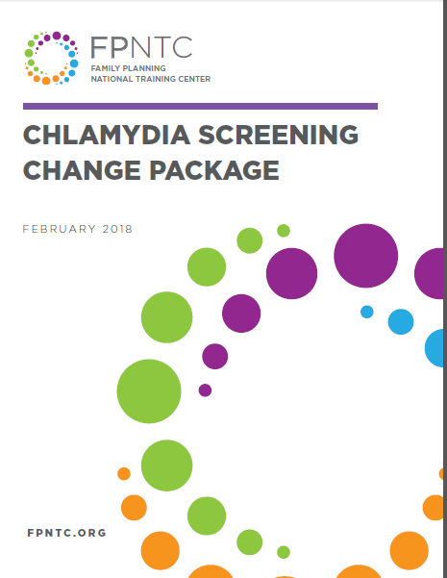
Chlamydia Screening Change Package
Include screening as part of routine care
Use normalizing and opt-out language
Use least invasive, high- quality test
Reduce cost as a barrier
Link: https://www.fpntc.org/resources/chlamydia-screening-change-package
Notes:
Including chlamydia screening as a part of routine clinical preventive care is the first best practice recommendation outlined in the Chlamydia Screening Change Package which was developed by the Family Planning National Training Center (FPNTC).
The Chlamydia Screening Change Package, which is an overview of the best practice recommendations and strategies, draws from the literature and most current practice guidelines to increase chlamydia screening following nationally recognized standards of care.
The other three Best Practices in the Change Package are:
BP 2: Use normalizing and opt-out language to explain chlamydia screening
BP 3: Use the least invasive, high-quality recommended laboratory technologies for chlamydia screening, with timely turnaround
BP 4: Utilize diverse payment options to reduce cost as a barrier for the client and the facility
In order to increase chlamydia screening rates, it’s important to consider all four best practices and utilize a comprehensive approach that addresses each.

Slide 3
Change Package Best Practice 1
Include chlamydia screening as a part of routine clinical preventive care. Use clinic support systems to systematically screen sexually active clients at least once a year for women 24 years and younger, for women >24 who are at increased risk, and men at increased risk.
Notes:
The best practice we are discussing today is Best Practice 1: Include chlamydia screening as a part of routine clinical preventive care. This best practice is to: use clinic support systems to systematically screen sexually active clients at least once a year for women 24 years and younger, for women >24 who are at increased risk, and men at increased risk.
Women at increased risk for infection are defined by CDC’s STD Treatment Guidelines as, for example, “those who have a new sex partner, more than one sex partner, a sex partner with concurrent partners, or a sex partner who has a sexually transmitted infection.”
According to CDC’s STD Treatment Guidelines, “targeted chlamydia screening in men should only be considered when resources permit, prevalence is high, and such screening does not hinder chlamydia screening efforts in women. More frequent screening for some women (e.g., adolescents) or certain men (e.g., men who have sex with men (MSM)) might be indicated.”
This first best practice lays the foundation for the other three best practices in the Chlamydia Screening Change Package.
Sources (for reference)
Office of Population Affairs (OPA). Program Requirements for Title X Funded Family Planning Projects. Version 1.0 April 2014
Gavin L, Moskosky S, Carter M et al. Providing Quality Family Planning Services: Recommendations of CDC and the U.S. Office of Population Affairs. MMWR 2014;63(4)

Slide 4
Meeting Objectives
By the end of the session, you should be able to:
Describe the rationale for incorporating chlamydia screening as a routine part of preventive care
Identify at least two strategies for using clinic support systems to systematically screen clients
Describe at least one way to use data to increase adherence to screening recommendations
Notes:
Here are the objectives of today’s session. By the end of today’s session, we hope you will be able to:
Describe the rationale for incorporating chlamydia screening as a routine part of preventive care
Identify at least two strategies for using clinic support systems to systematically screen clients at risk
Describe at least one way to use data to increase adherence to screening recommendations

Slide 5
Rationale for Including Chlamydia Screening as Routine Clinical Care
Chlamydia is the most commonly reported notifiable disease in the United States and is usually asymptomatic.
If untreated, chlamydia infection can lead to pelvic inflammatory disease, a major cause of infertility, ectopic pregnancy, and chronic pelvic pain.
The highest rates are among women ages 15–24.
Consistent recommendations: CDC, US Preventive Services Task Force, HEDIS, and NQF
Notes:
Let’s briefly recap the rationale for ensuring chlamydia screening is including in routine clinical care. We covered this at the kickoff meeting, so we’ll be brief:
Chlamydia is the most commonly reported notifiable disease in the United States. In 2015, there were over 1.5 million cases of chlamydia reported to CDC. For perspective, there are fewer than 1.5 million people in 10 U.S. states. For example, Hawaii has 1.4 million and Wyoming has just over 500,000 people living there.
Chlamydia infection is often asymptomatic. If left untreated, chlamydia infection can lead to pelvic inflammatory disease (PID), a major cause of infertility, ectopic pregnancy, and chronic pelvic pain.
Chlamydia infection rates vary widely by age group. The highest rates of chlamydia infection are among women 15 to 24 years of age. (The rate for women ages 15 to 19 is almost five times the rate for all women.)
There is also a high degree of agreement on the benefits of population-based chlamydia screening. CDC, the US Preventive Services Task Force, Healthcare Effectiveness Data and Information Set (HEDIS), and the National Quality Forum (NQF) all have consistent recommendations and performance measures to promote chlamydia screening in young women.
Source (for reference)
Centers for Disease Control and Prevention. Sexually Transmitted Disease Surveillance 2015. Atlanta: U.S. Department of Health and Human Services; 2016.

Slide 6
Overview of Strategies
Have written policies and protocols
Establish standing orders and a standardized workflow
Prepare for screening based on the sex and age before the client is seen
Share screening data with staff and providers
Notes:
Now let’s talk about some strategies for including chlamydia screening as a part of routine clinical preventive care.
The primary strategies for achieving this best practice recommendation that we will discuss today are:
Have written policies and protocols
Establish standing orders and a standardized workflow
Prepare for screening based on the sex and age before the client is seen
Share screening data with staff and providers
We will talk through each of these strategies and also work through the challenges that come with each.

Slide 7
Written Policy and Protocol
Have a written policy and protocol for screening all sexually active women 24 years and younger, for women > 24 who are at increased risk, and men at increased risk.
Check screening history and include consideration for screening at any visit including pregnancy test visits, EC counseling, walk-ins, and sports physicals
Notes:
The first strategy for including chlamydia screening as part of routine care is to have a written policy and protocol for screening all sexually active women 24 years and younger, for women > 24 who are at increased risk, and men at increased risk.
Ensure all staff are aware of the policy, and that they understand and buy in to it.
Use data to explain the importance of chlamydia screening
Ensure staff understand that chlamydia is common, often has no symptoms, and has severe consequences when left untreated in women
The policy should include the following elements
Before the client even arrives, staff are to check screening history, and for women 24 and younger,
Include the chlamydia screening assessment at any visit, not just during preventive health visits.
Chlamydia positivity rates are especially high among clients screened at pregnancy test visits. Include chlamydia screening in pregnancy test visits, emergency contraception (EC) counseling visits, sports physicals, etc.
Assess and include considerations for screening for women over 24 and men at increased risk at all visits as well.
Source (for reference)
Butler, B. Chlamydia Screening of Young Women Seeking Pregnancy Tests or Emergency Contraception. Infertility Prevention Project, PA Department of Health 2007.

Slide 8
Standing Orders & Standardized Workflow
Utilize clinic support systems and reminder systems to support routine chlamydia screening
Implement site-level protocols to establish a standardized workflow
Review chlamydia screening history before client arrives
Clearly outline who is responsible for specific tasks
Use EHR templates and prompts
Consider “hard stop” in EHR—“reason for not screening”—for all women 24 and younger
Notes:
The second strategy for including chlamydia screening as a part of routine clinical care is to implement site-level protocols using standing orders (if allowed in your location and agency) and a standardized workflow. This includes:
Utilize clinic support systems and reminder systems to support routine chlamydia screening
Implement site-level protocols to establish a standardized workflow
Review chlamydia screening history before client arrives
Clearly outline who is responsible for specific tasks
Use electronic health record (EHR) templates and prompts to remind staff about chlamydia screening
Consider a “hard stop” in EHR— “reason for not screening”—for all women 24 and younger

Slide 9
Team-Based Approach to Care
Utilize trained non-clinician team members to identify screening based on a standard algorithm
Clinical staff should provide client education that is appropriate to the staff person’s level of education
Notes:
The next strategy is to utilize a team approach to care. The provider cannot and should not do this all by herself.
Using a team-based approach to care can increase adherence to recommendations, increase efficiency, and improve the quality of care.
Your team should include trained non-clinician members to identify screening recommendations based on a standard algorithm.
Clinical staff should be trained to provide client education that is appropriate to the staff person’s level of education.
Discussion prompts
How do you make sure that all staff are involved in ensuring chlamydia screening is part of routine care? And that this is not just the provider’s role?
Who is flagging the chart?
Who is setting up for tests?
Who is asking and providing education and counseling?
How are staff providing the education and counseling being supported, so that they feel competent and confident in this role?

Slide 10
Use Data to Improve Adherence
Share screening data with staff and providers.
Perform data validation checks to ensure that your screening rates are being calculated accurately
Share site- and provider-specific screening rates with staff
Compare to national averages to determine target screening rate
Notes:
Another way to improve adherence to screening criteria is to share screening data with staff and providers.
Before sharing your data, you’ll want to know that the rates being calculated are accurate. Performing data validation checks is an important first step. This can be done with a small chart audit. If the data in the chart don’t match the data pulled to calculate the measure, it could be because staff are charting in an area of the EHR that isn’t being used for the data pull, or that the specifications for the data pull need to be finessed. Either way, you will probably need to involve both information technology (IT) and clinical staff to resolve any data issues you find.
Many providers overestimate their screening rates. Sharing site- and provider-specific screening rates may increase their awareness of opportunities for screening.
Showing providers comparisons to national averages from different settings can help with setting target screening rates. Title X screening rates can be found in the Family Planning Annual Report (FPAR) broken down by Region, while HEDIS measure rates are available on the National Center for Quality Assurance (NCQA) website broken down by preferred provider organization (PPO) and health maintenance organization (HMO). The HMO rates are broken down by commercial and Medicaid.
Sources (for reference)
HEDIS measures for commercial and Medicaid plans are available at http://www.ncqa.org/report-cards/health-plans/state-of-health-care-quality/2016-table-of-contents/chlamydia-screening
The Chlamydia Screening Performance Measure Specifications and Calculator are available through the FPNTC’s Sexually Transmitted Disease Services page at https://www.fpntc.org/training-packages/sexually-transmitted-disease-services

Slide 11
Service Delivery Approaches to Increase Efficiency
Capitalize on client wait times by having them complete assessment forms and provide specimens
Develop a protocol for express visits for routine asymptomatic STD screening
Consider the use of technology to facilitate sign-in, risk assessment, and clinic flow
Notes:
The last strategy to discuss today is: utilizing service delivery approaches that increase clinic efficiency.
Capitalize on wait times by having clients complete assessment forms and provide specimens while waiting in the clinic to be seen
Develop a protocol for express visits for routine asymptomatic STD screening
Consider the use of technology to facilitate check-in, risk assessment, and clinic flow. Apps, tablets, kiosks, and handouts can be used with clients while they wait in the clinic to see the provider (or before and after the visit)
Discussion
What new service delivery models and approaches have you considered to increase access to—and efficiency of—services that will result in increased screening rates?

Slide 12
Success Story: Pasco County Department of Health, FL
Baseline: 22% of women < 24 screened
At baseline, chlamydia screening offered at annual exams
Recognizing that fewer clients were coming in for annual exams, Pasco County decided to expand screening and offer at pregnancy test-only and nursing-only visits
Key to implementing this change were educating staff about high chlamydia rates and giving feedback
After expansion: 78% of women < 24 screened
Notes:
Let’s look at a success story from the field. We know it can be valuable to see how other Title X sites are implementing these best practice recommendations.
This is a story from a site that participated in the FPNTC Chlamydia Screening Learning Collaborative. The site’s story was written up as a short case study and included in the Chlamydia Screening Change Package.
When Pasco County Department of Health, a sub-recipient of the Florida State Department of Health, had a baseline screening rate for women 24 years and younger of 52%, staff explored the barriers to increasing the department’s chlamydia screening rate, and found that screening was only taking place during annual exam visits. Recognizing that fewer and fewer clients were coming to the clinic for annual exams, Pasco County Department of Health decided to introduce chlamydia screening as a part of routine clinical preventive care at all visits, including pregnancy test-only and nursing-only visits.
Key components to implementing this change was educating clinical staff about the high chlamydia rates in their area and providing feedback about the successes they were having in increasing chlamydia screening rates by screening at all visits.
Before expanding testing, Pasco County Department of Health’s chlamydia screening rate for female clients 24 years and younger was 52% and increased to an average of 78% in the months following the expansion.

Slide 13
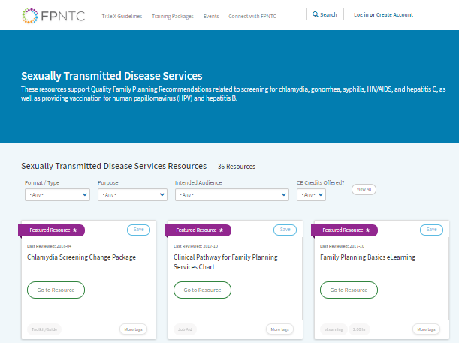
FPNTC Resources
Link: https://www.fpntc.org/training-packages/sexually-transmitted-disease-services
Notes:
For related resources, visit the FPNTC’s Sexually Transmitted Disease Services Resource page.
There you will find resources that support the Quality Family Planning Recommendations (QFP) related to screening for chlamydia, gonorrhea, syphilis, HIV/AIDS, and hepatitis C, as well as for providing vaccinations for human papillomavirus (HPV) and hepatitis B.

Slide 14
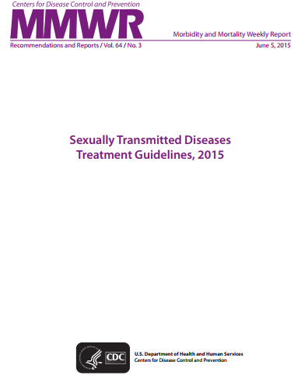
Recommendations, Guidelines, and Tools
Link: https://www.fpntc.org/training-packages/sexually-transmitted-disease-services
Notes:
On the FPNTC’s Sexually Transmitted Disease Services Resource page you will find resources, including nationally recognized guidelines and implementation tools that support QFP, recommendations related to screening for chlamydia, gonorrhea, syphilis, HIV/AIDS, and hepatitis C, as well as for providing vaccinations for HPV and hepatitis B.
Source (for reference)
https://www.fpntc.org/training-packages/sexually-transmitted-disease-services

Slide 15
Thank you!
Contact:
nysfptraining@jsi.com
Notes:
Thank you for participating in today’s discussion.

