Slide 1
New York State Family Planning Program Chlamydia Screening Performance Improvement Collaborative Kickoff
September 18, 2018
1
Notes:
Katie
Welcome to our first session of this learning collaborative.
We are so excited to work with you all over the next 7 months.
The remainder of our monthly meetings will be virtual but this opportunity to meet in person has been priceless in getting these learning collaboratives kicked off on the right foot to solidify our work together. Thank you for making the time to be here today.
Housekeeping
Informal – get up and move
Have a lot to cram in today, we’ll try to give some breaks but want to get out of here on time
Bathrooms, water
Sign in if you haven’t already
So let’s start with some introductions before we get into our objectives for what we’d like to accomplish today
Icebreaker: Tell us your name, role, agency affiliation, and one fun fact about yourself
Give NYSDOH opportunity to introduce themselves and welcome

Slide 2
Performance Improvement Collaborative
What do you think of when you hear the term “Performance Improvement Collaborative”?
Notes:
Katie
What is a performance improvement collaborative? What do you think of when you hear those words?
Maybe you think of people talking to each other, learning new strategies or skills, or gaining a greater knowledge base for common work. If you thought of any of these things you were right!
Definition: 2 aspects of this: collaboration and performance improvement
Collaborative: This is a group of people interested in learning, sharing information, and supporting each other around a common theme. They are characterized by a usual meeting time (either physically or virtually) and a regular way to stay in touch/share information. The philosophy behind these groups is that there is a wealth of knowledge between people and that knowledge builds by providing some structure for reflecting on and sharing information. The basic concept is – teams with a common goal or interest and a commitment to shared learning and mutual support.
Our role is to be facilitators of this learning –we will present recommendations and strategy ideas, but we depend on you to help each other in thinking about how this works in practice, because you all are the context experts
Performance improvement piece means driving improvement on a designated measure of performance—that is a measure of quality services at our sites

Slide 3
Learning Collaborative Group Expectations
Participation and engagement
Sharing lessons learned, best practices
Self-advocacy
Others?
What was most valuable?
“Hearing from other sites what they are doing and how we might be able to use their ideas.”
– Collaborative participant
Notes:
Katie
Has anyone in the room participated in a learning collaborative before? If so, what was it, and how do these expectations jive with your experience?
Whether you’ve participated in a learning collaborative, community of practice, or peer learning network – What do you hope the group to commit to for our time together that would best support you in staying engaged?
We hope to foster trust among the group so you can be vulnerable to share areas where you may be struggling because we don’t have all the answers but the group together is a more likely resource for helping solve issues than individually.
In our experience, where there is trust and willingness to share, we can be really effective as a group in driving performance.

Slide 4
This Performance Improvement Collaborative is to:
Support you in the achievement of your chlamydia screening performance goals
Increase capacity to conduct quality improvement (QI)
Provide an space to build relationships between peer sites
4
Notes:
Katie
A learning collaborative works in situation where we can “close the gap”. That is, we know what works—that is, the best practice recommendations in the change package, and we want to work towards implementing that.
So that brings us to, what is this performance improvement collaborative all about?
First and foremost, to support you—the participating sites—to achieve your chlamydia screening performance goals
Secondary goals: Increase capacity to conduct quality improvement (QI) and Provide an space to build relationships between peer sites
4

Slide 5
Meeting Objectives
By the end of today’s meeting you will be able to:
Describe the best practice recommendations as outlined in the Chlamydia Screening Change Package
Describe how the Model for Improvement can be used in the family planning setting
Develop at least two aim statements to guide PDSAs in your improvement plan
Identify at least two changes to test through PDSAs based on strategies suggested in the change package and experience of other teams
Notes:
Katie
The plan for today is to review the best practice recommendations in the Chlamydia Screening Change Package, review the Model for Improvement, which is the quality improvement framework we’ll be using for the chlamydia screening performance improvement collaborative, and then provide your team some action planning time and tools to start the process.
By the end of today’s meeting you should have an initial action plan to take back with you so you can start implementing tests of change at your site.

Slide 6
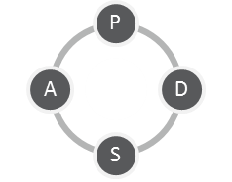
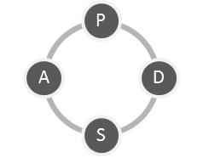
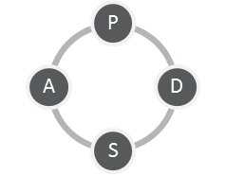
Breakthrough Series Learning Collaborative Model
In-person Learning Session
Virtual Learning Session 1
Action Period 1
Virtual Learning Session 2
Action Period 2
Virtual Learning Session 3
Action Period 3
Virtual Learning Session 4
Holding onto Gains
Sept. 18, 2018
In-person launch
Oct-Mar
Online sessions
6
Notes:
Katie
The performance improvement collaborative is based on IHI Breakthrough Series Model
So as you can see from this illustration, we will meet monthly virtually, and our model for this collaborative will include action periods between each of our virtual meeting. We’ll be using data to inform our conversations and your tests of change in between each session and at the forefront of all of this will be peer to peer sharing.
Learning will take place both during our meetings and between sessions when you’re conducting your Quality Improvement (Plan DO Study Act) efforts. We’ll be supporting you all along the way by connecting via phone and email to check in on how you’re doing.

Slide 7
Month | Proposed Content
TODAY | Getting Started: QI Action Planning
October | Best Practice 1. Include chlamydia screening as a part of routine clinical care for women 24 years and younger, <24 who are at increased risk, and men at increased risk.
November | Best Practice 2. Use normalizing and opt out language to explain chlamydia screening.
December | Best Practice 3. Use the least invasive, high quality, recommended laboratory technologies for chlamydia screening and timely turnaround.
January | Best Practice 4. Utilize diverse payment options to reduce cost as a barrier for the facility and the patient.
February | Optional flexible session (ongoing challenges, issues)
March | Lessons Learned and Scale Up
7
Notes:
Katie
Each of the Virtual sessions will primarily focus on a best practice identified in the literature for what works for improving chlamydia screening—outlined in the chlamydia screening change package. Here are the session dates. This is in your welcome packets. Virtual meetings will be on Wednesdays at 1-2:30pm.
We will send out calendar appointments after this meeting. It’s really critical that at least one or two members of your team attend each session live. We hear from many folks they like to schedule a conference room and all watch it together so they can strategize in real time.
(Turn it over to Lisa to talk about chlamydia – where we are starting from, and best practice recommendations)

Slide 8
Why Chlamydia Screening?
Source: https://www.cdc.gov/nchhstp/newsroom/2018/2018-std-prevention-conference.html
Notes:
Lisa
I am guessing that we have all heard about the importance of chlamydia screening.
As you probably have heard, STD rates have been increasing across the US
Chlamydia is the most commonly reported condition in the United States.
There were more than 1.7 million cases of chlamydia reported to the Centers for Disease Control and Prevention. This represented the highest number of annual cases of any condition ever reported to the CDC, and a 31% increase from 2013.

Slide 9
Chlamydia — Reported Cases and Rates of Reported Cases by State, Ranked by Rates, United States, 2016 (CDC)
Source: https://www.cdc.gov/std/stats16/tables/2.htm
Notes:
Lisa
In 2016, NYS had the 12th highest rate of chlamydia, with a rate of 552.8 per 100,000.
This was higher than the US overall of 497.3 per 100,000
Data source: https://www.cdc.gov/std/stats16/tables/2.htm

Slide 10
Why Chlamydia Screening?
Chlamydia — Rates of Reported Cases by Age Group and Sex, United States, 2016 (CDC)
Source: https://www.cdc.gov/std/chlamydia/stats.htm
Notes:
Lisa
Chlamydia is more prevalent among adolescent (15 to 19) and young adult (20 to 24) women.
While a chlamydia infection is usually asymptomatic, if left untreated, chlamydia infection in women can lead to pelvic inflammatory disease (PID), a major cause of infertility, ectopic pregnancy, and chronic pelvic pain.
Chlamydial infection also increases susceptibility to the transmission of HIV.
Chlamydia is easily detected and, if identified, treatable with antibiotics.
Chart source: https://www.cdc.gov/std/chlamydia/stats.htm

Slide 11
Why Chlamydia Screening?
You are making a difference!
CT testing in 11 agencies during 2016:¹
24,783 CT tests females tested
360 CT infections prevented
50 cases of PID prevented
10 women who are still fertile
Gross cost savings from CT testing - $136,450
¹Guttmacher calculator: https://data.guttmacher.org/calculator
11
Notes:
Lisa
24,783 CT tests were performed at the 11 agencies participating in the collaborative during 2016. As a result
50 cases of PID were prevented and
10 women are still fertile
$136,450 dollars saved from CT testing. (This is conservative because some things are excluded)
Assuming these tests were combo gonorrhea / chlamydia tests,
60 gonorrhea infections were also prevented with an additional $20,000 in savings
11

Slide 12
Chlamydia Screening Measure
HEDIS Measure: The percentage of women 16‐24 years of age who were identified as sexually active and who had at least one test for chlamydia during the measurement period.
Using data from Ahlers, use age group: 15-24
Measurement period = monthly
Although the HEDIS measure focuses on women 16-24 years of age, improvement activities should address all women and men at risk of chlamydia.
12
Notes:
Lisa
In this case, our measure of performance is derived from an adaptation of this HEDIS measure: HEDIS Measure: The percentage of women 16‐24 years of age who were identified as sexually active and who had at least one test for chlamydia during the measurement year.
HEDIS - The Healthcare Effectiveness Data and Information Set (HEDIS) is a tool used by more than 90 percent of America's health plans to measure performance on important dimensions of care and service.
Because this is a recognized measure, we want to be as true to the measure as possible – however, there are two adaptations
15-24 age group b/c of FPAR data, what you can get through Ahlers
We’ll look at data monthly because this is a QI project and we want smaller numbers to track changes and improvements– however, HEDIS is in measurement year
So, our best proxy measure is the number of patients screened during the reporting month
CDC recommends annual chlamydia screening of all sexually active women younger than 25 years, as well as older women with risk factors such as new or multiple sex partners, or a sex partner who has a sexually transmitted infection, so although the HEDIS measure focuses on women 16-24 years of age, improvement activities should address all women and men at risk of chlamydia.
There are instructions for accessing this data from Ahlers in the packet
12

Slide 13
Sexually Active Females 15 to 24 Years of Age
(Average Screening May-July, 2018)
2016 HEDIS (Medicaid) = 57%
2016 Title X Average & 2016 NYS Average = 62%
Notes:
Lisa
Reflect on where we are starting from as a group in terms of our CT screening data
2016 Title X Average = 61.5%. Title X average = % of users 15-24 screened for chlamydia in prior year
2016 New York State Average = 62.2%
2016 HEDIS (Medicaid) = 57.3%
On the whole –have lots of room for improvement!

Slide 14
Brainstorm
What barriers does your site face related to chlamydia screening?
Notes:
Lisa
So, why is this the case? We know that there are many drivers that influence performance. What are those challenges that you see at your site?
[Brainstorm with group what barriers are related to chlamydia screening (15 min)]
Probe
What are patient barriers?
What are facility barriers?
Lea – Scribe barriers on flip charts on the wall

Slide 15
Chlamydia Screening Change Package
Best practice recommendations
Rationale
Strategies
Suggested evaluation measures
Tools and resources
15
Notes:
Lisa
OK, so we have a list of challenges. Now what?
The Family Planning National Training Center, which JSI also manages, developed this change package of best practice recommendations for how to address barriers and improve performance on the chlamydia screening measure
In the change package you will find
Best practice recommendations
Rationale
Strategies
Suggested evaluation measures
Tools and resources
We are going to briefly review the best practice recommendations now, but again we will dive into each of these in more detail during the virtual learning sessions
15

Slide 16
Best Practice #1
Include chlamydia screening as a part of routine clinical preventive care for women 24 years and younger, women >24 who are at risk increased risk , and men at increased risk.
16
Notes:
Lisa
Best practice 1 is to: Include chlamydia screening as a part of routine clinical preventive care for women 24 years and younger, women >24 who are at risk increased risk , and men at increased risk
16

Slide 17
Where are we now?
Notes:
Lisa
Here are the strategy recommendations under this best practice and the % of teams that said they were doing this on the baseline assessment already.
Having a written policy and protocol for screening all sexually active women 24 years and younger for chlamydia and gonorrhea as a routine part of preventive health care, and for women >24 who are at increased risk, and men at increased risk
Routinely checking the screening history of patients and assessing the need to screen at any visit not just preventive health visits, especially for adolescents
Having site-level protocols to establish standing orders for chlamydia screening
Using reminder systems like stickers or messaging to remind staff, providers, and patients about chlamydia screening
Having an established chlamydia screening prompt in the HER – and potentially using a “hard stop” in the EHR that includes asking staff to identify “reason for not screening” for all women 24 years of age and younger?
Sharing data with staff such as provider-specific screening rates, national averages, and target screening rates
There is room for growth, and that’s great!

Slide 18
Best Practice #2
Use normalizing and opt-out language to explain chlamydia screening to all women 24 years and younger, women <24 at increased risk, and men at increased risk
18
Notes:
Lisa
Best Practice 2 is to: Use normalizing and opt-out language to explain chlamydia screening to all women 24 years and younger, women <24 at increased risk, and men at increased risk
18

Slide 19
Where are we now?
Notes:
Lisa
Here are the strategy recommendations under this best practice and the % of teams that said they were doing this on the baseline assessment already.
Including all staff in training about chlamydia screening efforts including front desk, support staff, nurses, and providers
Training staff with patient contact received training on:
National screening recommendations and rationale for routine screening of patients 24 years of age and younger;
The potential sequelae of untreated chlamydia, including the fact that chlamydia is the leading preventable cause of tubal factor infertility;
Chlamydia prevalence and epidemiology; and
How to respond to positive results including: timely treatment; infectious disease reporting requirements; partner treatment option; recommendations for re-testing
Training all staff with patient contact to use normalizing language with all patients, such as “we recommend annual chlamydia screening the same way we recommend getting an annual flu shot”
Providing staff sample scripts with opt out language for sexually active women 24 years and younger -- Opt out language assumes the patient will be screened unless they “opt-out.”
Avoiding asking questions such as: “Do you want to be tested for Chlamydia today?” or “Do you need to be tested for STDs today?”
Having staff practice role playing with opt-out language
Encouraging patients who screen positive to ensure that their partner(s) are treated by allowing patients to bring partners to treatment appointments and offering EPT services if the partner cannot be treated directly
Capitalizing on patient wait times by having them complete assessment forms and specimen collection
Offering free condoms and promote condoms as a dual method protection for patients using other contraceptive methods to also protect against STDs
And making STD prevention patient education materials widely available such as: signage in public places and exam rooms, materials to take home that fit in a pocket or purse, brochures

Slide 20
Best Practice #3
Use the least invasive, high quality, recommended laboratory technologies available for chlamydia screening with timely turnaround.
20
Notes:
Lisa
Best Practice 3 is to: Use the least invasive, high quality, recommended laboratory technologies available for chlamydia screening with timely turnaround.
According to the CDC – for chlamydia testing for WOMEN:
Nucleic acid amplification tests (NAATs) are the recommended test method.
A self- or clinician-collected vaginal swab is the recommended sample type. Self-collected vaginal swab specimens are an option for screening women when a pelvic exam is not otherwise indicated.
An endocervical swab is acceptable when a pelvic examination is indicated.
A first catch urine specimen is acceptable but might detect up to 10% fewer infections when compared with vaginal and endocervical swab samples.
An endocervical swab specimen for N. gonorrhoeae culture should be obtained and evaluated for antibiotic susceptibility in patients that have received CDC-recommended antimicrobial regimen as treatment, and subsequently had a positive N. gonorrhoeae test result (positive NAAT ≥7 days after treatment), and did not engage in sexual activity after treatment.
https://www.cdc.gov/mmwr/preview/mmwrhtml/rr6302a1.htm
For reference:
Chlamydia trachomatis and Neisseria gonorrhoeae testing in men
Nucleic acid amplification tests (NAATs) are the recommended test method.
A first catch urine is the recommended sample type and is equivalent to a urethral swab in detecting infection.
A urethral swab specimen for N. gonorrhoeae culture should be obtained and evaluated for antibiotic susceptibility in patients who have received CDC-recommended an antimicrobial regimen as treatment, and subsequently had a positive N. gonorrhoeae test result (positive NAAT ≥7 days after treatment), and did not engage in sexual activity after treatment.
Detection of Chlamydia trachomatis and Neisseria gonorrhoeae infections in the rectum and oropharynx
Nucleic acid amplification tests (NAATs) are the recommended test method for rectal and oropharyngeal specimens.
Laboratories must be in compliance with CLIA for test modifications since these tests have not been cleared by the FDA for these specimen types.
Commensal Neisseria species commonly found in the oropharynx might cause false positive reactions in some NAATs, and further testing might be required for accuracy.
A rectal or oropharyngeal swab specimen for N. gonorrhoeae culture should be obtained and evaluated for antibiotic susceptibility in patients who have received CDC-recommended antimicrobial regimen as treatment, had a subsequent positive N. gonorrhoeae test result (positive NAAT ≥7 days after treatment), and did not engage in sexual activity after treatment.
20

Slide 21
Where are we now?
Notes:
Lisa
Here are the strategy recommendations under this best practice and the % of teams that said they were doing this on the baseline assessment already.
Training staff on acceptable specimen collection options and how to get a sufficient specimen
Providing access to all chlamydia screening specimen collection options—including urine, and provider/self-collected vaginal swabs
Having clear patient instructions posted for how to properly collect a urine and/or self-collected vaginal swab sample
Having an established recall systems to retest patients three months after treatment in the case of a positive result

Slide 22
Best Practice #4
Utilize diverse payment options to reduce cost as a barrier for the patient and the facility.
22
Notes:
Lisa
Best practice 4 is to: Utilize diverse payment options to reduce cost as a barrier for the patient and the facility.
22

Slide 23
Where are we now?
Notes:
Lisa
Here are the strategy recommendations under this best practice and the % of teams that said they were doing this on the baseline assessment already.
Ensuring patients have access to STD screening regardless of ability to pay
Charging all patients in accordance with Title X guidelines. This includes:
Projects should not have a general policy of no fees for minors, or a schedule of fees for minors that is different from other populations. Eligibility for discounts must be based on the income of the minor.
Clients whose documented income is at or below 100% of the Federal Poverty Level (FPL) must not be charged, although projects must bill all third parties authorized or legally obligated to pay for services;
A schedule of discounts is required for individuals between 101% and 250% FPL;
For families over 250% FPL, charges must be made in accordance with a fee schedule to recover the reasonable cost of providing services;
Establishing options for confidential billing for minors and other patients who do not wish to use their insurance
When possible, obtaining third-party reimbursement for patients with, or eligible for, third-party coverage such as private insurance, Medicaid, or Family Planning Benefit Program (FPBP)
Routinely conducting quality assurance to ensure coding for chlamydia testing is accurate
Providing insurance eligibility screening and application assistance for all patients identified as in need on site or by referral
Developing strategies to pay for safety net screening services (for those without or not wanting to use their insurance coverage)
Accessing other revenue including private and grant funding for chlamydia screening
Informing patients about patient assistance programs
On the whole this seems like an area of scrength!
Now, I’m going to turn it over to Katie to help you start to prioritize which of these things to work on with each of your teams.

Slide 24
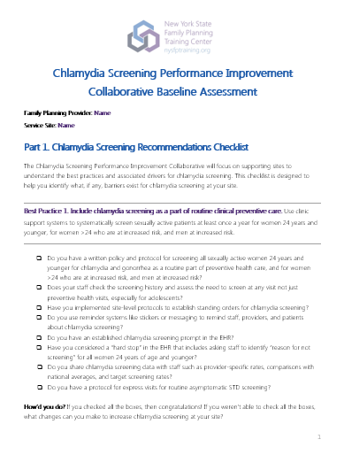
Prioritization Activity
You’ve listed some barriers and completed the Access Checklist (baseline assessment)…
Now what will move the needle at your service site?
Notes:
Katie
So we’ve had a chance to brainstorm some barriers to chlamydia screening in general, and to discuss some best practice recommendations highlighted in the change package.
We now want to start thinking about what are the specific barriers at your site, and changes will be able to move the needle on your performance measures? And, there are a lot of different ideas. So this activity will help you figure out, where do we start?
We are going to hand out the baseline assessments that you completed. On the first 3 pages, you’ll see the answers to the checklist assessing implementation of best practice recommendations. We’ve bolded the ones you left unchecked, but we also encourage you to go through and think about each item and whether these practices are really happening 100% of the time for patients, or if there are potentially areas for improvement.

Slide 25
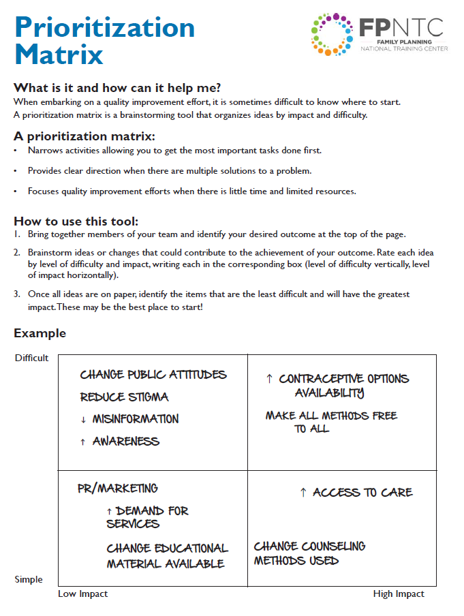
Prioritization Activity
Brainstorm ideas that should contribute to the achievement of your outcome: increased CT screening. Plot these on the Prioritization Matrix.
Now, choose a few (2-3) things that are high impact, low effort to start with. Write each idea on a sticky note.
Notes:
Katie
We’re now going to do an Activity in our teams.
So thinking about the barriers we brainstormed as a group, the change package, and with your baseline assessment, work as a team to brainstorm all of the things that are barriers contributing to your performance at the participating site.
Plot all of these things on the prioritization worksheet (in your folder) in one of the four quadrants related to whether the barrier is difficult or easy to change, and whether it will have a high or low impact.
Take 15 minutes or so to do that with your team now.
(15 minutes later)
OK, you should now have several ideas that could make a difference at your service site, in a variety of quadrants.
Now we’ll think about where do we start? Choose a few things – 2 to 3 - that are high impact, and low effort that you can get started with - or ideas that you are particularly jazzed about - even if they are high impact high effort.
Take a few minutes to select these 2-3 ideas, and highlight them on your sheet (so you know which you’ve selected). Then also write EACH idea on its own sticky note, which you’ll find on the table. (5 minutes)
Now, each team will read off their sticky notes and we will take the sticky and put it on our wall, organized by best practice area. (10 minutes)
We’re now going to take a 10 minute break. When you come back, you’ll see labels on the table according to best practice area. We’ll have the opportunity to talk across teams about some of the ideas you just prioritized. If you had ideas in multiple areas, may want to split up your team across multiple tables.
During break, JSI to put table tents with best practice on tables.

Slide 26
Cross-Team Sharing of Ideas
Questions to discuss:
What is a challenge you want to address?
What is a change idea you are considering?
What concerns do you have about this idea?
What is something you’ve tried before? How did it work?
Notes:
Katie
Now we’re going to get started with action planning and coming up with an approach to address the barriers at your service site.
The learning collaborative is all about hearing from each other….so let’s start with that…
30 mins - Cross group activity: Teams who decided to work in the same best practice area of interest to get together and discuss your challenges, your action plan ideas, share strategies that have worked. Team members may break up across tables to discuss multiple best practice areas.
After: Hopefully you gained some new insight from talking to each other. We’re now going to break for lunch for 1 hour. When we return, you’ll be working within your teams to develop an initial action plan – a living document that you’ll be implementing and updating over the course of the collaborative.

Slide 27
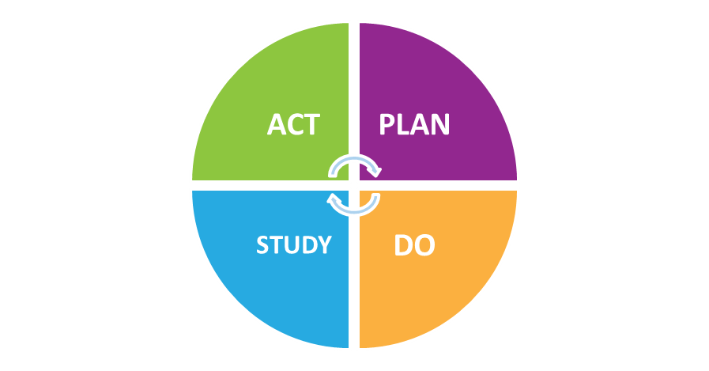
Model for Improvement
What are we trying to accomplish?
How will we know that a change is an improvement?
What changes can we make that will result in improvement?
27
Notes:
Katie
The Performance Improvement Collaborative’s framework for QI is called the Model for Improvement (MFI). The model for improvement is an approach, made popular by the Institute for Healthcare Improvement (IHI).
Who is familiar with this model already? How would you describe it?
The model is based on a combination of three fundamental questions that drive all improvement:
What are we trying to accomplish?
How will we know that a change is an improvement? (i.e. what do we need in terms of measurement / data)
What changes can we make that will result in improvement? (what can you do about it?)
The Model for Improvement is all about rapid cycle improvements. You’ll set an aim, think of ideas that you think will help you reach that aim, and then test them on a small scale. But it’s a guess – you think that if you make a change, it will result in an improvement. Plan-Do-Study-Act (PDSA) Cycles are a systematic way to test a change before implementing it system wide. Thinking on a small scale first can help you reduce the chance that you take things network wide when there are still kinks that need to be worked out.
We’re going to talk about these three questions now in order, but just keep in mind that part of this being rapid cycle is that it’s not always a linear process. You might think of an idea, and in thinking of ideas might re-evaluate what you are trying to accomplish. But keeping these three questions in mind at all times can help ensure you’re continuously being critical and moving in the right direction.
27

Slide 28
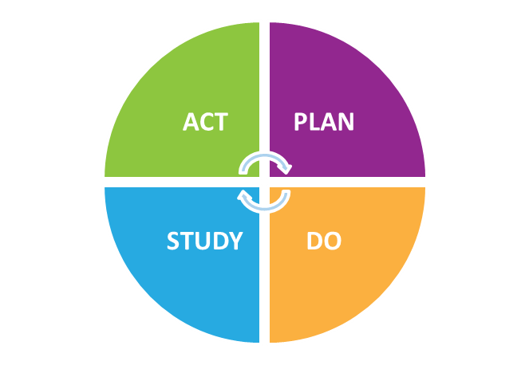
Model for Improvement
What are we trying to accomplish?
How will we know that a change is an improvement?
What changes can we make that will result in improvement?
Prioritization Matrix can help you figure out where to start and organize your ideas by impact and difficulty
28
Notes:
Katie
The first question: What are we trying to accomplish? What’s our objective?
There are two parts of determining what you want to accomplish – the big picture goal on the performance measure, and then aim statements that break down the goal into smaller pieces.
Identifying the 2-3 ideas before lunch using the prioritization matrix was the first step in figuring out what those small pieces might be that you can target, which will ultimately move the need on the performance measure.
We’ll talk through setting a goal and writing an aim statement in just a few minutes.
28

Slide 29
Model for Improvement
What are we trying to accomplish?
How will we know that a change is an improvement?
What changes can we make that will result in improvement?
29
Notes:
Katie
The second question is – how will we know that a change is an improvement?
It’s easy to make a change and check it off the list. Done! But did the change make a difference? Did it result in an improvement? Did it help to get you where you want to go? You might think it did, but how do you know for sure?
Data help separate what we think is happening from what is really happening and then establish a baseline and allow for periodic monitoring.
“data” can be: qualitative or quantitative – it may be large scale, or very small scale. It could be making tick-marks on the back of an envelope OR it could be the data from your EHR. Either way, you need some way of knowing if this change worked before you start changing clinical practice, administrative systems, EHR templates, etc.
[Share Arizona’s story on LARC removals….without the data on why removals were happening, they would have taken a very different approach to “addressing the problem”]
29

Slide 30
Model for Improvement
What are we trying to accomplish?
How will we know that a change is an improvement?
What changes can we make that will result in improvement?
Data-informed processes can help you:
Identify root cause
Identify a change
Select a change
30
Notes:
Katie
So, finally, What changes can we make that will result in improvement? What can be done?
It’s important to identify the root cause of a barrier – whether it relates back to administrative systems, provider behavior, financial processes, etc. but the deeper you go, the greater impact your change is likely to have. Figure out what needs to be done to make a change.
This is why the question about data comes before the question on “what changes can you make” – because it’s what you want to see happen, i.e. what the data will show, that should help inform the changes you select.
30

Slide 31
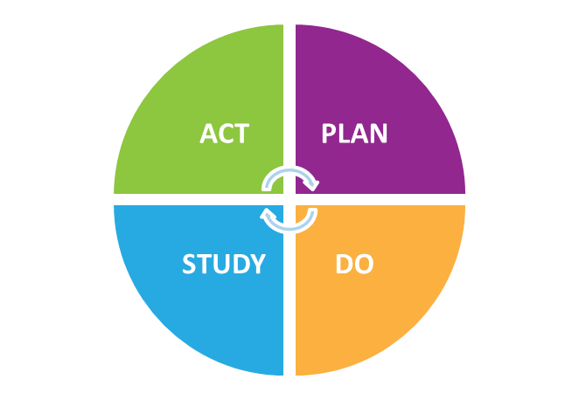
Testing the Change
PLAN to test your change.
DO try carrying out the change.
STUDY the test to see if it worked.
ACT based on your measured results.
What are we trying to accomplish?
How will we know that a change is an improvement?
What changes can we make that will result in improvement?
31
Notes:
Katie
Ok but as we said, this is rapid cycle, small changes. And your ideas are guesses on what you think might drive improvement. Your solution or change is really just a hypothesis. How do you know for sure that it will make a difference? Test it and start small! Start with one patient, with just one provider, on one day, etc….before you make changes that involve larger systems and staff, etc. You wan to be sure that this will work!
PDSA helps you to plan accordingly and ensure that you’re testing your change in a documented and deliberate way so that you can easily evaluate its impact.
First, PLAN: “What’s happening now? What will happen if we try something different?”
Then, DO: “Let’s try it!”
Next you STUDY: “Did it work?”
Finally, ACT: “What’s next?”
31

Slide 32
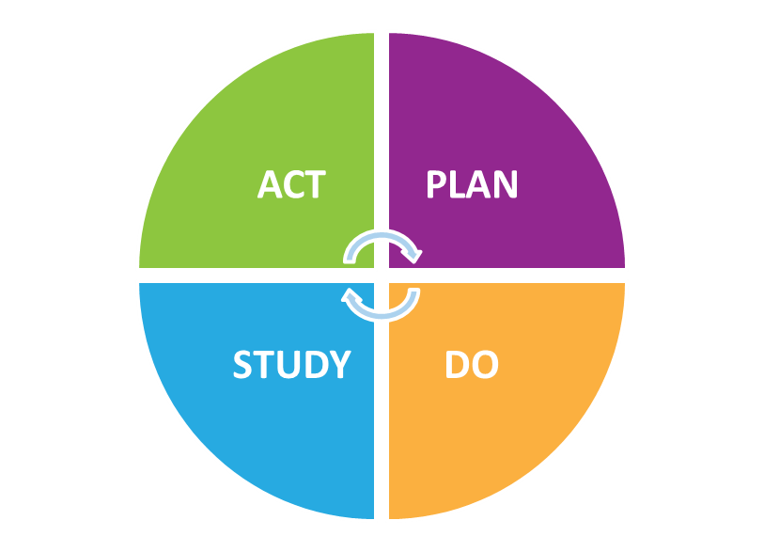
PLAN: What’s happening now?
Clarify your objective
Determine the change you want to test.
Predict your outcome
What do you think will happen? Will it help?
Identify steps you need to take
What data do you need to show change? Who? What? When? How?
32
Notes:
Katie
We’ll be working through this process this afternoon, but to break down each of these steps:
Plan: Some people say it should be called, “Plan, Plan, Plan, Plan, Do, Study, Act”
Planning is the most important and most involved step:
Clarify objective
Predict outcome
Identify steps: data, who, what, when, how
32

Slide 33
DO: Let’s try it
Carry out the plan
Document Observations
Begin Analysis
33
Notes:
Katie
Do: try it
But try it SMALL first
And we really mean small…. The starting small is important. All of you are probably very familiar with change fatigue in your service sites. And what you want to make sure is that you’re not just one more person coming in with grand ideas for changes that should be made. Really fine-tuning the change on a small level can demonstrate to staff that you’re committed to getting this right before causing all sorts of disruptions.
Your early PDSA Cycles aim to give you information – and, as we saw, sometimes one patient can give you the information you need. This is just a first step – you won’t stop here – but it is the way to start.
Here’s a tip. When you’re working with your team to design a test, listen to what people suggest as the time frame. Then, move down two levels.
If you hear quarters…Ask what test can we do by the end of next week?
If you hear weeks, ask what we can do in the next hours.
The point is to get moving, to try something out. You’ll never make a change if you don’t….actually make a change.
33

Slide 34
STUDY: Did it work?
Analyze qualitative & quantitative data
Compare data against predictions
Summarize lessons learned
34
Notes:
Katie
Now study – What happened? Did it work?
Look at your data: both qualitative and quantitative
Front desk staff input etc.
34

Slide 35
ACT: Decide what to do
Decide if you will:
Adopt
Abandon
Adapt
35
Notes:
Katie
Finally - Use your data to determine if you are going to: Adopt, Abandon, or Adapt -
35

Slide 36
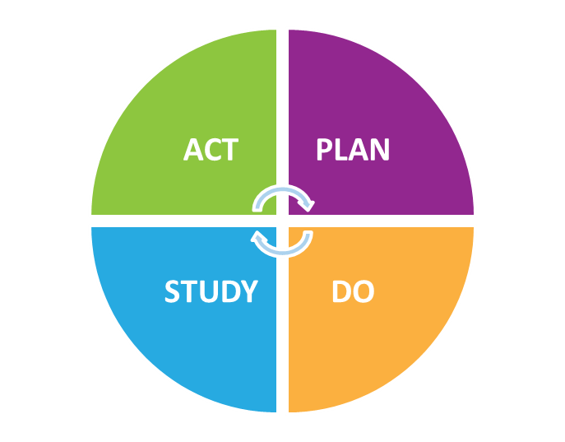
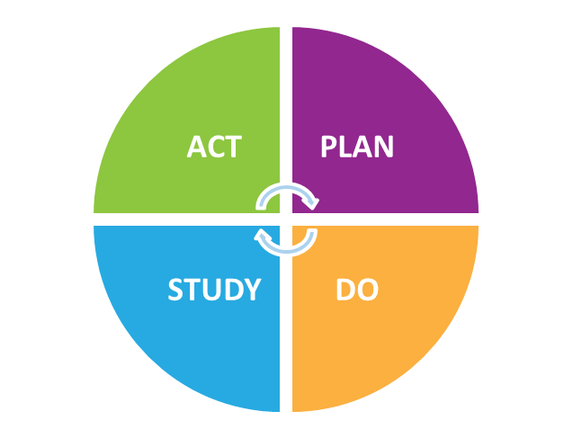
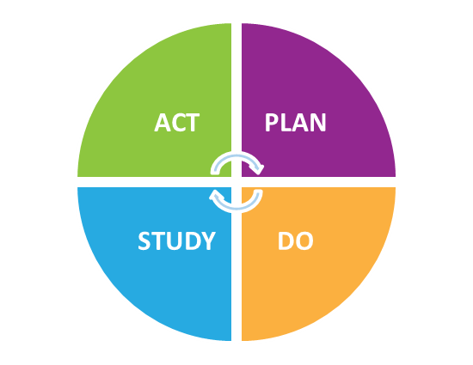
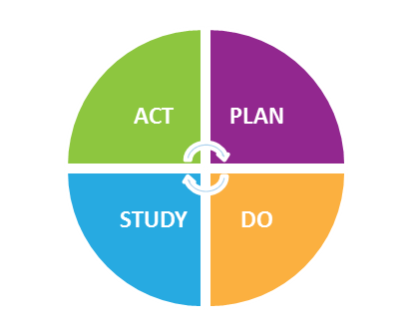
PDSA Scale Up
Learn from one cycle and apply those findings to the next.
36
Notes:
Katie
Just because we start small, that doesn’t mean that that is where we end up. This diagram shows the relationship between multiple PDSA cycles. The PDSA process is supposed to be iterative with the learning building from one cycle to the next.
The PDSA grows over time. As we build our degree of belief that a change is an improvement, the scale of the test increases.
Have we quickly identified a promising idea? If so, we try it on a few more patients, continuing to build our confidence that the change is leading to improvement. Then maybe we expand the test a little more, trying it under different conditions (with a different provider, different patient, different day). Only changes that show promise are expanded for testing on larger and larger scales, until the team can be confident that the change should be adopted widely.
At the end of the day we want a change that results in improvement implemented for every case. But we take small steps to get there to make sure it’s being implemented the right way.
This is why we asked you to work with a specific site, and then scale up to other sites after the collaborative. The participating site is a place to test changes and see what works and what doesn’t
36

Slide 37
How Will You Know Change is an Improvement?
BEST PRACTICES | PLAN |  |  |  |  | DO | STUDY | ACT
 | Aim Statement | Tasks | Who | When | Measures | What progress has been made? What is happening as you make progress? | What do the measures show? What are your observations? | What are your next steps?
 | What do you want to accomplish? By when? (May be the same as or a subset of Step) | What tasks need to be accomplished to reach this Aim? | Who will complete the Tasks? | Task will be done by what date? | How will you know you have been successful?
Best Practice 1. Include chlamydia screening as a part of routine clinical preventive care for women 24 years and younger, women >24 who are at risk increased risk , and men at increased risk.
Best Practice 2. Use normalizing and opt-out language to explain chlamydia screening to all women 24 years and younger, women <24 at increased risk, and men at increased risk.
Best Practice 3. Use the least invasive, high quality, recommended laboratory technologies available for chlamydia screening with timely turnaround.
Best Practice 4. Utilize diverse payment options to reduce cost as a barrier for the patient and the facility.
37
Notes:
Katie
How does the MFI look in the Chlamydia Screening performance improvement collaborative? The Improvement plan as how we will operationalize these steps
Each line is designed to help you track where you are in implementing a test of change. Remember, these tests of change are small.
We’ll hand this out to you in a minute.
We’ll ask you to report monthly on what your doing – the changes you’re trying, what you’ve observed in the study phase, and what your plans are for adopting, abandoning, or adapting.
37

Slide 38
How Will You Know Change is an Improvement?
15%
20%
22%
31%
33%
40%
38
Notes:
Katie
And at the end of the day what we care about is moving the needle on the measures, so we’ll also ask you to report the performance measure data.
Both of these are tabs in an excel spreadsheet, which will we will send this to you electronically too
38

Slide 39
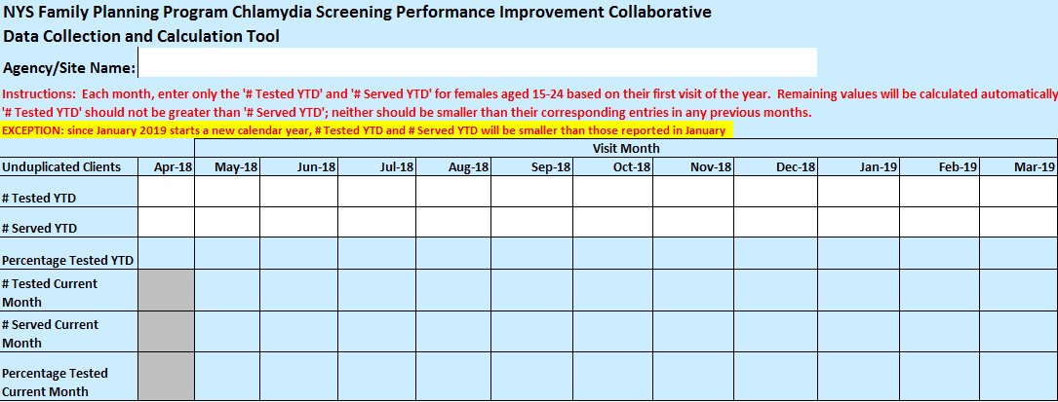
Data Collection & Tracking Tool
Notes:
Katie
The third tab in the monthly tracking sheet is a data input form, where you only need to enter the # of tested clients and clients seen and it will update automatically for you
Again we’ll be emailing you this template following todays meeting

Slide 40
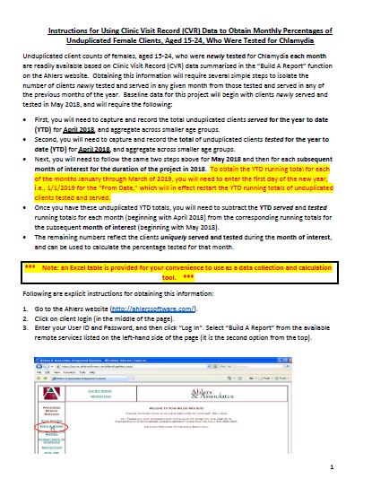
Instructions for using CVR Data to Obtain Monthly Percentages
Notes:
Katie
We have instructions for how to access this data on the website

Slide 41
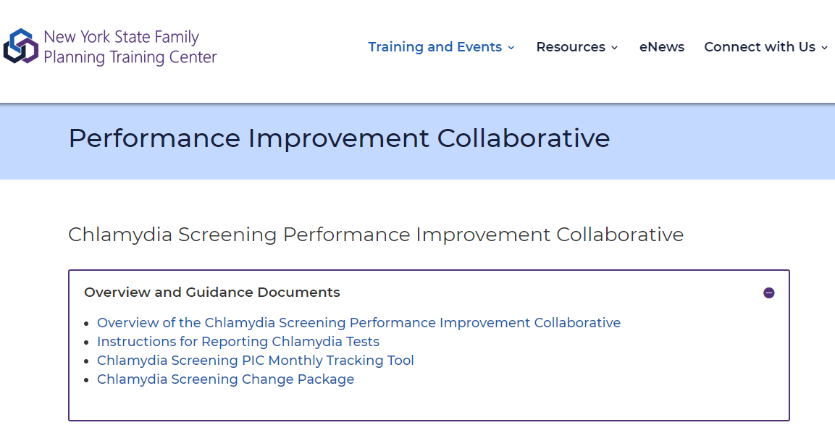
PIC Webpage: nysfptraining.org
41
Notes:
Katie
This monthly tracking tool is on our webpage at nysfptraining.org. Access under “training and events”
This is also where we’ll be posting all event materials (do demo if possible, if time)

Slide 42
What Do You Want to Accomplish?
Performance Goal
Big picture goal for performance measures
E.g., Increase % of women 15‐24 years of age who were identified as sexually active and who had at least one test for chlamydia in the reporting month from 50% to 60%
Aim Statements
Smaller interim goals to help you define if your planned activities are successful – to track movement towards your performance goal
42
Notes:
Katie
Let’s tackle the first question of the MFI: What Do You Want to Accomplish?
There are two pieces of this….
First is the performance goal. For OUR project, the performance goal is about the performance measure.
Then is the aim statement - which we’ll talk about next. Aims are smaller, bite size chunks. We’ll talk more about those in a minute.
42

Slide 43
Notes:
Katie
What are good goals? I’m sure we’re all familiar with SMART – so this is a reminder that as we move into goal setting, we should use those parameters

Slide 44
Goal Setting
Aim for a benchmark:
2016 Title X Average = 61.5%
2016 New York State Average = 62.2%
2016 HEDIS (Medicaid) = 57.3%
Set a percentage increase e.g.,
50% improvement over baseline
Increase of 20 percentage points
Notes:
Katie
Two ways to think about goal setting:
Aim for a benchmark:
2016 Title X Average = 61.5%
2016 New York State Average = 62.2%
2016 HEDIS (Medicaid) = 57.3%
Set a percentage increase e.g.,
50% improvement over baseline
Increase of 20 percentage points

Slide 45
Performance Goals
Review your baseline data and think about what performance goal makes sense for you.
Write it on your improvement plan.
 | Jan | Feb | Mar | Apr | May | Jun | July | Aug | Sept | Oct | Performance Goal
% of women 16‐24 years of age who were identified as sexually active and who had at least one test for chlamydia in the reporting month | 50% | 54% | 60%
45
Notes:
Katie
OK – now, look at this page on your handout, and in the “performance goal column”, choose a goal for your team and write it down (10 minutes)
One note is that the data in your spreadsheet MIGHT be for your agency overall and not for a specific site
After the meeting, we’ll be sending out this spreadsheet to you and you’ll be able to enter 1) updated data for the site, if needed and 2) the performance goal. But for now, use what you have here.
45

Slide 46
Model for Improvement
An aim statement:
Helps create a shared vision
Defines the scope of your quality improvement
Defines what you are working towards
Is a commitment to achieve improvement
Has a definite timeline
Has quantified goals
46
Notes:
Katie
Ok, the next piece is the aim statement. Again this is the smaller interim goals to help you track movement towards your performance goal
Let’s talk about aim statements for a second.
46

Slide 47
Aim Statement
By December 1, 2018, increase the percentage of patients whose providers use “opt out” chlamydia screening language from 0% to 50%.
47
Notes:
Katie
Overarching goal is about the performance measure
An example aim statement –smaller– is an interim goal that moves us towards the performance measure
It has a few key elements

Slide 48
Aim Statement
By December 1, 2018, increase the percentage of patients whose providers use “opt out” chlamydia screening language from 0% to 50%.
By when?
48
Notes:
Katie

Slide 49
Aim Statement
By December 1, 2018, increase the percentage of patients whose providers use “opt out” chlamydia screening language from 0% to 50%.
What?
49
Notes:
Katie

Slide 50
Aim Statement
By December 1, 2018, increase the percentage of patients whose providers use “opt out” chlamydia screening language from 0% to 50%.
By how much?
50
Notes:
Katie

Slide 51
Model for Improvement
TIPS: Be Specific
Control: Is this something you have control over?
Time: Can the aim be achieved in the time specified?
Resources: Are there sufficient resources?
Team: Who needs to be involved for success?
Alignment: Is your aim aligned with the organization’s mission and goals?
51
Notes:
Katie

Slide 52
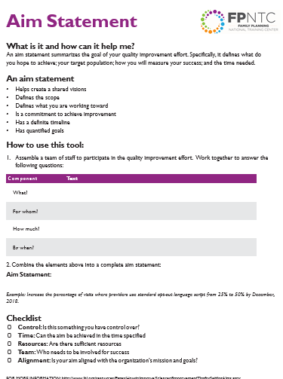
Develop an Aim Statement
52
Notes:
Katie
Our goal now is to develop a couple of aim statements
Think back to what they think will move the needle (from morning discussion within and across teams) and the Prioritization Matrix. For each of the 2-3 ideas, use the aim statement worksheet to help organize your thoughts and then transcribe that statement onto the team improvement plan when you’re done.
How will you know change is an improvement? -how will you measure the impact?
Reiterate that aim statement goal should be small, changes should be small. Discuss how to break down what to measure. If you’re thinking all providers, try thinking about what you can do with 1 first.
Complete 2-3 aim statement worksheets to organize your thoughts, and then transcribe them over to your improvement plan.
Goal = 2-3 lines on the improvement plan, in different best practice areas are fleshed out
(20 minutes)

Slide 53
BEST PRACTICES | PLAN
 | Aim Statement | Tasks | Who | When | Measures
 | What do you want to accomplish? By when? (May be the same as or a subset of Step) | What tasks need to be accomplished to reach this Aim? | Who will complete the Tasks? | Task will be done by what date? | How will you know you have been successful?
Best Practice 1. Include chlamydia screening as a part of routine clinical preventive care for women 24 years and younger, women >24 who are at risk increased risk , and men at increased risk.
Best Practice 2. Use normalizing and opt-out language to explain chlamydia screening to all women 24 years and younger, women <24 at increased risk, and men at increased risk.
53
Notes:
Lisa
If you haven’t already, start to transcribe your aim statements into the work plan
And now, start fleshing out the rest of the plan section in your improvement plan – consider the necessary tasks, who to do it, by when, and how to measure success. Completing these steps will help to get you started with your first PDSA cycle back at your site.
Ultimately the goal is to have multiple PDSA cycles in each best practice area, but starting with a few at a time. (10 minutes)

Slide 54
Poster Session
Each group to create a poster:
What do you want to accomplish?
How will you know a change is an improvement?
What changes can you make that will result in improvement?
Be creative! We strongly support pictures, charts, graphs…
54
Notes:
Lisa
Ok so now as you are continuing to work on finishing your planned first PDSA cycles, we want you to start thinking about how to share this with your colleagues on a poster. Each team will make a poster.
The poster should address the three MFI questions:
What do you want to accomplish? What is your aim statement?
How will you know - ways to measure
What changes can you make that will result in improvement: the different ways, approaches, ideas you all will achieve your aim statement/goal.
Do visual representation - be creative!
The poster should represents one PDSA you want to work through
Use flip chart paper and makers
You’ll have 20 minutes to develop it. You’ll select one person to be your poster presenter and other teammates will walk around and visit the other posters; and then swap
54

Slide 55
Next Steps and Wrap-Up
How will you bring back this action planning process to the rest of your team?
Thinking about your aim statements and barriers discussed today, do you have everyone you need on the team?
Front desk, billing/finance, clinical staff
Do you have a regular meeting time for team to move action plan forward?
55
Notes:
Katie
As we move to wrap up, let’s think about next steps:
How will you bring back this action planning process to the rest of your team?
Thinking about your aim statements and barriers discussed today, do you have everyone you need on the team?
Front desk, billing/finance, clinical staff
Do you have a regular meeting time for team to move action plan forward?
55

Slide 56
Breakthrough Series Learning Collaborations Model
In-person Learning Session
Virtual Learning Session 1
Action Period 1
Virtual Learning Session 2
Action Period 2
Virtual Learning Session 3
Action Period 3
Virtual Learning Session 4
Holding onto Gains
Sept 18, 2018
In-person launch
Oct-March
Online sessions
56
Notes:
Katie
When we meet again, it will be online
We’ll be sending calendar appointments for the next online learning session in October

Slide 57
Month | Proposed Content
TODAY | Getting Started: QI Action Planning
October 17th 1-2:30 ET | Best Practice 1. Include chlamydia screening as a part of routine clinical care for women 24 years and younger, <24 who are at increased risk, and men at increased risk.
November (new date) | Best Practice 2. Use normalizing and opt out language to explain chlamydia screening.
December | Best Practice 3. Use the least invasive, high quality, recommended laboratory technologies for chlamydia screening and timely turnaround.
January | Best Practice 4. Utilize diverse payment options to reduce cost as a barrier for the facility and the patient.
February | Flexible session (topic TBD)
March | Lessons Learned and Scale Up
57
Notes:
Katie
Our first online session will be about: Best Practice 1. Include chlamydia screening as a part of routine clinical care for women 24 years and younger, <24 who are at increased risk, and men at increased risk.

Slide 58
What We Expect from You
Consistent participation on the learning sessions
Monthly submissions
Site-level chlamydia screening data
Updated improvement plan
What was most valuable?
“Hearing from other sites what they are doing and how we might be able to use their ideas.”
– Collaborative participant
58
Notes:
Katie
The online sessions are only as valuable as you make them. We rely on your participation, questions, and engagement to make them helpful to the group
Folks always say hearing from each other is the most valuable aspect of the sessions
In addition to participating in the sessions, we will collect from you monthly your data and improvement plan. Again, we have a spreadsheet with space for data collection and improvement planning that we’ll send out following todays meeting.
58

Slide 59
How Will You Know Change is an Improvement?
BEST PRACTICES | PLAN |  |  |  |  | DO | STUDY | ACT
 | Aim Statement | Tasks | Who | When | Measures | What progress has been made? What is happening as you make progress? | What do the measures show? What are your observations? | What are your next steps?
 | What do you want to accomplish? By when? (May be the same as or a subset of Step) | What tasks need to be accomplished to reach this Aim? | Who will complete the Tasks? | Task will be done by what date? | How will you know you have been successful?
Best Practice 1. Include chlamydia screening as a part of routine clinical preventive care for women 24 years and younger, women >24 who are at risk increased risk , and men at increased risk.
Best Practice 2. Use normalizing and opt-out language to explain chlamydia screening to all women 24 years and younger, women <24 at increased risk, and men at increased risk.
Best Practice 3. Use the least invasive, high quality, recommended laboratory technologies available for chlamydia screening with timely turnaround.
Best Practice 4. Utilize diverse payment options to reduce cost as a barrier for the patient and the facility.
59
Notes:
Katie
We’ll be asking you to submit this monthly improvement plan and data monthly on the 15th of the month
You’ve started it today – it’s a living document!
59

Slide 60
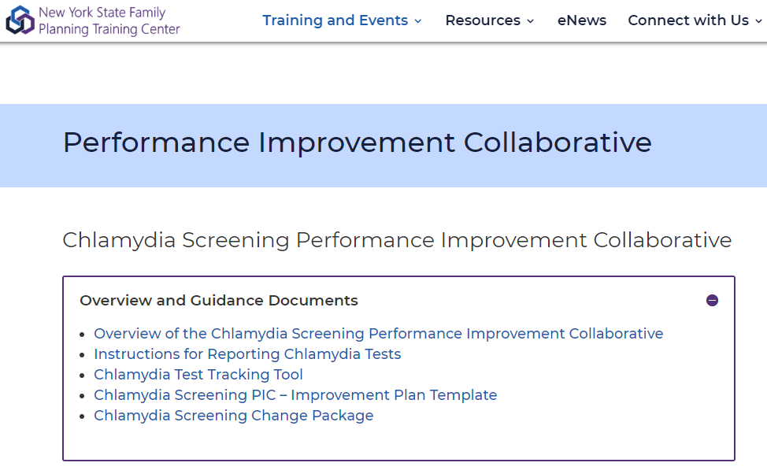
Between Now and Then
60
Notes:
Katie
Final reminder: Web page available

Slide 61
QI e-Learning Course
Introduction to QI for Family Planning
QI Methodologies: Using the Model for Improvement
Data-Driven QI
Implementing Sustainable QI
Building a Culture of Quality for Family Planning
61
Notes:
Katie
If you are new to QI, recommend this quality improvement for family planning eLearning course
61

Slide 62
Reflection
What is the first thing you’ll do when you return to your workplace?
62
Notes:
Katie
Quick round-robin: after today, What is the first thing you’ll do when you return to your workplace?
62

Slide 63
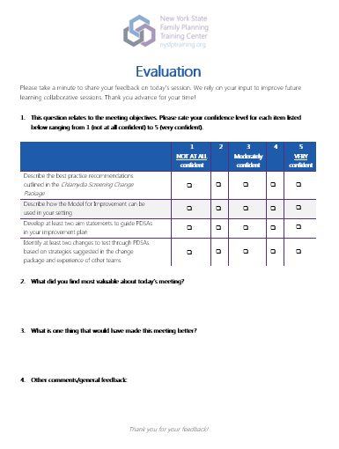
Please complete the evaluation before you leave!
63
Notes:
Katie

Slide 64
Katie DeAngelis, MPH
katie_deangelis@jsi.com
Lisa Anne Schamus, MPH
lisa_schamus@jsi.com
Lea Kassa
lea_kassa@jsi.com
64
Notes:
64

