Slide 1
Chlamydia Screening Performance Improvement Collaborative: Team Presentations Part 1
February 20, 2019
Last Updated March 2018
Notes:
Katie
Welcome to today’s session, where we’ll be hearing the first 4 of 9 team presentations.

Slide 2
Muting Your Line
Click the mute button on your phone OR
Click on the WebEx meeting and hover at the top or bottom of screen until you see a menu
Click the person icon
Hover over your name in the attendee list.
Click the microphone icon. When muted, microphone will appear red.
To unmute, click microphone icon again
Notes:
Katie
Before we begin, I’m going to ask everyone please take a minute to mute your lines
You can click the mute button on your phone OR
Click on the webex screen, hover over the top or bottom until this menu appears
If a microphone pops up in the menu, you can click that to mute yourself. If the menu appears at the top, click the person icon in the menu. This will make the attendee list show up, then, hover over your name in the attendee list and click the microphone icon. When muted, microphone will appear red. To unmute, click microphone icon again

Slide 3
Tell us in the chat….
Your name
Names of the people in the room with you
Your team affiliation
Finger Lakes Migrant Health Center
Chautauqua County
Planned Parenthood of Mohawk Hudson
Tioga Opportunities
HRHCare
Public Health Solutions/MIC
Jacobi Hospital
S
Gotham South Queens
Coney Island Hospital
Notes:
Katie
We want to know who is here with us today. Because we want to make sure we have time for team presentations, tell us in the chat….

Slide 4
Median Percent Tested
% Tested Current Month
% Tested Year to Date
Notes:
Katie
A quick check in on our data – we are continuing to see an increase. Note we are now reporting a single baseline average, and showing the comparison of current month vs. YTD testing. When we show this, we still see increases. The YTD is slower over time, but still ticking upwards.

Slide 5
Team Presentations
Tioga Opportunities
Coney Island Hospital
Gotham South Queens
Planned Parenthood of Mohawk Hudson
Notes:
Katie
I’d now like to move into our team presentations. We’ll have ~5 mins for presentations, followed by 5 mins of Q&A. Please jot down your questions as we go, or feel free to chat them in while the teams are presenting. As you know, we’ll hear from each team an overview of their data, what was the most impactful change, challenges that arose, and their plans for next steps.
In the past, we’ve found that teams find this time valuable to ask about other changes they’re considering making, and have heard from a successful team that has already implemented this change.
I’d first like to invite the Tioga Opportunities team to present.

Slide 6
Tioga Opportunities, Inc.
Chlamydia Screening Performance Update
February 20, 2019

Slide 7
Screening Rate: % Tested in Current Month, Over Time
Notes:
Qualitatively describe the data. What trends do you see?
To what extent can the trend be explained? What do you think drove the observed ups and downs throughout the learning collaborative?

Slide 8
Screening Rate: Baseline Average vs. Learning Collaborative Average
10%
Increase
Notes:
Baseline average = average monthly screening rate from May to August
Learning collaborative average = average monthly screening rate from September to December

Slide 9
Most Impactful Change
Describe the change that had the most impact on your chlamydia screening rate, or the change of which you are proudest.
- Our clinic is very proud of the development and implementation of the standing orders and express STI nurse visits. However, the change that has had the most impact on screening rate is the use of opt-out language during the appointments.

Slide 10
Most Impactful Change
Tell us, why did you decide to make this change in the first place?
- The opt-out language was incorporated to increase the overall screening rates for chlamydia and to offer the screening for patients seeking pregnancy tests and EC.

Slide 11
Most Impactful Change
Describe a brief overview of the process of implementing this change.
- From the beginning of this collaborative, it was apparent to the clinical staff that the use of opt-out language was a necessary component of each visit to increase the screening rates. To implement this as a small clinic, the RN wrote the new policy and procedure for the standing orders for chlamydia screening. The Medical Director approved the new policy and procedure. The Practitioner and RN implemented the change during visits.

Slide 12
Measurement of Change
Describe how you measured that this change had an impact. What makes you say this was the most impactful change?
- To measure the impact, the data reports required for the collaborative were used. They indicated a clear increase in screening rates since the collaborative began.

Slide 13
Measurement of Change
What data do you have that shows the impact of this change?
- The data from the reports for the collaborative reflect an increase in the screening rates.

Slide 14
Challenges
What challenges did you encounter while working on increasing chlamydia screening rates at your site?
- The challenges the clinic encountered were due to patient resistance to new collection options. The clinic now has self-collected vaginal swabs available for chlamydia screening. Patients are resistant to choose this method of specimen collection during appointments.

Slide 15
Challenges
How did you overcome those challenges?
- We kept patients informed regarding use of the self-collected swab by continuing to offer the option along with providing education about use of the self-collected swab.
How are you continuing to work on addressing challenges?
- In conjunction with continuing to offer the self-collected swab and providing education, we are listening to patient feedback about the self-collected swab to be able to improve the service moving forward.

Slide 16
Next Steps and Opportunities
What next steps have you identified for continuing the progress made during the course of the collaborative?
- We will continue using opt-out language at all visits and use the standing orders if and when appropriate. Further, we are in the process of developing a data collection method for information about visits that didn’t include screening for chlamydia. We plan to use this information to assess missed screening opportunities.

Slide 17
Next Steps and Opportunities
What are your plans for ensuring changes and improvements are sustained?
Continue to track data on a monthly basis
Share data at monthly staff meetings
Review any missed opportunities for screening
Reinforce the importance of screening for chlamydia on all patients to increase staff and patient buy-in

Slide 18
NYC H+H Coney Island
Chlamydia Screening Performance Update
February 20, 2019

Slide 19
Screening Rate: % Tested in Current Month, Over Time
Notes:
Qualitatively describe the data. What trends do you see?
To what extent can the trend be explained? What do you think drove the observed ups and downs throughout the learning collaborative?

Slide 20
Screening Rate: Baseline Average vs. Learning Collaborative Average
65%
Increase
Notes:
Baseline average = average monthly screening rate from May to August
Learning collaborative average = average monthly screening rate from September to December

Slide 21
Most Impactful Change
We are proud to see the outcome of our teams hard work through the data presented in the previous slides. We have seen an overall increase in our screening and testing rate.
Why did you decide to make this change in the first place?
Currently NYC Health + Hospitals/ Coney Island Family Planning Program plays an important role in screening individuals for chlamydial infections and providing treatment when needed in a high risk population located in the Southern Brooklyn community. Joining this collaborative will provide strategies which will help achieve our overall goal to continue to reduce the rate of chlamydial infections and increase chlamydial screenings average by at least 50%.

Slide 22
Describe a brief overview of the process of implementing this change.
Creating a plan.
Informing administrative leaders of various disciplines of the Chlamydia initiative, our goals and the importance of them being involved.
Scheduling educational sessions.
Executing actual instructions with allowance of questions and answer periods for staff clarification.
Review and analyze data to ensure our goals are on track and make adjustments as needed.

Slide 23
Measurement of Change
In order to observe that the increase on chlamydia screenings stemmed from educational changes of staff members we utilized real time data and positive feedback from staff members.

Slide 24
Challenges
One of our challenges is implementing the use of self swabs for chlamydia testing. We feel this can improve our screening rates particularly in patients who are not having a speculum exam at the time of their visit. We are currently working on this process which will include;
Administrative approval
Obtaining ordering and purchasing information
Education of staff including all provider levels, nurses, laboratory technicians
Establishing a policy and procedure

Slide 25
Next Steps and Opportunities
Coney Island intends to re-educate staff at our main sites and off sites on a yearly basis as well as conduct quarterly reviews of data for quality assurance purposes in hopes of sustaining / improving our chlamydia screenings overall.

Slide 26
NYC H+H Gotham South Queens
Chlamydia Screening Performance Update
February 20, 2019

Slide 27
Screening Rate: % Tested in Current Month, Over Time
Notes:
Qualitatively describe the data. What trends do you see?
To what extent can the trend be explained? What do you think drove the observed ups and downs throughout the learning collaborative?

Slide 28
Screening Rate: Baseline Average vs. Learning Collaborative Average
42%
Increase
Notes:
Baseline average = average monthly screening rate from May to August
Learning collaborative average = average monthly screening rate from September to December

Slide 29
Most Impactful Change
Most impactful change: We’ve had several changes throughout this Chlamydia Screening PIC, mainly in our workflow. Our transition into this workflow was pretty smooth after having our Staff meeting. Everyone now knows what part of the CVR pertains to them, and they make sure they get it filled efficiently, every time., on that Date of Service. Boosting our rate up by 34%. I’m very proud of our Staff for coming together and doing their part in this PIC.
Why did you decided to make this change in the first place? When I sat down to review our Ahlers Data with one of our Providers, Ms. Thomas, she brought to my attention that she strongly believed there were discrepancies in our Data Collection. We then reviewed some physical CVRs and discovered Data was missing from a couple of them, including Chlamydia Screening.
Process of implementing this change. We decided to capture Data two different ways. We assigned individual Staff Members a specific section to fill out on each CVR. Making it easier for them to know exactly what they're responsible for. Additionally, I gave Nursing a Notebook in which they manually enter every patient (15yrs – 24yrs) that receives Chlamydia Screening. I then compare them manually, before uploading to Ahlers. Its been tedious, but definitely an eye opener!

Slide 30
Measurement of Change
Describe how you measured that this change had an impact. Having done this PIC for the past couple of months & using the CVR Data as a measurement tool, what I came to realize is that each time it was completed there was a decrease in discrepancies compared to the previous months, in relation to Data Capturing.
What data do you have that shows the impact of this change?
Patient feedback: I had a patient a couple of weeks ago that (according to her) came in for a concern only, but ended up having a full Annual Exam. As she left she came back to me and said she was happy she came because she got all her testing done as well. She was grateful that the Provider reminded her she's due for it! This proved to me that the Provider is doing what we agreed would be our Plan of Action in regards to Patients that are due for Screening.
Staff Feedback: Our workflow in regards to our Data via CVR collection has been not only a lot smoother, but the margin of error has decreased significantly. I haven’t had to return any CVRs for Review to the Staff this past month and the Staff is happy about that. Makes work a lot easier & efficient.
Process measures: Our measuring tool is our Ahlers Data, watching as our numbers increase throughout these months while doing this PIC. Achieving a 34% increase!

Slide 31
Challenges
What challenges did you encounter while working on increasing chlamydia screening rates at your site? Our main challenge was honestly the Providers. Not all of them were as Enthusiastic as others. The first 2 months I would say, the Providers “section” on the CVRs were empty and I repeatedly had to come back to them to fill them out (usually [before this PIC] we would have Nursing do it). With that being said, Accountability played a major part in this project. Now, I rarely find myself going back for clarification on CVR Data.
How did you overcome those challenges? Consistency. I stuck to what we agreed on in our Staff Meeting and held everyone accountable for their CVR Section. Whenever anything was missing, I simply took it back to them to Review.
How are you continuing to work on addressing challenges? We’ve decided to use part of this PIC as a permanent work flow for us. Everyone being in charge of their own Part has minimized margin of error significantly. We all work together as a team! If for whatever reason, a Staff member is out and someone is Covering, we make sure we educate them on our Purpose and how we’re doing Data Collection so we don’t miss anything!

Slide 32
Next Steps and Opportunities
What next steps have you identified for continuing the progress made during the course of the collaborative? One thing we’d like to do, is further train our Providers on “Opt-Out Language”, which was discussed in our Chlamydia Conference. Other than that, we will continue doing the CVR Data collection by assigning each Staff Member to a certain section.
If you have more than one site, how will you bring lessons learned from this collaborative to those other sites? We don’t, we only have South Queens under Title X.
What are your plans for ensuring changes and improvements are sustained? I am planning on selecting 5 CVR’s monthly at random, and going over them with our Staff, making sure all Services are being checked off accordingly.

Slide 33
Planned Parenthood Mohawk Hudson | Johnstown
Chlamydia Screening Performance Update
February 20, 2019

Slide 34
Screening Rate: % Tested in Current Month, Over Time
Notes:
Qualitatively describe the data. What trends do you see?
To what extent can the trend be explained? What do you think drove the observed ups and downs throughout the learning collaborative?

Slide 35
Screening Rate: Baseline Average vs. Learning Collaborative Average
29%
Increase
Notes:
Baseline average = average monthly screening rate from May to August
Learning collaborative average = average monthly screening rate from September to December

Slide 36
Most Impactful Change
Is that OK with you?
Is that OK with you?
Opt-out and normalizing language.
Is that OK with you?
Notes:
Recommended as a best practice by the learning collaborative and it seemed like on of the easiest, cost free changes to make.
Realized that we had some work we could do around opt-out language. It was a little hard for us because we are so focused on empowering our patients to make their decisions that we really wanted to make sure we were still putting the decisions in their hands.
We got buy in from the medical director, she felt very strongly that the patient had to have the ability to consent and that it was clear that they knew what they were consenting to.
Developed language as a team based on what has been successful with patients in the past. Decided on “Is that OK with you?” because we could use it regardless of how we were collecting the sample or what appointment type they were there for and it was language we could use for other screening outside of this collaborative ( other screenings)
Shared the wording with our director of specialty training who specializes in Health literacy and got the OK with her.
Set a date with the team to start using the language so we could measure data
Laminated copies on the language and hung around the clinic to remind staff.

Slide 37
Measurement of Change
Implemented one best practice at a time.
Data shows the largest jump in testing rates after we implemented this language.
65.2% 70%
Data remained steady
Notes:
We were careful to implement just one best practice over time so we could clearly differentiate if the chance had a positive or negative impact on numbers. The data gets a little muddled when you make multiple changes at one time.
We implemented this change on 11/1/18 and we saw the largest increase in testing rates from 65.2% in October to 70% in November.
The data remained at around 70% for the month of December, after we implemented self-swabbing.
Anecdotally staff reported that they thought this change in language has the greatest impact.

Slide 38
Challenges
Patient perception of who is at risk for STI’s
Education & normalizing language
Billing, insurance companies declining to cover testing even with high risk patients.
Team provider will be speaking at APC meeting
Notes:
1- examples such as patients who have been in long term relationships.
2-Colleen is on the agenda to present information on billing and dx codes related to chlm/gc screening at the next affiliate wide APC meeting.

Slide 39
Next Steps and Opportunities
2019 affiliate PIQM Plan
Performance Indicator: Chlamydia Screening Rates
Performance Goal: Increase affiliate wide chlamydia screening rates for females ages 16-24 from 62.07% to 67%.
Method of Data Collection: CVR data
Data Source: Ahlers
Reporting Frequency: Monthly
Responsible Person/Dept.: Johnstown HCD/ Director of Medical Support Training
Timeframe: Fourth Quarter 2019
Notes:
We are continuing to work with Fulton County Public Health to agree on a contract to become the county STI clinic.
Ashley and I have added Chlamydia screening rates to the 2019 affiliate PIQM plan to roll out these best practices to the remaining 9 sites.
Will request that Chlamydia screening be officially added to the encounter plans for pregnancy tests, and birth control related visits. Testing is already a part of ACU visits, STI checks, and pre-op appointments.
Will train remaining clinics on self-swab collection options and normalizing/opt-out language.
PIQM Plans requires that we report out data monthly so we can monitor progress and note if numbers are slipping.

Slide 40
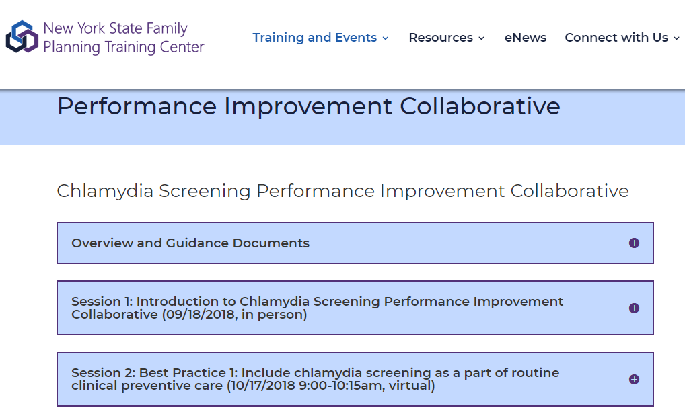
nysfptraining.org > Training and Events
Notes:
Katie
As a reminder, all of the materials from today’s session will be posted on our PIC webpage, which you can access by going to nysfptraining.org > clicking on “training and events” in the top menu, and clicking on the Performance Improvement Collaborative webpage.

Slide 41
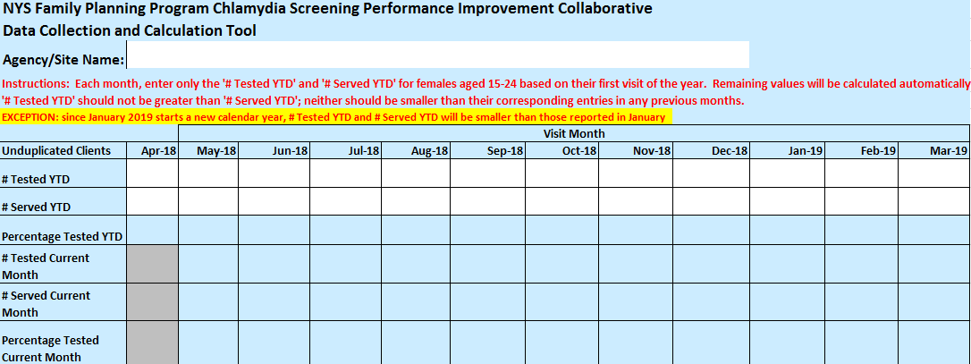
Monthly Data Reports
Please send us your updated screening data so we can continue to report the run chart next month!
Next report due Feb 28 (data through Jan)
Notes:
Katie
The next report will be due February 28, and that will include data through January

Slide 42
March 20th Team Presentations
HRHCare
Jacobi Hospital
Finger Lakes Health Care
Public Health Solutions
Chautauqua County
Please remember to send your slides to us no later than March 15th
Notes:
Katie

Slide 43
Thank you!
Contact:
nysfptraining@jsi.com
Notes:
Katie
Thank you for participating in today’s discussion.
Feel free to contact us at nysfptraining@jsi.com
Please take a second to complete the evaluation before you leave!
Our next session is March 20th.

