Slide 1
Promoting Sexual Health in NYS
Rachel Malloy, Surveillance and Special Projects Director
Diane Moore, Public Health Educator

Slide 2
Bureau of Sexual Health & Epidemiology
Personnel
Name
Structural
Sexual Health
Stigma Free
Vision
Policy & Program
Q.I.
Priorities
Notes:
New name
Staffing changes – focus on enhanced program coordination capacity
Data-drive decision-making, quality improvement perspective
Focus on sexual health
Stigma

Slide 3
Age Adjusted Rate of Sexually Transmitted Infections (STIs) and HIV by Diagnosis Year, New York State, 2001-2017
HIV Data as of September 2017
Age adjusted using Surveillance, Epidemiology, and End Results Program (SEER) Data
Notes:
Rates of CT, GC, and all stages of syphilis have been increasing for the past 4 years; all stages of syphilis increasing for past 6 years
This is similar to national data citing the same 4 years increases
Rates of bacterial STIs exceed that of HIV, and the gap continues to widen
Note for HIV data: The annual surveillance report uses the census population for age adjustment, here we used the SEER data to align with STI. HIV age adjusted rate for new diagnoses in 2016 is slightly higher using SEER (14.4) compared to census data (14.3).

Slide 4
Sexually Transmitted Infections
New York State excluding NYC, 2017
Chlamydia
45,154 Diagnoses
Gonorrhea
10,620 Diagnoses
Early Syphilis
1,130 Diagnoses
Congenital Syphilis
8 Diagnoses
5%
6%
11%
167%
2016:
42,801 Diagnoses
2016:
10,019 Diagnoses
2016:
1,021 Diagnoses
2016:
3 Diagnoses
Years of consecutive
increases:
4
4
8
1
Notes:
Here we microscope into NYS excluding NYC and we add some big scary arrows just to drive home the point that things are increasing.
Slide shows the increase in various STIs from 2016 to 2017, and the number of years each have been increasing during that time…
CT, GC, and ES all increased Congenital syphilis increased (167%) from 3 cases reported in 2014, 2015, and 2016, to 8 in 2017
or the 4th consecutive year, with ES increasing for 8 consecutive years (ranging from increases of 5% for CT to 11% for ES).

Slide 5
Primary and Secondary (P&S) Syphilis Rates per 100,000 by Age
New York State, 2017
Highest among:
Males
Black and Hispanic individuals
Age 25-34
*Rates for persons >50 not presented, and do not exceed 11 per 100,000
Notes:
P&S rates in 2017 are highest among:
Males
Black and Hispanic individuals, and
Persons 25-34
RHM 10/2018

Slide 6
Reported Diagnoses of Primary and Secondary Syphilis by Sex and Sex of Sex Partner, 2010-2017*
*72% of Male diagnoses had information on sex partners
MSM – Males who report a history of sex with males
MSMW – Males who report a history of sex with both males and females
MSW – Males who report a history of sex with females only
WOMEN – Females who report sex with males and/or females
Notes:
The number of reported diagnoses among MSM, MSW, and MSMW has been increasing since 2011, 2012, and 2013, respectively.
86% of males with known sex of sex partners reported sex with males
RHM 10/2018

Slide 7
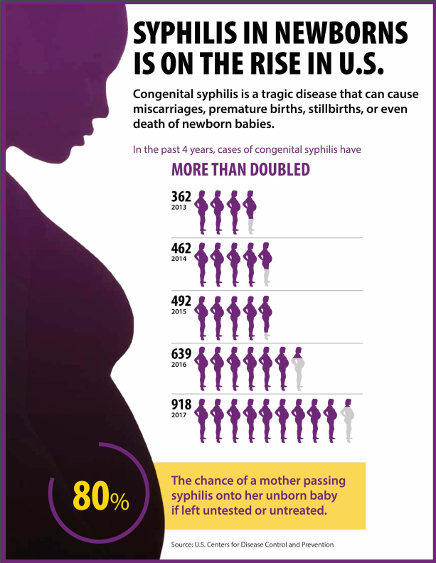
Congenital Syphilis
Once diagnosed, easily cured with the right antibiotics
Serious complications if left untreated
All pregnant individuals should be tested:
  early in first trimester
  again in third trimester, if high risk
  at delivery
Notes:
Key findings
In 2017 there were 918 reported cases of congenital syphilis in the US, up from 362 in 2013
70% of cases in 2017 were concentrated in just five states
Syphilis testing is crucial during pregnancy
Once diagnosed, syphilis during pregnancy is easily cured with the right antibiotics
All pregnant women should be tested for syphilis early in the first trimester
Testing once may not be enough – women at increased risk for syphilis should also be tested in the third trimester and again at delivery

Slide 8
Congenital Syphilis and Primary and Secondary Syphilis Cases among Women of Childbearing Age, by County, New York State excluding New York City, 2013-2018

Slide 9
Gonorrhea Rates per 100,000 by Age
New York State, 2017
Highest among:
Males
Black and AI/AN individuals
Ages 20-29 years
*Rates for persons >50 not presented, and do not exceed 50 per 100,000
Notes:
GC rates in 2017 are highest among:
Males
Black and American Indian/Alaska Native individuals, and
Persons 20-29
RHM 10/2018

Slide 10
Rate of Gonorrhea by Sex and Year, New York State, 2001-2017
*Rates are age adjusted
Notes:
Although rates of males are 2.4 times that of females, the rate among males has only exceed that among females since 2006 (prior to which the rates were quite similar)
Factors behind switch are not well understood although there has been an increased focus on testing men at all anatomic sites, thereby potentially picking up more rectal and oral infections which would not have been detected previously.
RHM 10/2018

Slide 11
Chlamydia Rates* per 100,000 by Age
New York State, 2017
Highest among:
Females
Black, AI/AN, and Hispanic Individuals
Ages 15-24 (screen sexually active females annually
*Rates for persons >50 not presented, and do not exceed 105 per 100,000
Notes:
CT rates in 2017 are highest among:
Females
Black, American Indian/Alaska Native, and Hispanic individuals, and
Persons 15-24 (which represents screening recommendations for annual screening of all sexually active women aged <25 years)
RHM 10/2018

Slide 12
Rate of Chlamydia by Sex and Year, New York State, 2001-2017
*Rates are age adjusted
Notes:
Although rates of females is 1.5 times that among males, the ratio of female to male cases has declined over time (from as high as 4.8 in 2001 to 1.5 in 2017)
Decreasing disparity over time could reflect increasing extra-genital testing
RHM 10/2018

Slide 13
Best Practices

Slide 14
5 Ps of Taking a Sexual History
Adapted from CDC Guide to Taking a Sexual History: https://www.cdc.gov/std/treatment/sexualhistory.pdf
5 “P”s
Notes:
Taking a sexual history of all patients: adolescents, young adults, older adults, seniors. Often avoided due to provider and patient discomfort. Many patients believe providers should initiative conversations. A questionnaire can be filled out prior to appointment, gone over during.

Slide 15
Select STD Screening Recommendations
Annual Chlamydia and gonorrhea tests for sexually active young people or individuals with risk factors such as multiple or new sex partners or a partner infected with an STD
Syphilis, HIV, chlamydia, and gonorrhea screening for all pregnant women early in pregnancy (more often as needed)
Regular syphilis, HIV, chlamydia, and gonorrhea screening for sexually active men who are gay, bisexual, or have sex with other men.
For full list visit:
https://www.cdc.gov/std/tg2015/screening-recommendations.htm

Slide 16
Expedited Partner Therapy (EPT)
A strategy for treating the sex partners of patients diagnosed w/ a sexually transmitted infection
Clinician provides medication or prescription to patient, who brings it to his/her partner(s)
  Medication EPT (patient-delivered partner therapy)
  Prescription EPT
Partner treatment given without the health care provider first examining the sex partner
Notes:
Legal in NYS, under-utilized, position statement

Slide 17
Benefits of EPT for Chlamydia Prevention
High disease burden, limited resources
Repeat infection common i.e., inadequate partner treatment
Asymptomatic – partners may not seek care
Can be treated with single dose therapy, which is well tolerated
No evidence of Azithromycin-resistance among Ct patients
Notes:
12% reinfection rate in NYS, untreated CT in females can lead to PID, infertility, miscarriage, chronic pain

Slide 18
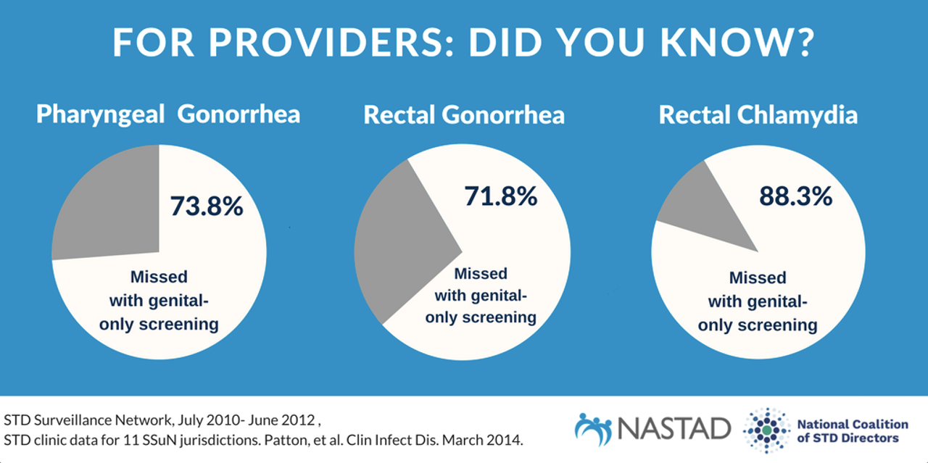
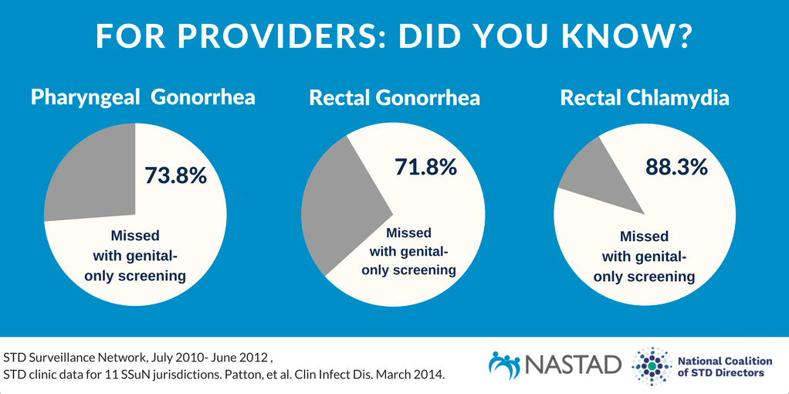
Notes:
3-site testing. Sexual history facilitates screening. Test each body site (throat, genitals, rectum) where patient has sex. There is a strong evidence base for why this screening is needed. According to data from the STD Surveillance Network (11 clinics),

Slide 19
Partner Services
Works with patients to create a plan to notify sex and/or needle-sharing partner(s) about an exposure to STI
Confidential; anonymity of patient assured
Partner Services Specialist arranges meeting with partner(s) to confidentially inform them of the exposure
Partner(s) offered free STI counseling and testing, referrals to other services

Slide 20
Resources/links
New York State DOH STI Website
https://www.health.ny.gov/diseases/communicable/std/
Brochures for specific STIs with ordering information
https://www.health.ny.gov/diseases/communicable/std/brochures.htm
CDC information on Sexually Transmitted Infections
https://www.cdc.gov/std/default.htm
CDC Guide to Taking a Sexual History
https://www.cdc.gov/std/treatment/sexualhistory.pdf

Slide 21
Rachel Hart-Malloy
rachel.malloy@health.ny.gov
518-473-7291
Diane Moore
Diane.moore@health.ny.gov
518-408-1159
Bureau of Sexual Health and Epidemiology
stdc@health.ny.gov
Thank you!

